Slide 1
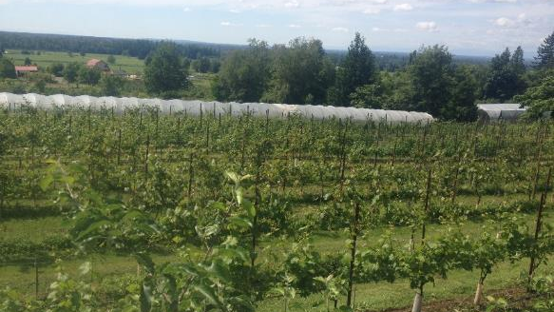
Cloud Mountain Farm Center
Non-profit since 2011
Mission:
To build experience, knowledge, and community to expand dynamic local food systems.

Slide 2
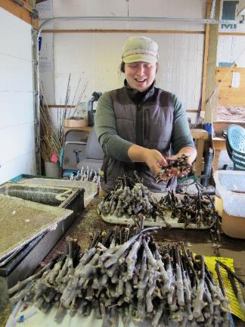
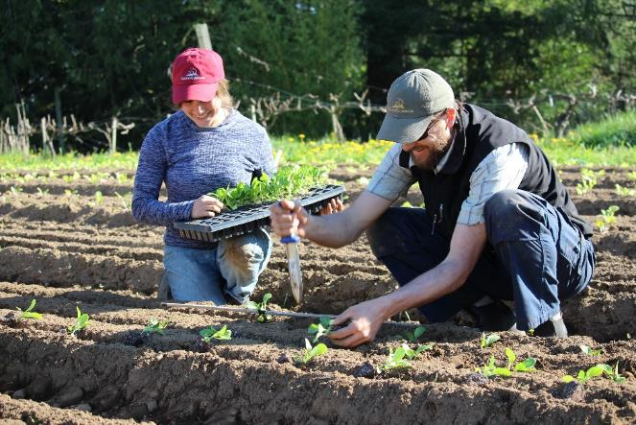
Educational Programing
Internship Program:
9 month program
rigorous integrated educational curriculum and experiential-based learning program
Paid work hours with hands-on training in annual, perennial and nursery crops
Classroom and field based education: crop production, business planning, marketing

Slide 3
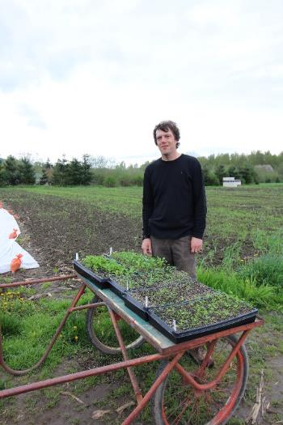
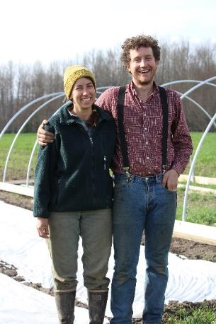
Incubator Program Goals: to reduce barriers to new farm businesses
Access to Land
Access to equipment
Production training
Support with financials and marketing

Slide 4
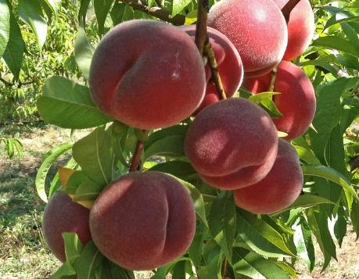
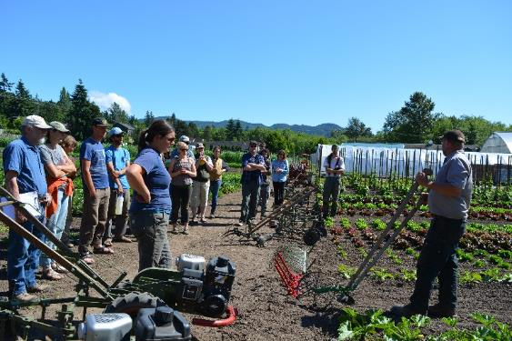
More educational programs
Community Workshops- more than 35 workshops each season on growing food and sustainable gardening, with over 450 participants
Farmers Roundtable Series- 7 farmer to farmer and scientist to farmer workshops serving over 60 people plus CMFC interns and staff
Crop Production Trials
Mechanized leafy green production
High density Sweet Cherry production
Wine Grape Cultivar Trials
Peach Variety Trials
Organic Day Neutral Strawberry Production
Table Grape Training Trial

Slide 5
Growing Small Fruits
Notes:
Annually, in early spring, remove weak wood at the base, and older, twiggy wood by cutting to the ground.

Slide 6
Basics of Growing Fruit Plants
Full sun
6-8 hours minimum March-September
Most need well drained soils
Most need annual pruning
Most will need some summer irrigation

Slide 7
Diversity of small fruits
Blueberries
Gooseberries
Currants
Raspberries
Blackberries
Strawberries
Kiwi
Grapes
Notables

Slide 8
Blueberries
Need acid, organic rich soil
Most need a pollinizer
Need protection from birds
Need summer irrigation
Careful using animal manures

Slide 9
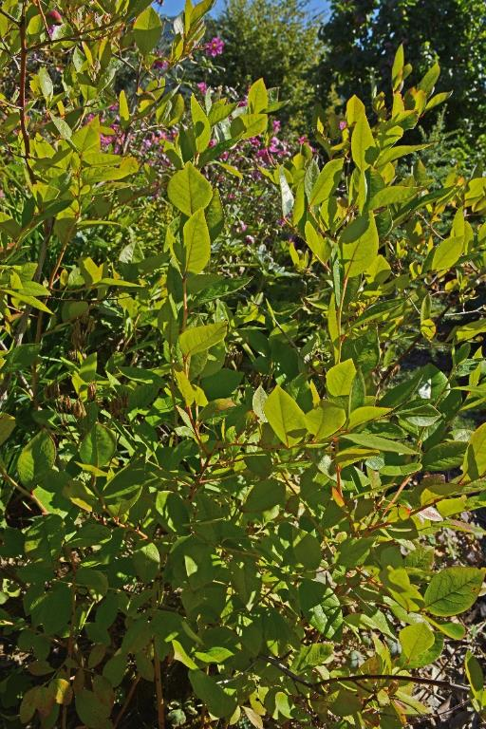
Successful blueberry growing
Weed free, rich organic soil is ideal. (1/2 to 1/3 organic matter).
In very wet soils, consider building raised beds
Plan for summer irrigation.
Plant slightly high, 1"-2" thick mulch to the crown of the plants.
Remove all blossoms the first year.
Remove weak wood, and cut back strong stems by 1/3rd
Blueberries are a long term investment- taking care of young plants pays off!
Young vigorous wood=productive bush
Notes:
. Annually, in early spring, remove weak wood at the base, and older, twiggy wood by cutting to the ground.

Slide 10
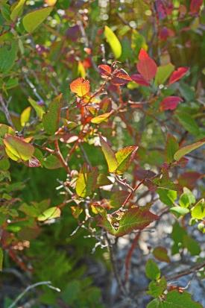
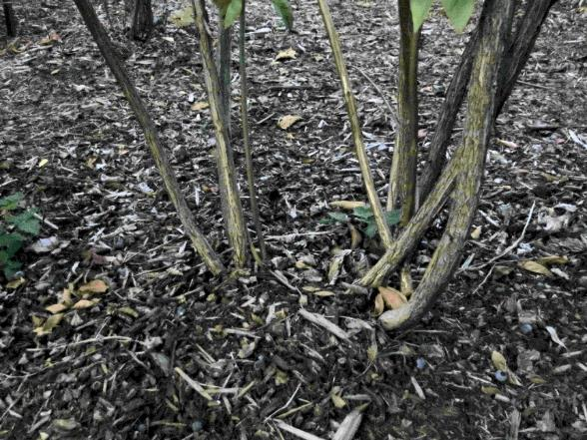
Brightly colored wood with long (3" or more) laterals bear the most fruit.
Cutting older, twiggy wood out promotes new growth.
Fertilize by using acid fertilizers (Rhododendron Food) or cottonseed meal.
Blueberries are not drought tolerant! Regular summer water is necessary for good production.
Keep the plants weeded and mulched.
Rake, turn, and replace the mulch each spring at pruning time. This helps prevent mummy berry disease.
When wood becomes twiggy, the stem should be cut to the ground for renewal.
Mulched base of mature blueberry

Slide 11
Most productive are highbush (HB) and compact highbush(CHB) varieties
Good varieties for our region:
Early ripening- Spartan (HB), Reka (HB), Patriot (CHB)
Midseason- Chandler (HB), Bluecrop (HB), Toro (CHB), Draper (HB), Olympia (HB), Northland (CHB)
Late Ripening- Liberty (HB), Legacy (HB)
Less productive but flavorful hybrids and half-highs:
Sunshine Blue- partially evergreen, ripens fruit over 9 week period
Chippewa- ‘wild’ blueberry flavor
Top Hat- dwarf hybrid, self fruitful
North Country- dwarf hybrid, productive
Mature highbush blueberry bush

Slide 12
Gooseberries & Currants
Best in well drained soils, but black currants tolerate winter wet soils
Choose mildew and rust resistant varieties
Tolerate some summer shade
Black currants are deer resistant
Need renewal pruning
Grown as freestanding, multi-stemmed bushes. Prune to develop an open, vase shaped bush.

Slide 13
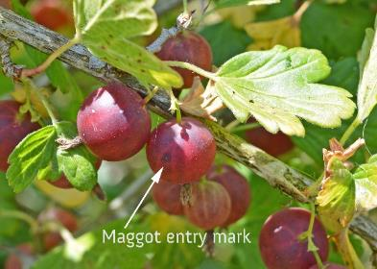
Growing currants & gooseberries
Disease and Insect Problems
Gooseberry Maggot- Adult flies emerges from the soil in April, lays eggs on the forming fruit. Maggots feed within the berries.
Imported Currant Worm- Sawfly larva defoliate bushes in a few days. ½" long larvae are small, black spotted green worms with black heads.
Aphids feed on the undersides of the leaves, causing them to crinkle, leads to a blistered look to the foliage.
Powdery Mildew. Keep the bushes pruned to encourage air circulation. The best control is to plant resistant varieties.
All Ribes are potentially alternate hosts for white pine blister rust. (5 needled pines) Plant rust resistant varieties.
Gooseberry maggot sign
Imported Currant Worm

Slide 14
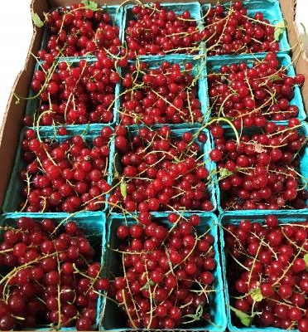
Best red currant variety is Rovada
Fruit grows on easy-to-pick chains, very productive bushes
Somewhat rust resistant, very mildew resistant
Red currants are not deer resistant
Rovada

Slide 15
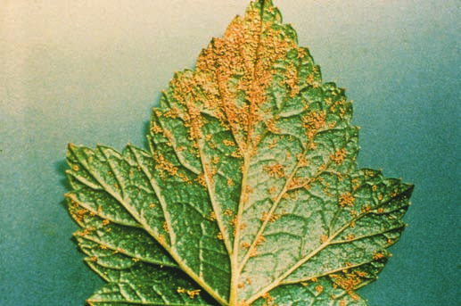
Blister rust on currant leaf
Black currants ready to harvest
Black currants are deer resistant.
Good black currant varieties:
Tiben: upright, productive, good disease resistance
Ben Sarek: very compact, large, flavorful fruit, rust immune, resistant to mildew
Ben Hope: most productive and flavorful, but is rust susceptible
5 year old Tiben bush

Slide 16
Gooseberries
Thorny, so deer resistant
Large tart fruit for eating fresh, jams and baking
Varieties
Poorman: Old variety, large pink fruit, good resistance to rust and mildew
Black Velvet: Compact habit, very large black fruit with complex flavor, good mildew resistance
Oregon Champion: Large green fruit with old-fashioned gooseberry flavor, very resistant to rust and mildew
Jostaberry: Hybrid of gooseberry & black currant, complex flavor, very vigorous bushes, thornless, rust resistant
Orus 8: Hybrid of gooseberry & black currant, excellent flavor, thorny, resistant to mildew and rust.
Black Velvet Gooseberry
Oregon Champion Gooseberry

Slide 17
Raspberries
Two types; summer (floricane/second year cane) bearing or fall (primocane/first year cane) bearing
Summer varieties need trellising, bear on 2nd year canes
Fall bearing can be cut to the ground each year, need less trellising
All raspberries need well drained soil. Build raised beds if planting on heavy soil.

Slide 18
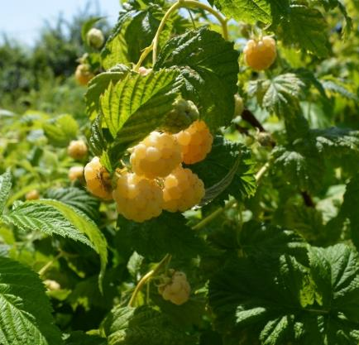
Successful raspberry site:
Full sun, well drained soil
Plant dormant canes no more than 2″deep, 30"-36" apart
Irrigate in summer
Pruning:
Floricane Varieties: Trellis 1st year canes of summer types & prune out 2nd year canes after fruiting.
Primocane Varieties: All canes of Fall bearing varieties can be cut to the ground annually
Pests & Diseases
Root rots caused by winter wet
Spotted wing drosophila
For more on raspberry pests and diseases, visit https://pnwhandbooks.org/
Summer (floricane) varieties
Meeker
Tulameen
Cascade Delight (more wet tolerant)
Fall (primocane) varieties
Autumn Bliss
Fall Gold

Slide 19
Blackberries
Successful Blackberry Growing- Advantages
Thornless varieties
Very Productive
Earlier ripening than Himalayan
Best in well drained soils but will tolerate some winter wet
Need trellising; produce on 2nd year canes
Ripening Challenges:
Some late varieties difficult to fully ripen (late August-September
Late summer rains can lead to berry rot/botrytis
Thornless Triple Crown

Slide 20
Best varieties:
Triple Crown: (Thornless) Huge berries, excellent yield, August ripening
Loch Ness: (Thornless) July ripening, excellent flavor, more flexible canes than Triple Crown
Marionberry: (Thorny) Huge berries with small seeds, distinctive flavor, commercially grown in area
Boysenberry: (Thornless and Thorny selections) Complex cross of blackberry, loganberry, raspberry, distinctive flavor
Loganberry: (Thornless) Raspberry-Blackberry cross, huge berries, distinctive flavor
Pests & Diseases
Rust can be controlled by removing and destroying infected canes
Root rots can occur in wet soils
Spotted wing drosophila

Slide 21
Table Grapes
Easy to grow in full sun
No pest/disease issues
Can be grown on fences or overhead trellis
Need annual pruning for production
Self fruitful
Jupiter

Slide 22
Lack of heat limits varieties locally
Older varieties with good production:
Interlaken: Green seedless, early ripening
Lynden Blue: Early concord type, slipskin, reliable, selected in Mission, B.C.
Reliance: Red seedless, excellent flavor
Canadice: Pink seedless, spicy-sweet flavor, needs a warm spot in cool summers
Interlaken
Lynden Blue

Slide 23
New varieties that thrive here:
Jupiter: Black seedless, excellent production
Glenora: Seedless slipskin type, great for juicing
Neptune: Green seedless, needs warm site, grafting onto rootstock ripens earlier
Still-on-trial varieties
Faith-early blue-black seedless non-slipskin
Gratitude- seedless green, crack resistant
Hope-seedless green, crack resistant
Joy- seedless blue, early ripening & crack resistant
Glenora

Slide 24
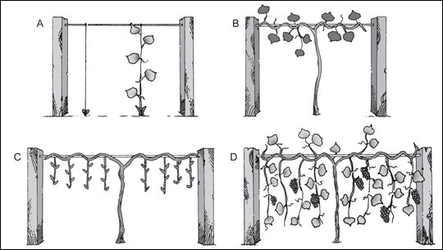
Table grape trellis and training methods
Table grapes are most productive when pruned in a spur pruning fashion
Trellis so cordons are high, and shoots from spurs hang down
Most productive is a double curtain style, with cordons running on parallel wires

Slide 25
Geneva Double Curtain

Slide 26
Actinidia arguta-Hardy Kiwis
Easy to grow and cold hardy
Need a male plant for every 6-8 female plants
Need trellising and annual pruning to produce well

Slide 27
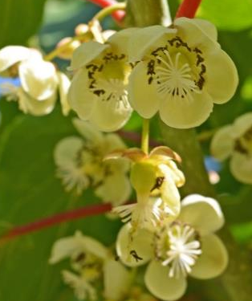
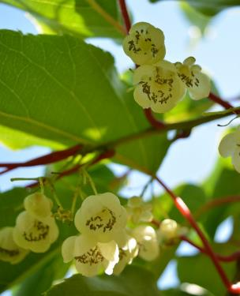
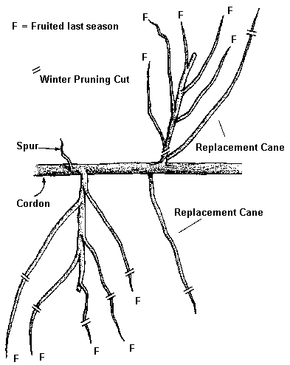
Easiest to grow varieties (female)
Ana (Ananasnaja)- old cultivar, reliable production of 1” fruit in October
Jumbo- newer, slightly larger fruit than Ana, ripens the same time
74-49- Slightly smaller fruit, ripens 10 days earlier than Ana, good for cooler sites
One male needed per 6-8 females
Female kiwi flowers vs Male kiwi flowers
Hardy kiwis on trellis

Slide 28
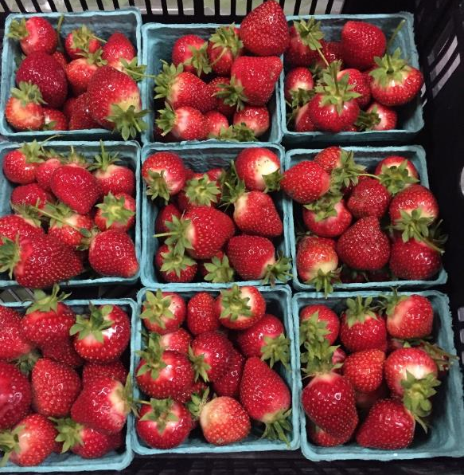
Strawberries
Strawberries are either main croppers or day-neutral ‘everbearer’ types.
Main crop berries grow to 12”-18” tall, bear one main crop in June or early July
Day neutral berries are low, matted plants, can be used as groundcover, bear flushes of berries all summer

Slide 29
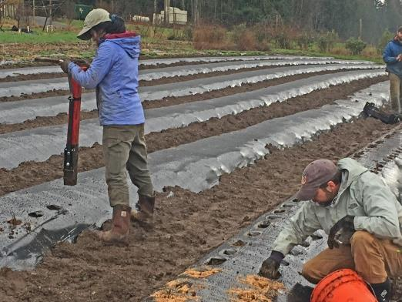

Slide 30
June (Main) Crop Berries
Varieties:
Shuksan: Cold hardy, excellent flavor, large berries, good for freezing, tolerant of some winter wet
Hood: Old variety considered by many to be the sweetest, needs superb drainage, virus susceptible
Puget Crimson: Very late ripening, excellent flavor
Charm: Very productive, mid-season ripening, good flavor
Puget Reliance: Sweet-tart flavor, resistant to viruses, wet tolerant

Slide 31
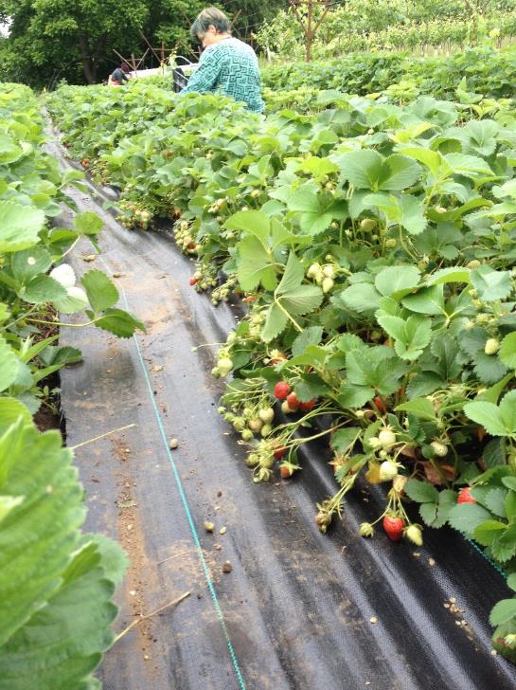
June bearers should be planted 12”-18" apart in rows spaced 36"-42”
Allow matted bed to grow 18-24” wide.
Runners allowed to fill the spaces between the plants to form a solid row.
Remove the first season’s flowers by cutting or pinching them off.
Plants can bear a crop the second year.

Slide 32
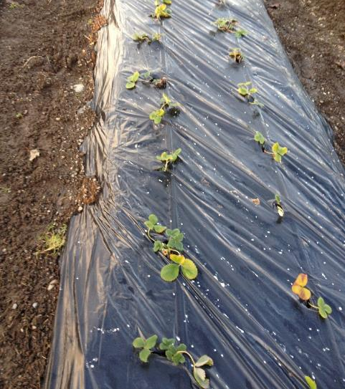
Day Neutral Strawberries
Plant 10"-18" apart in rows spaced 30"-36".
Best fruit quality treat plant as rosette remove all runners.
Remove the first blossoms to encourage root development.
Flowers appearing after mid-June can be allowed to form fruit.
Varieties
Albion: Large firm berries with good flavor. Somewhat susceptible to virus decline
Tristar: Old cultivar considered by some to have the best flavor. Berries are small in cool weather, becoming larger in warmer weather
Seascape: Large berries with good flavor, considered the best for flavor and size combination. Moderate yields.
Sweet Ann: Vigorous plant with high productivity and exceptional flavor. Fruit is large, medium firmness, and produces few runners. Hard to find plants.

Slide 33
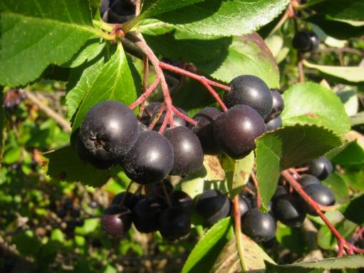
Notable and unusual
Elderberry
Aronia
Goji Berry
Goumi & Autumn Olive (Eleagnus sp)
Seaberry

Slide 34
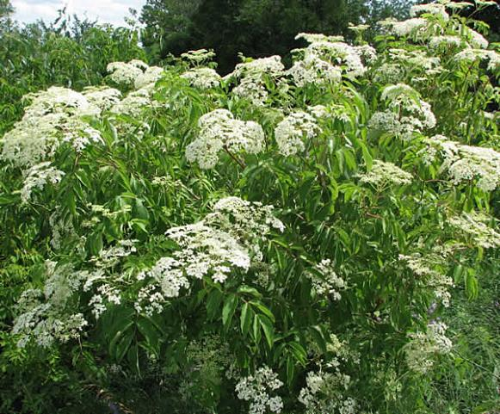
Sambucus species- Elderberry
Sambucus nigra or Sambucus canadensis
Grow in sun to partial shade
Grow to 10’-12’ high and wide
Somewhat deer tolerant
Heavier fruit set with two cultivars
Flowers used to flavor wines and liqueurs, berries for processing
Varieties:
Nova- Selected for production
York- Earlier ripening than Nova
Sambucus caerula Blue Elder, native subspecies of S. nigra
Ornamental cultivars, including Black Lace, Black Beauty & Thundercloud- flowers are useful, berries are smaller

Slide 35
Aronia melanocarpa- Chokeberry
Chokeberry grows to 5’-6’ high & wide, slowly suckers
Tolerates wet soil, dry soil
Great fall color
Fruit is cranberry-like, tart & astringent, mostly used for processing and juice
Not deer resistant
Varieties:
Egerta: large berries, strong flavor, easy to pick
Viking: smaller berries, higher sugar content

Slide 36
Lycium barbarum – Goji Berry
Very hardy vine-like shrub native to the Himalayas
Berries are high in antioxidants
Berries are best dried for use
Plants are deer resistant
Soil pH of 7.0-9.0 best, so liming is recommended
Variety:
Crimson Star, self fertile
Can be grown from seed, berry quality is variable

Slide 37
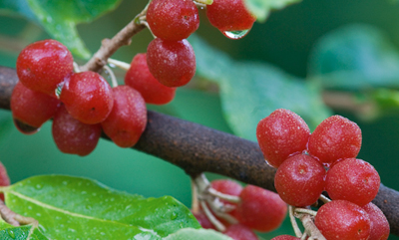
Eleagnus species- Autumn Olive and Goumi
Nitrogen fixing shrubs
Drought tolerant
Somewhat suckering
Can self seed
Blooms are attractive to pollinators
Autumn Olive needs 2 varieties to set fruit
Goumi are self fertile
Goumi Sweet Scarlet
Autumn Olive Ruby

Slide 38
Hippophae rhamnoides- Seaberry
Large growing deciduous shrubs
Spread by suckering
Very drought tolerant
Nitrogen fixers
Deer resistant
One male plant needed for every 6-8 female plants for pollination
Varieties (female)
Titian- large sweet berries, compact bushes to 8’-10’
Leikora- very productive, large growing to 12’-15’
Harvest when berries are bright orange. Often juiced or processed
Freeze whole branches and remove berries by striking frozen branch on countertop.

Slide 39
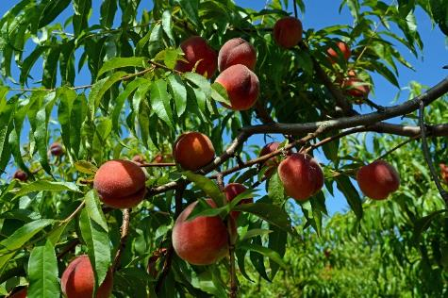
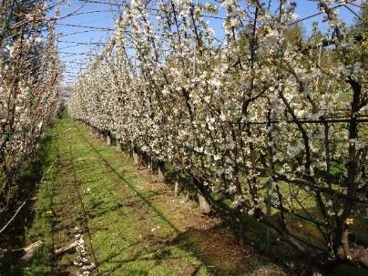
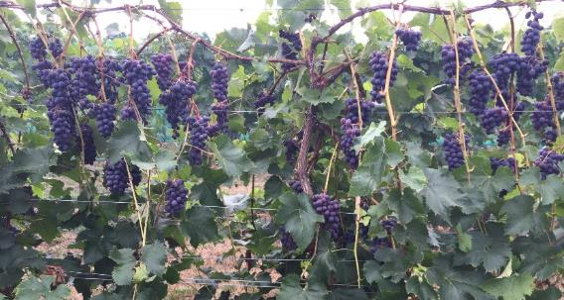
Thank You
Crop Development projects CMFC
Peach trials-photo of fruit
Cherry UFO- Trellis in bloom
Table Grapes- Jupiter full plant trellis
Peach Plum

