Slide 1
Seed Stewardship for Locally Adapted Plants
Community Seed Saving at the Home Garden Scale
Presented for the Orcas Island Garden Club
February 15, 2023
Marisa Hendron

Slide 2
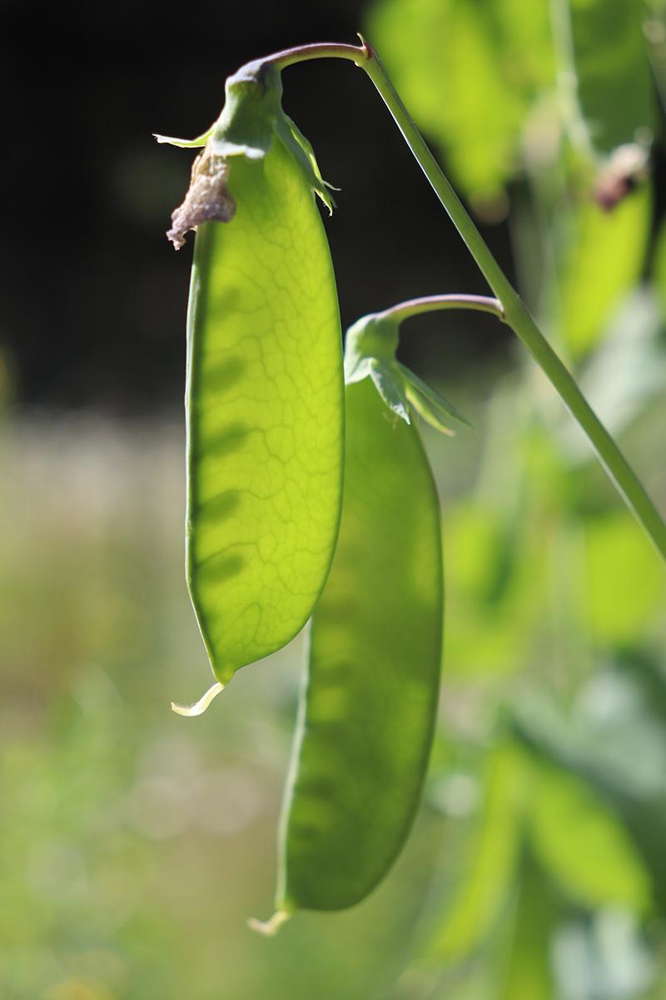
Overview
Why save seeds?
Community Seed Projects
Intro to the Orcas Seed Library
Seed Gardening:
What to expect
How to plan
How to get the most out of your seed-saving endeavors
Selection strategies
Tools & techniques
Local challenges and opportunities
Image Credit:
Renee Delight

Slide 3
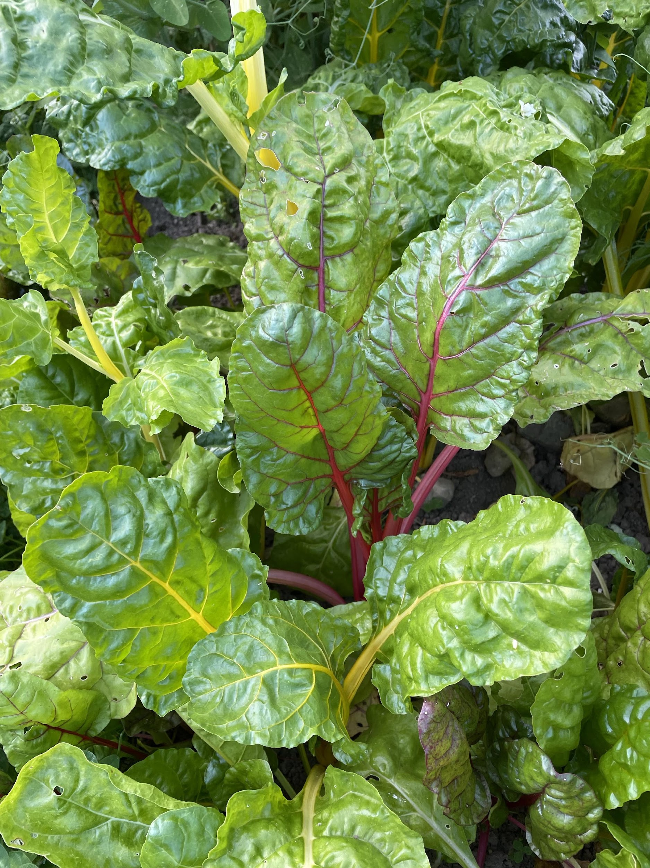
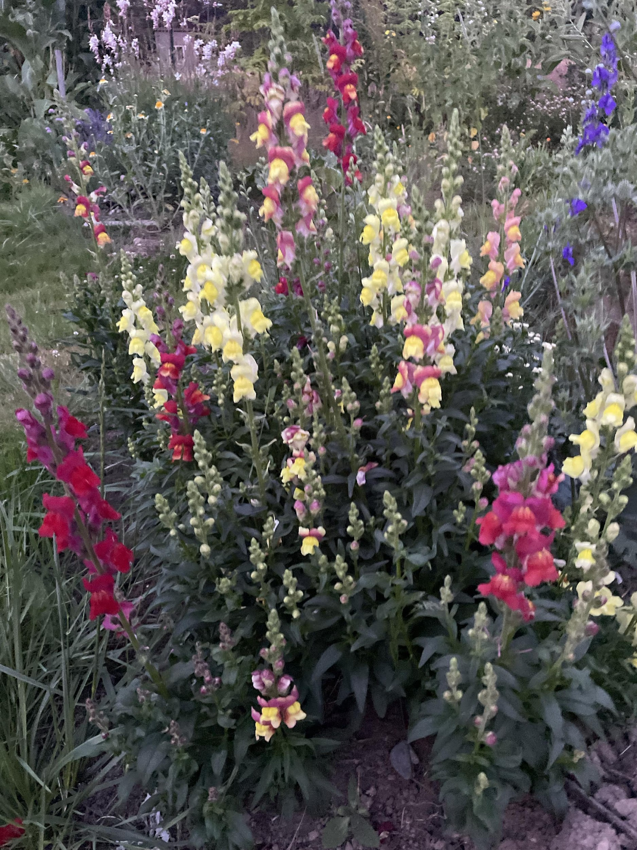
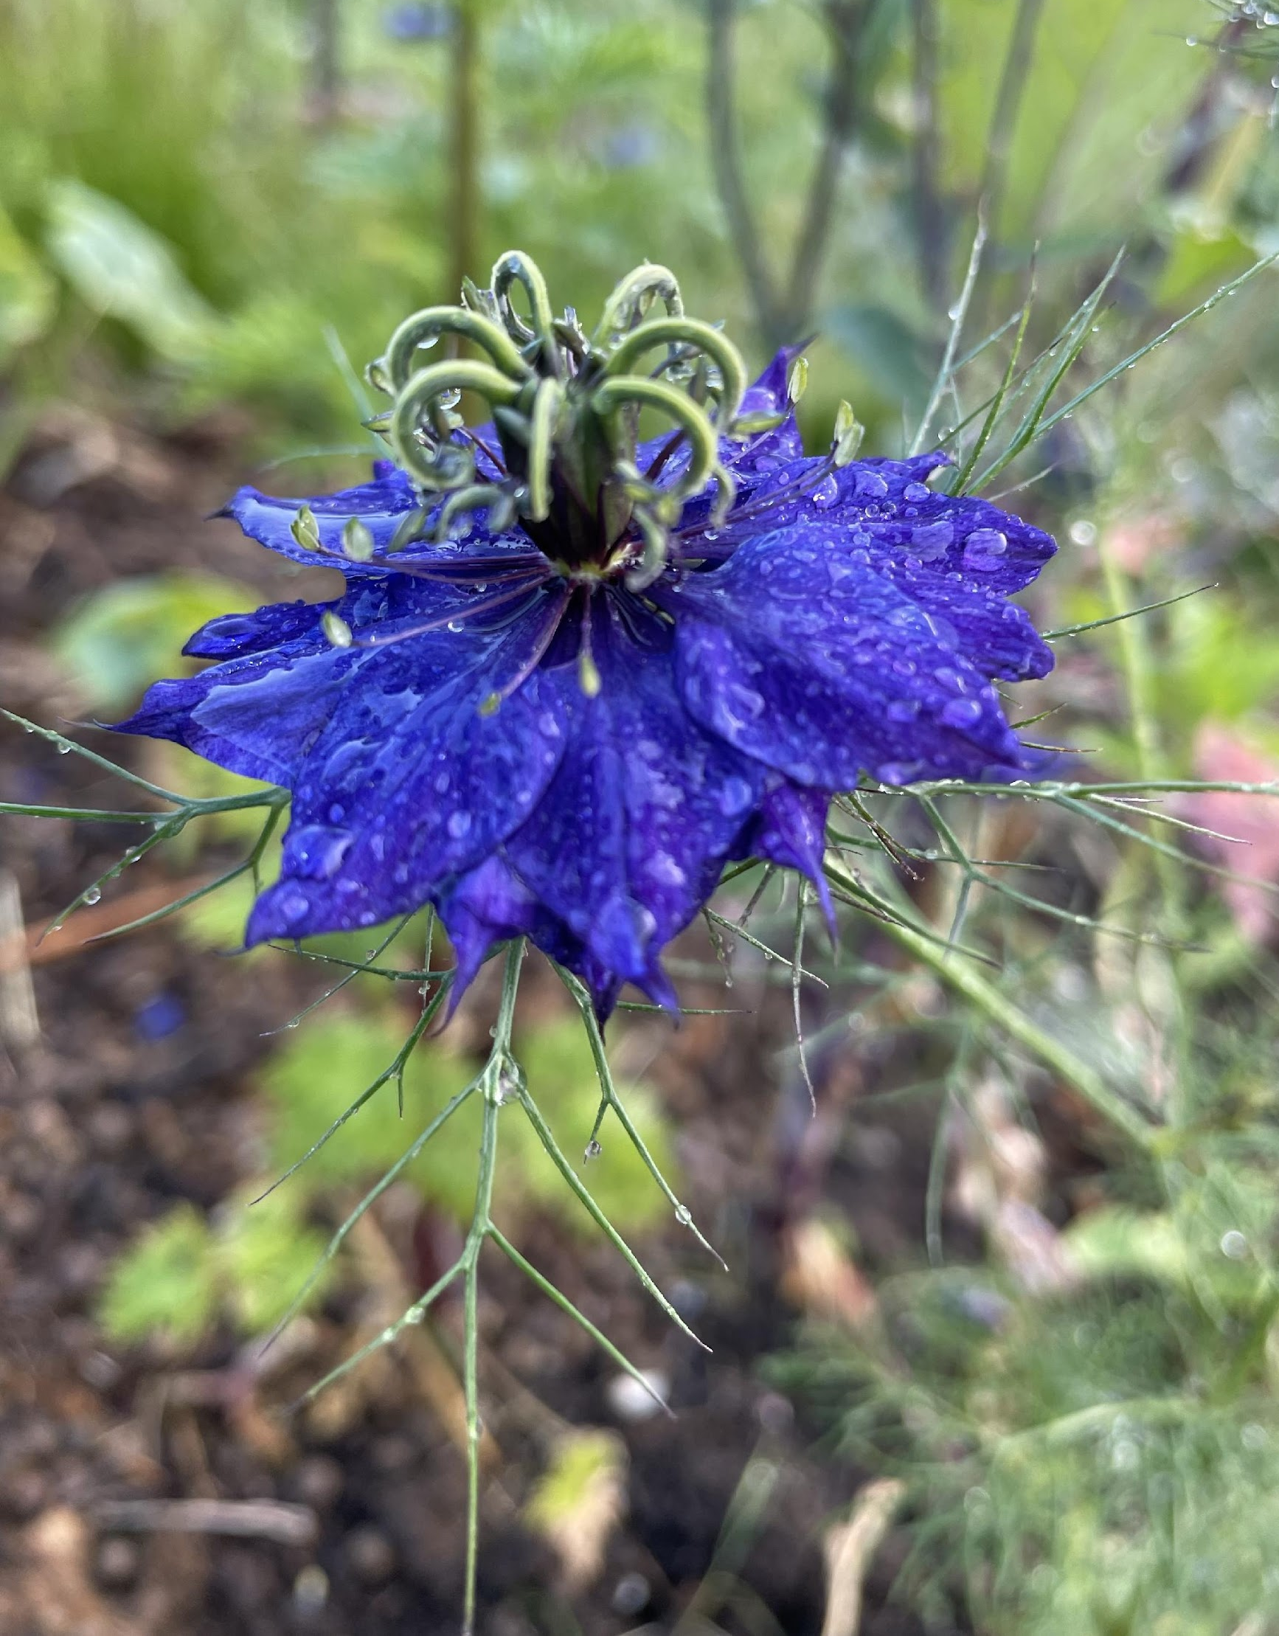
Why Save Seeds?
“Free” seeds
Seeds that are adapted to local conditions
Building autonomy and local resilience
More opportunity for community connection
More nuanced local knowledge
Develop varieties that work for your style
There are more surprises
It adds to winter gardening tasks (cleaning seeds)
Photo Credit: Marisa Hendron

Slide 4
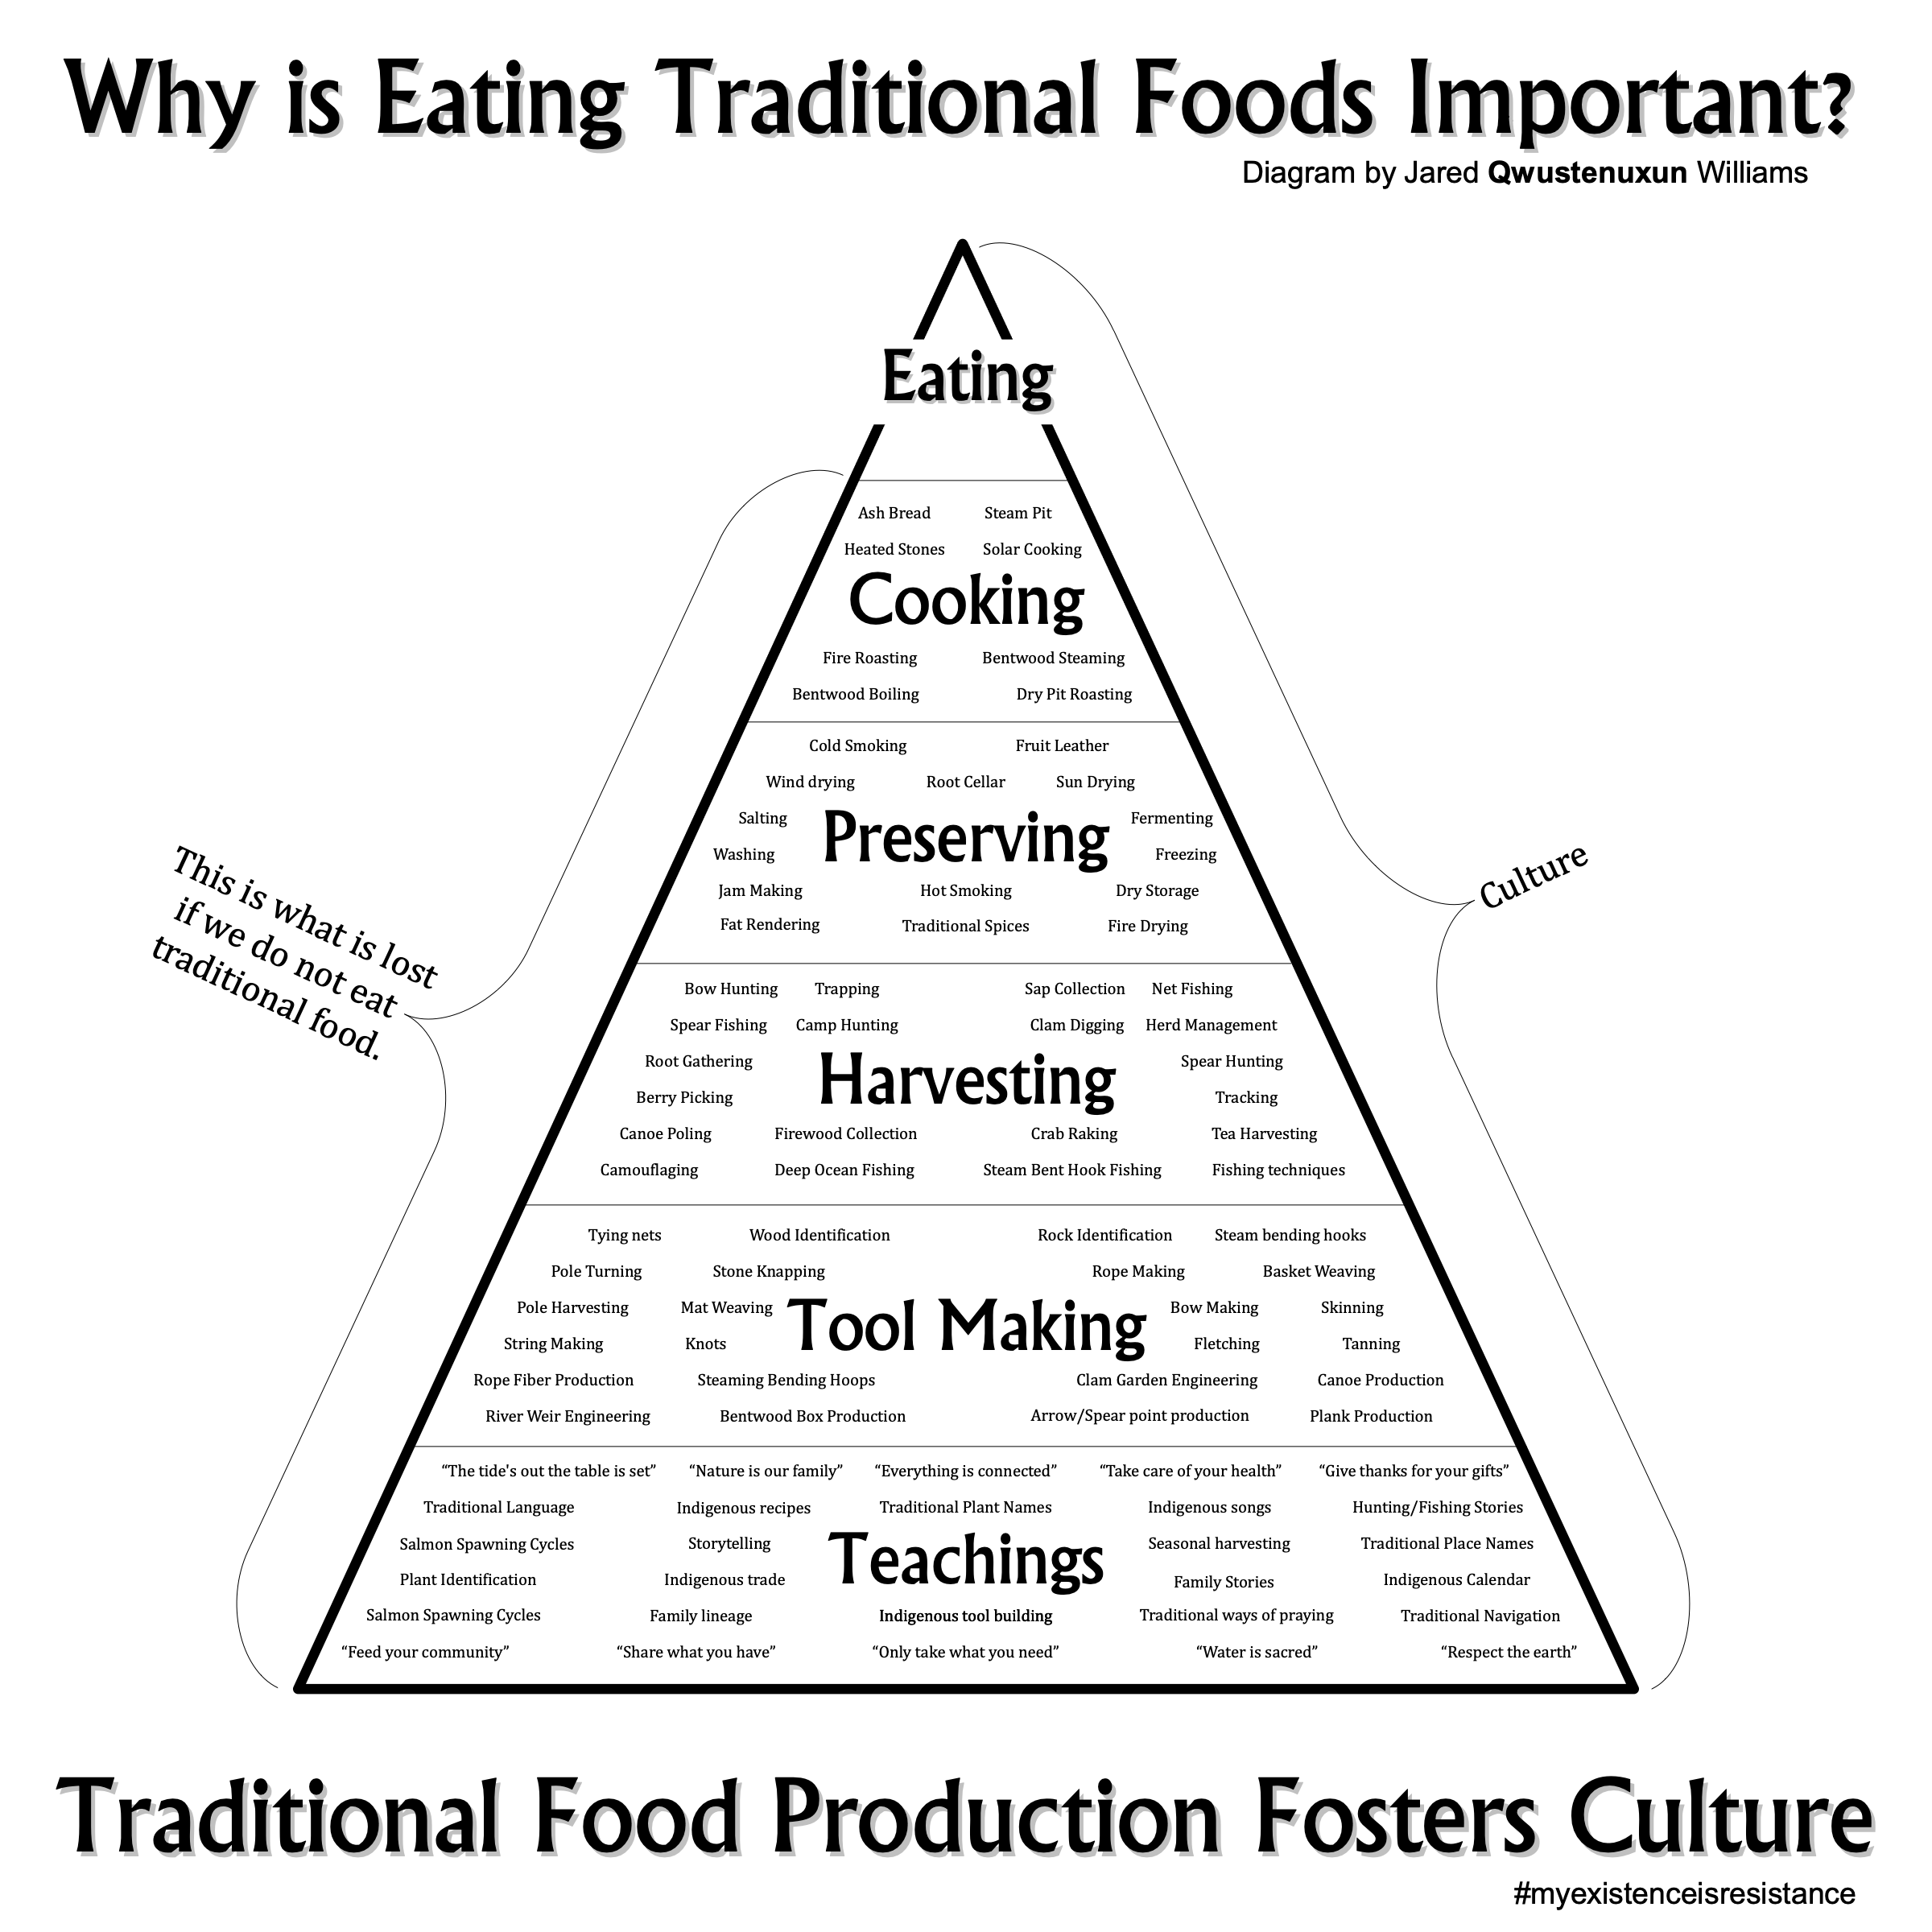
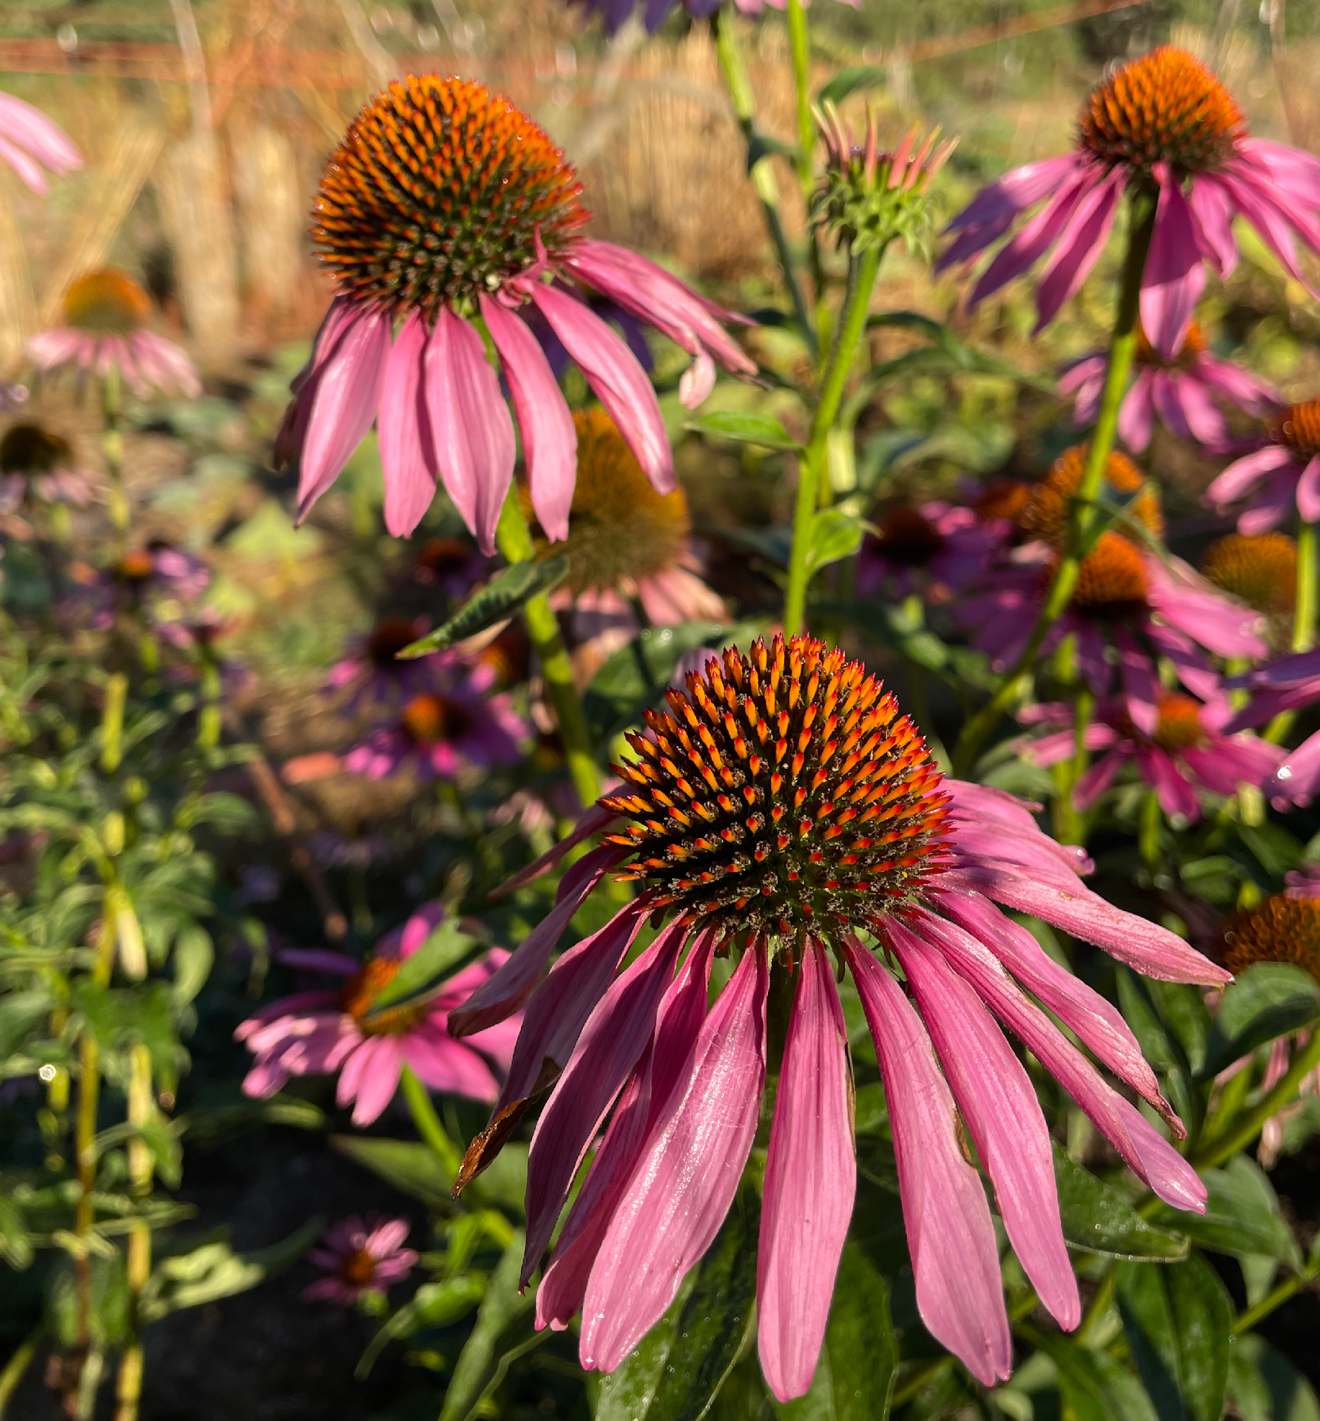
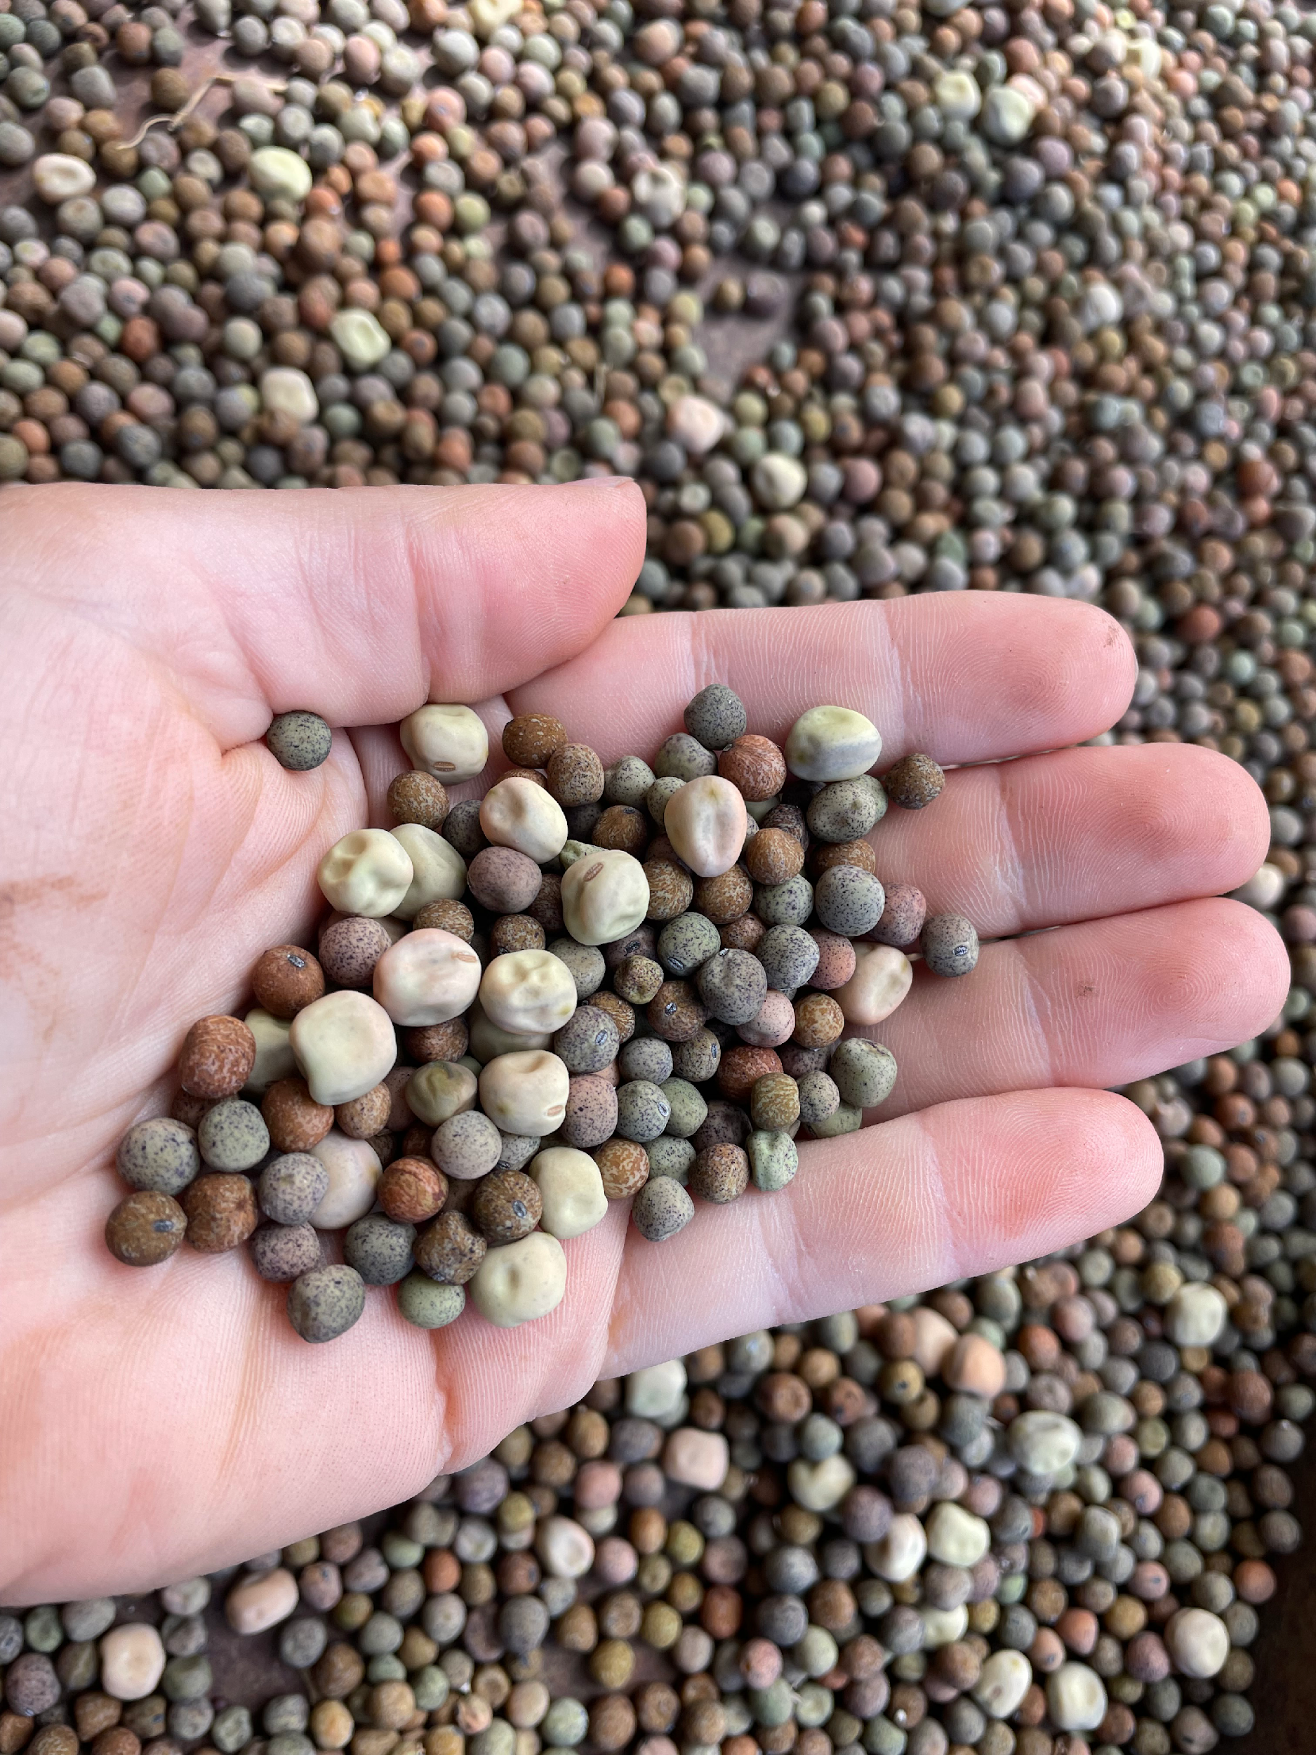
Image Credits:
Left: Jared Qwustenuxun Williams
www.qwustenuxun.com
Above & Right: Marisa Hendron

Slide 5
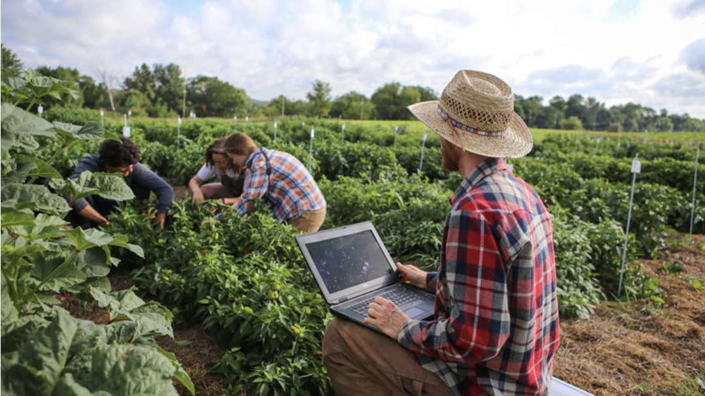
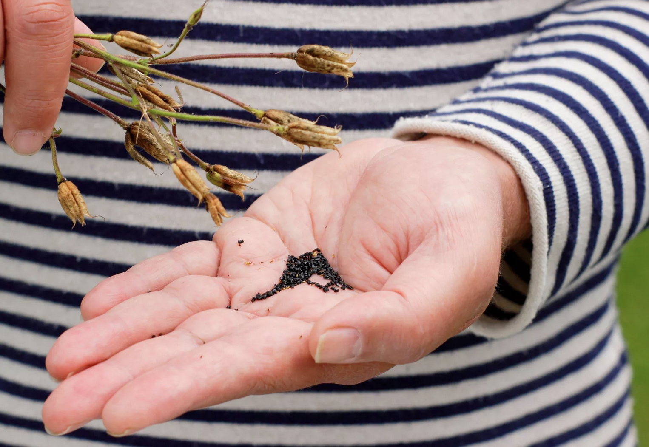
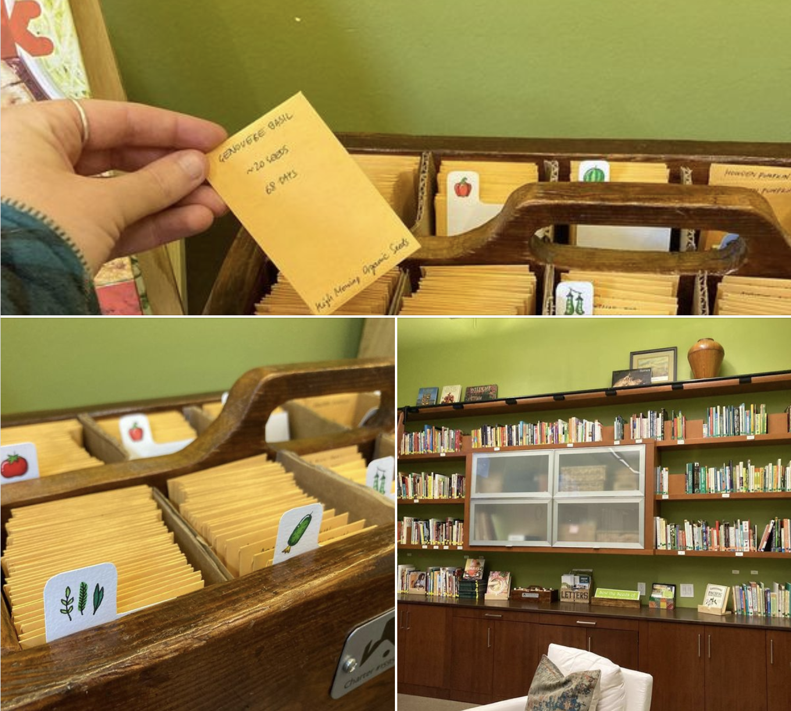
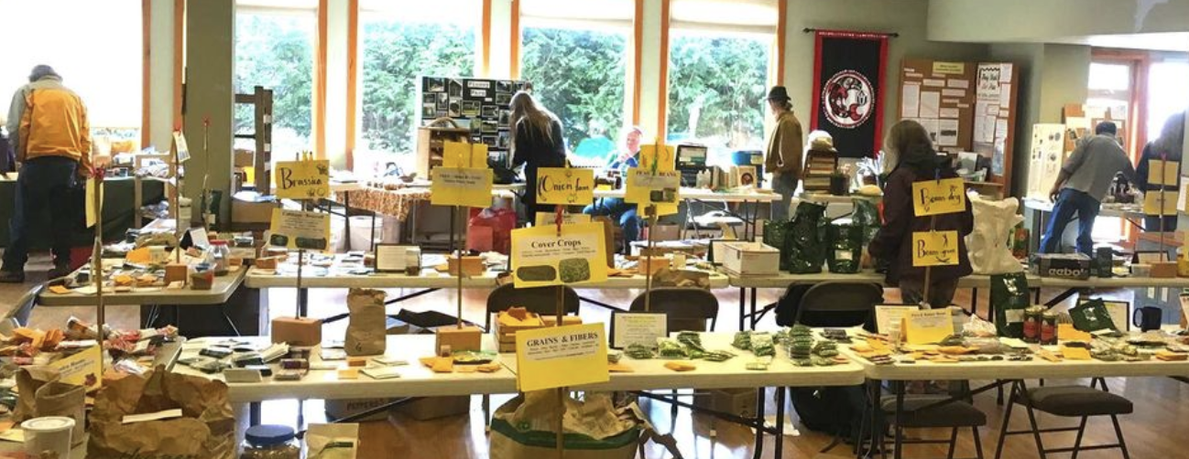
Community Seed Saving: What are the options?
Seed Libraries
Image Credit:
21 Acres
https://21acres.org/
Large-Scale Community Seed Projects
Image Credit: Seed Saver’s Exchange
https://www.seedsavers.org/mission
Personal Seed Saving
Image Credit: Deborah Vernon
Alamy Stock Photo
Seed Swaps
Image Credit: Salish Seed Guild, https://www.salishseed.org/

Slide 6
Seed Library
Check out Seeds
Make sure to log your check-out
Grow your Garden
Keep track of the Seeds
Decide if they’re worth saving
Pick out Seeds
https://orcaslibrary.org/seeds.html
Return Seeds
Use the “Returns” drawer at the bottom of the seed library
Collect & Clean Seeds

Slide 7
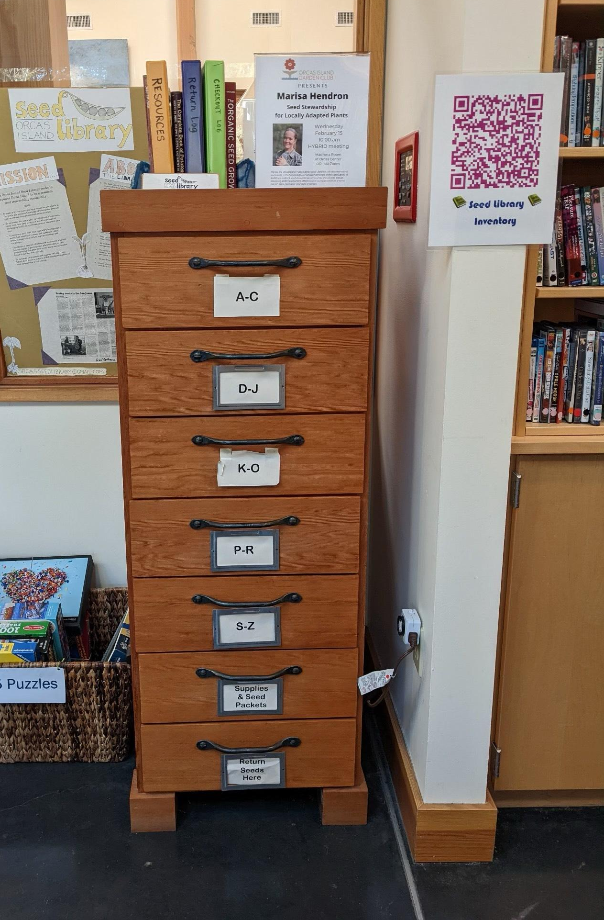
The Actual Seed Library
Alphabetical By Common Name
Take the amount you need
Resources & Checkout Log on the top
Supplies & Returns Drawer at the bottom
Commercial Seed Swap on the top
Inventory is online: http://bit.ly/3S2rapO
Coming Soon! Pin Map

Slide 8
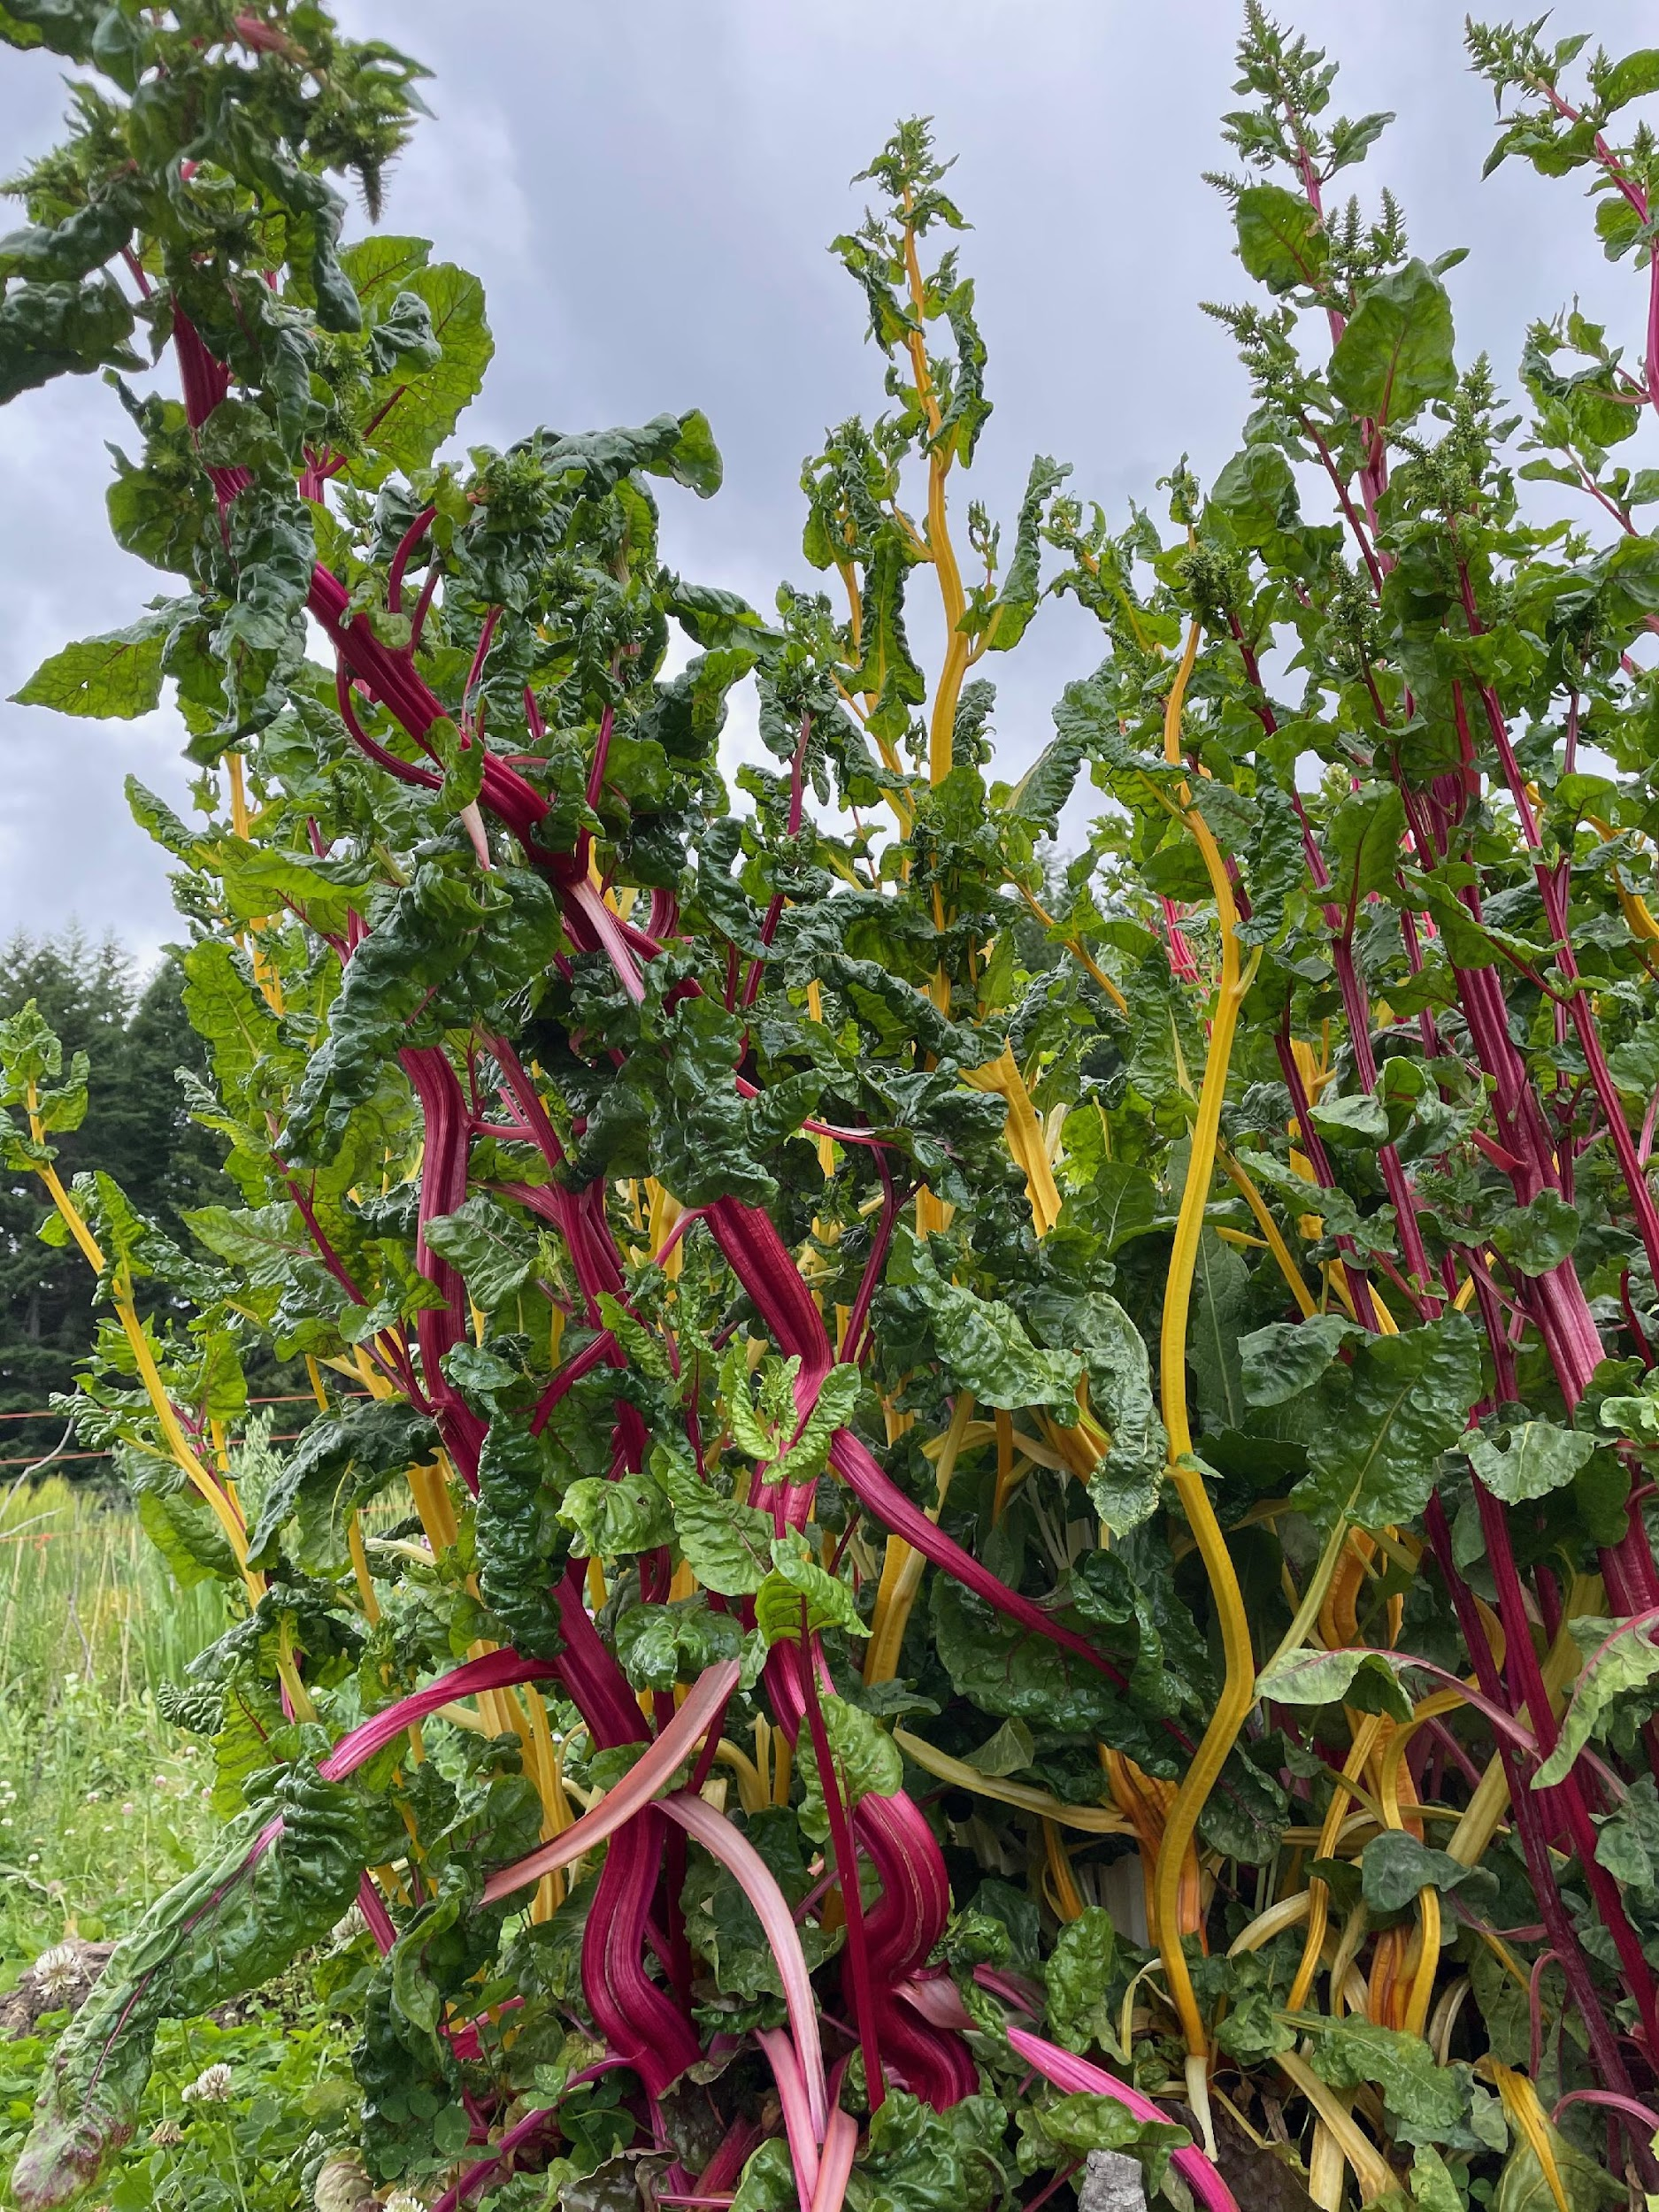
Planning a Seed Garden
You Will Need to Consider….
Time to harvest
Overwinter storage?
Rainy fall days?
Space needs
Longer garden residence
Cross-Pollination Prevention
Active or passive?
Pests and Diseases
Hungry autumn creatures
Molds & other late-season issues
Population Size
Yields
Does seed-saving interfere with your desired yield? Does that matter?
Image Credit: Marisa Hendron

Slide 9
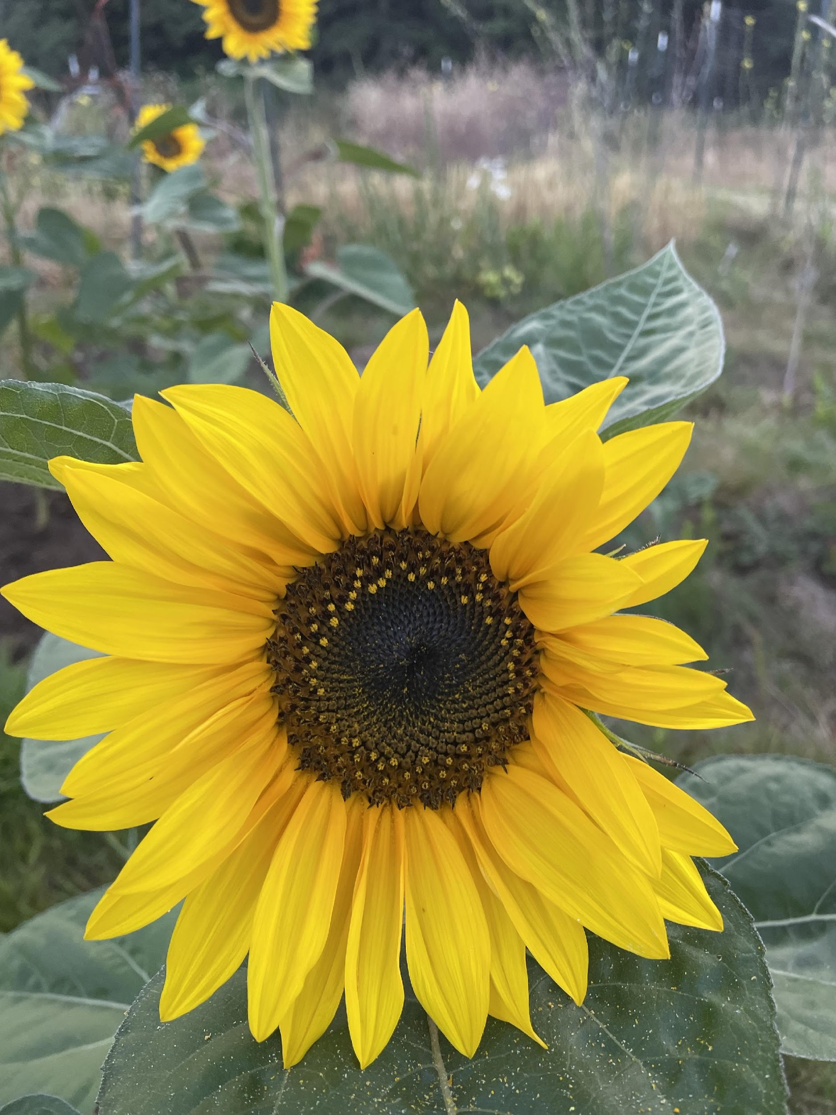
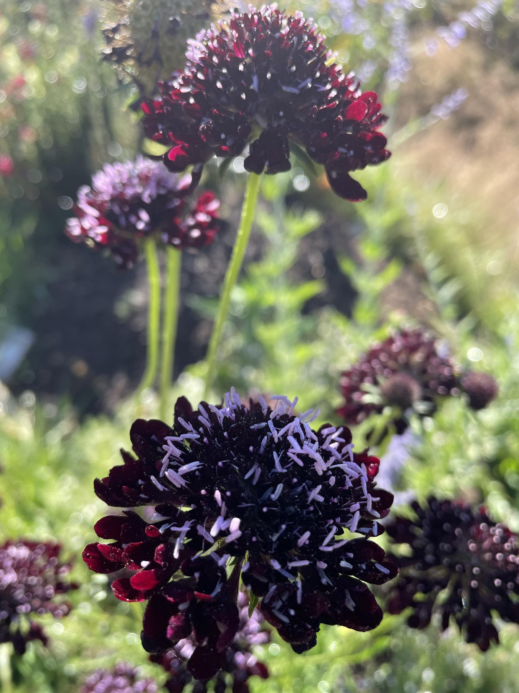
Seed Saving on the Island
Greens
Onions
Squash
Flowers
Herbs: Basil, Tulsi, medicinals
Wheat
Peas
Rye
Potatoes
Flowers: Marigold, Sweet peas
Greens: Arugula, kale
Herbs: Calendula, Chives, Parsley
Beans
Bond
Frances Kring
Rockwell
Root vegetables
Delicate or super-tasty bi-ennials
Specific crosses
Crops with high cross-pollination
Crops with late ripening
Crops with long or tricky germination
Day neutral crops

Slide 10
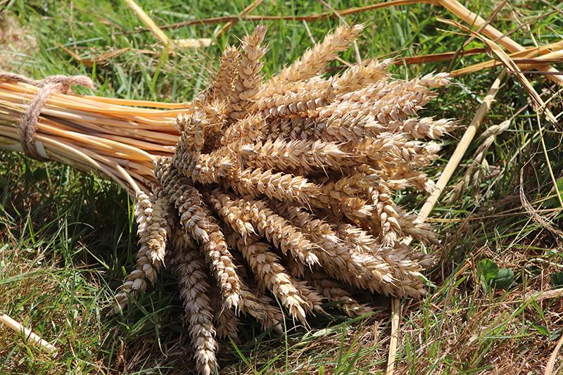
Styles of Seed Saving
Create a New or Consistent Variety
Landrace or Grex
Images:
Left: Overwinter Pea Grex
(Credit: Marisa Hendron)
Below: Motto Wheat
(Credit: Renee Delight)
See what works
Mix in varieties you like
Let the climate & weather have maximum impact
Allow diversity, which may be more resilient year to year
Select carefully for specific traits
This means eating/pulling/culling more actively
Possible to lose adaptive traits
You can create just what you want!

Slide 11
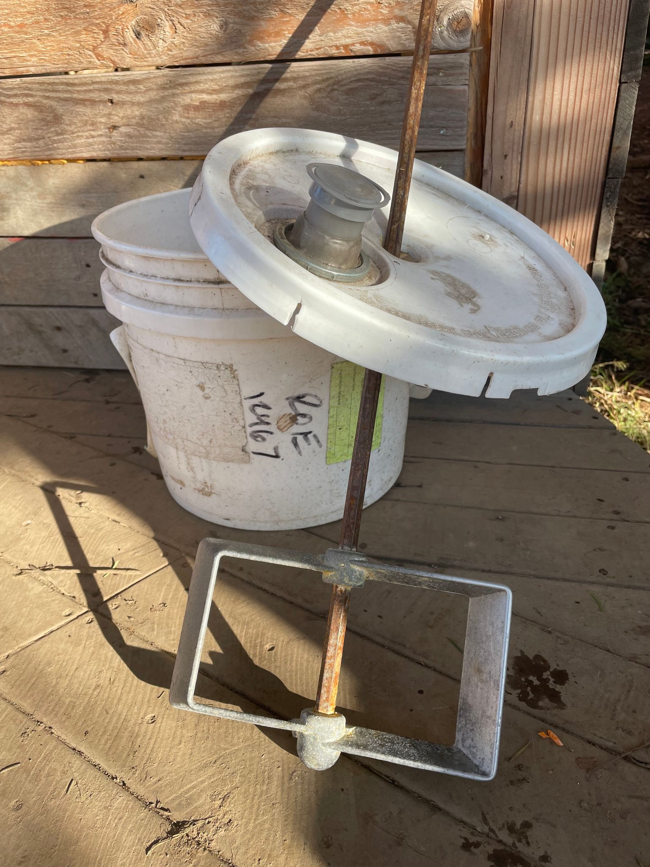
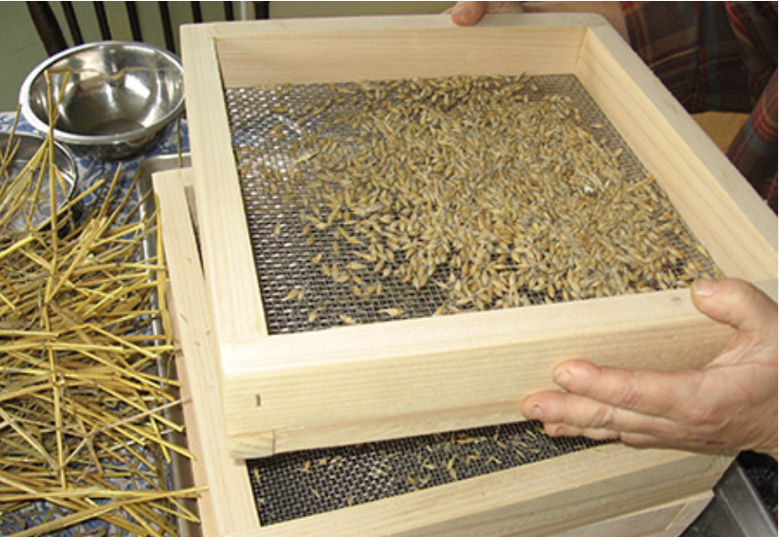
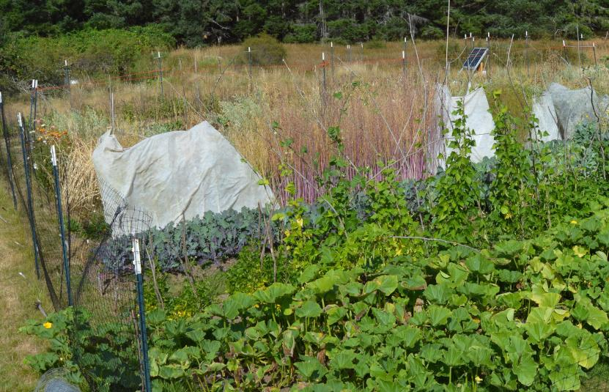
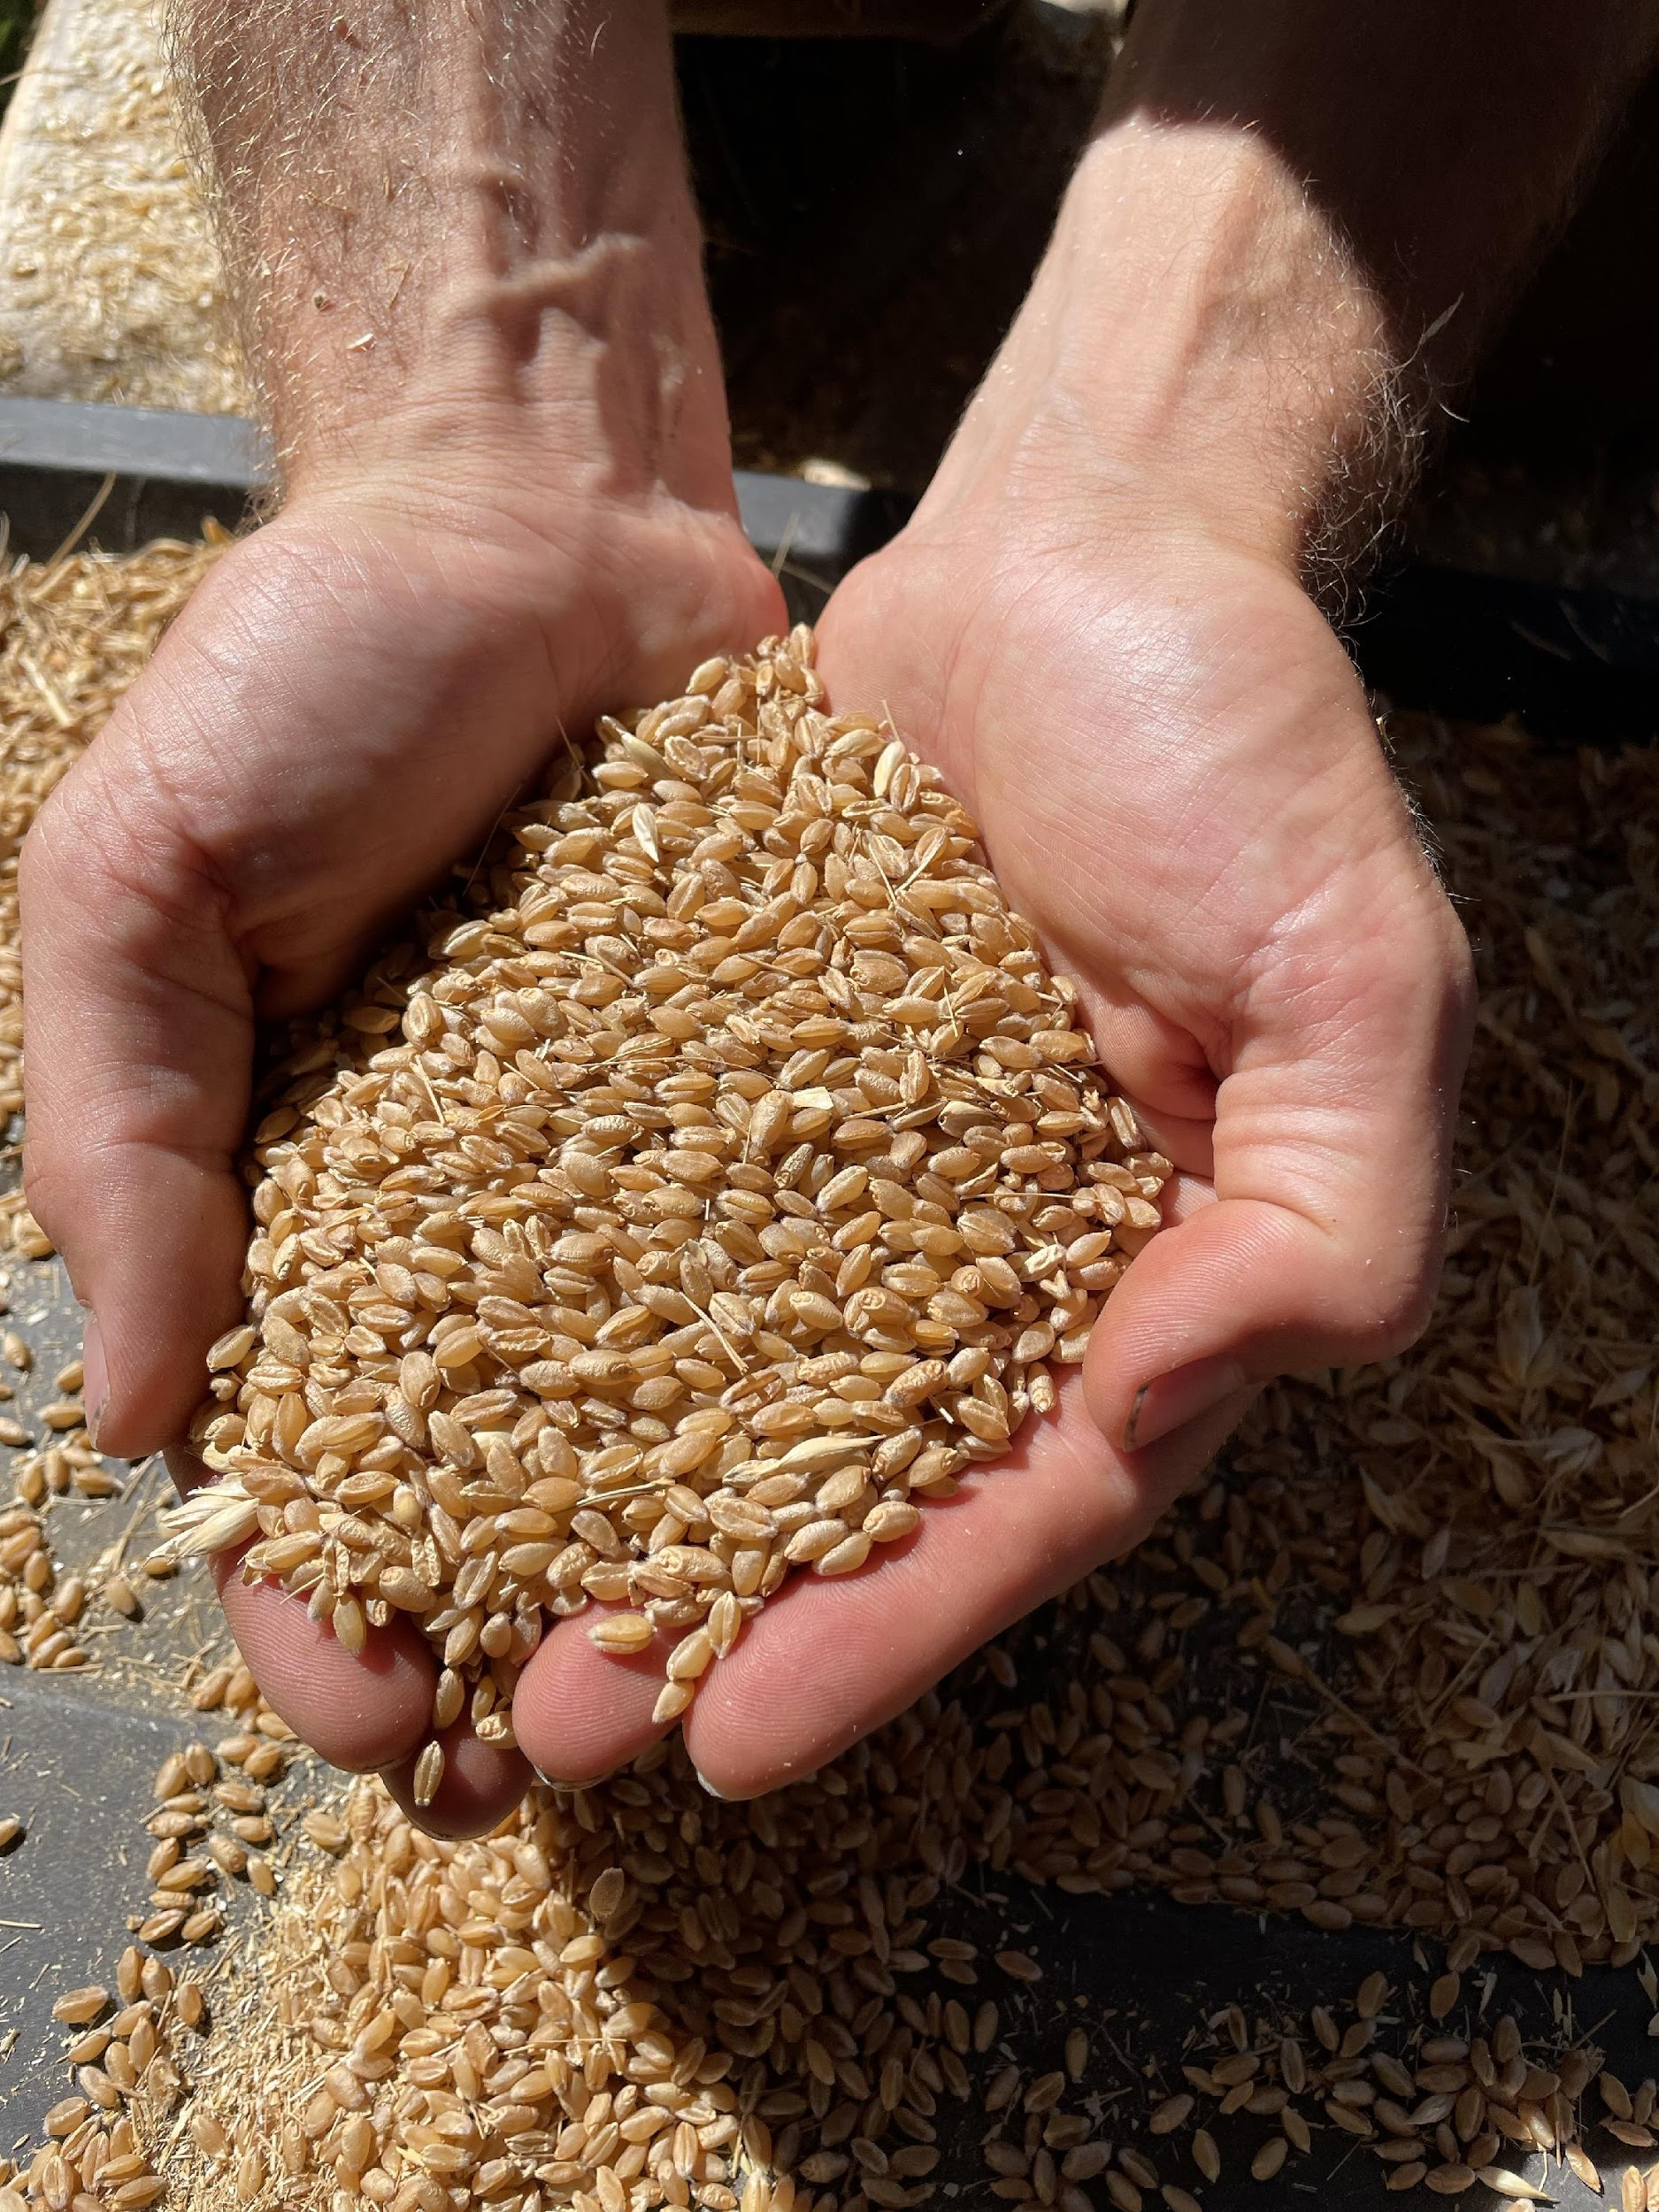
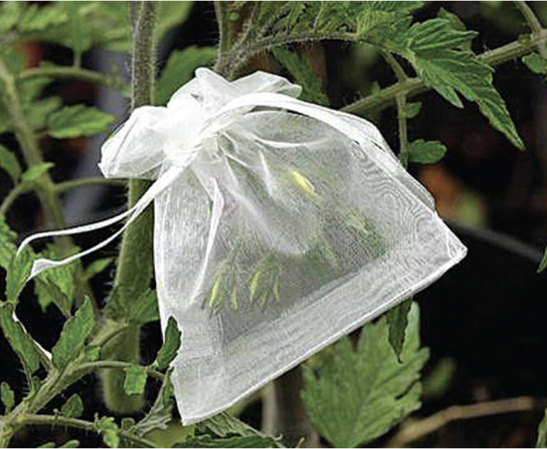
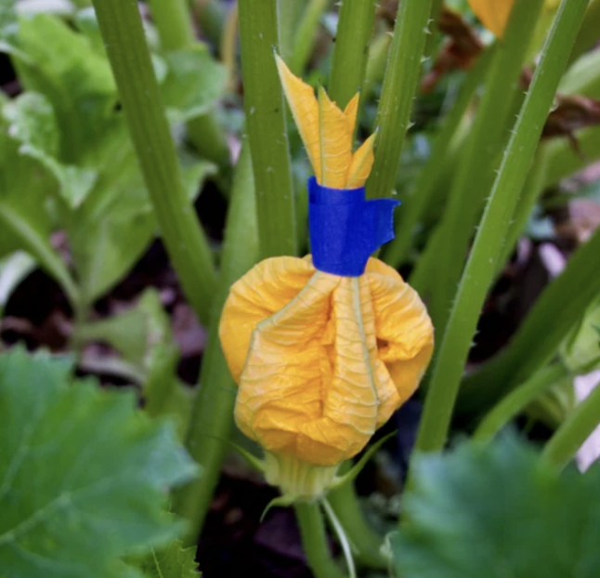
Tools & Techniques
Cleaning
Screens
Paint Mixer
Stomping
Threshing machines
Pollination Control
Physical Barriers
Taping Flowers
Isolation
Photo Credits:
Above Left: Marisa Hendron
Above Right: BC Farms & Food (https://bcfarmsandfood.com)
Right: Marisa Hendron
Photo Credits:
Above, Marisa Hendron
Right upper: Seed Saver’s Exchange
Right Lower: ORTA https://ortakitchengarden.com/

Slide 12
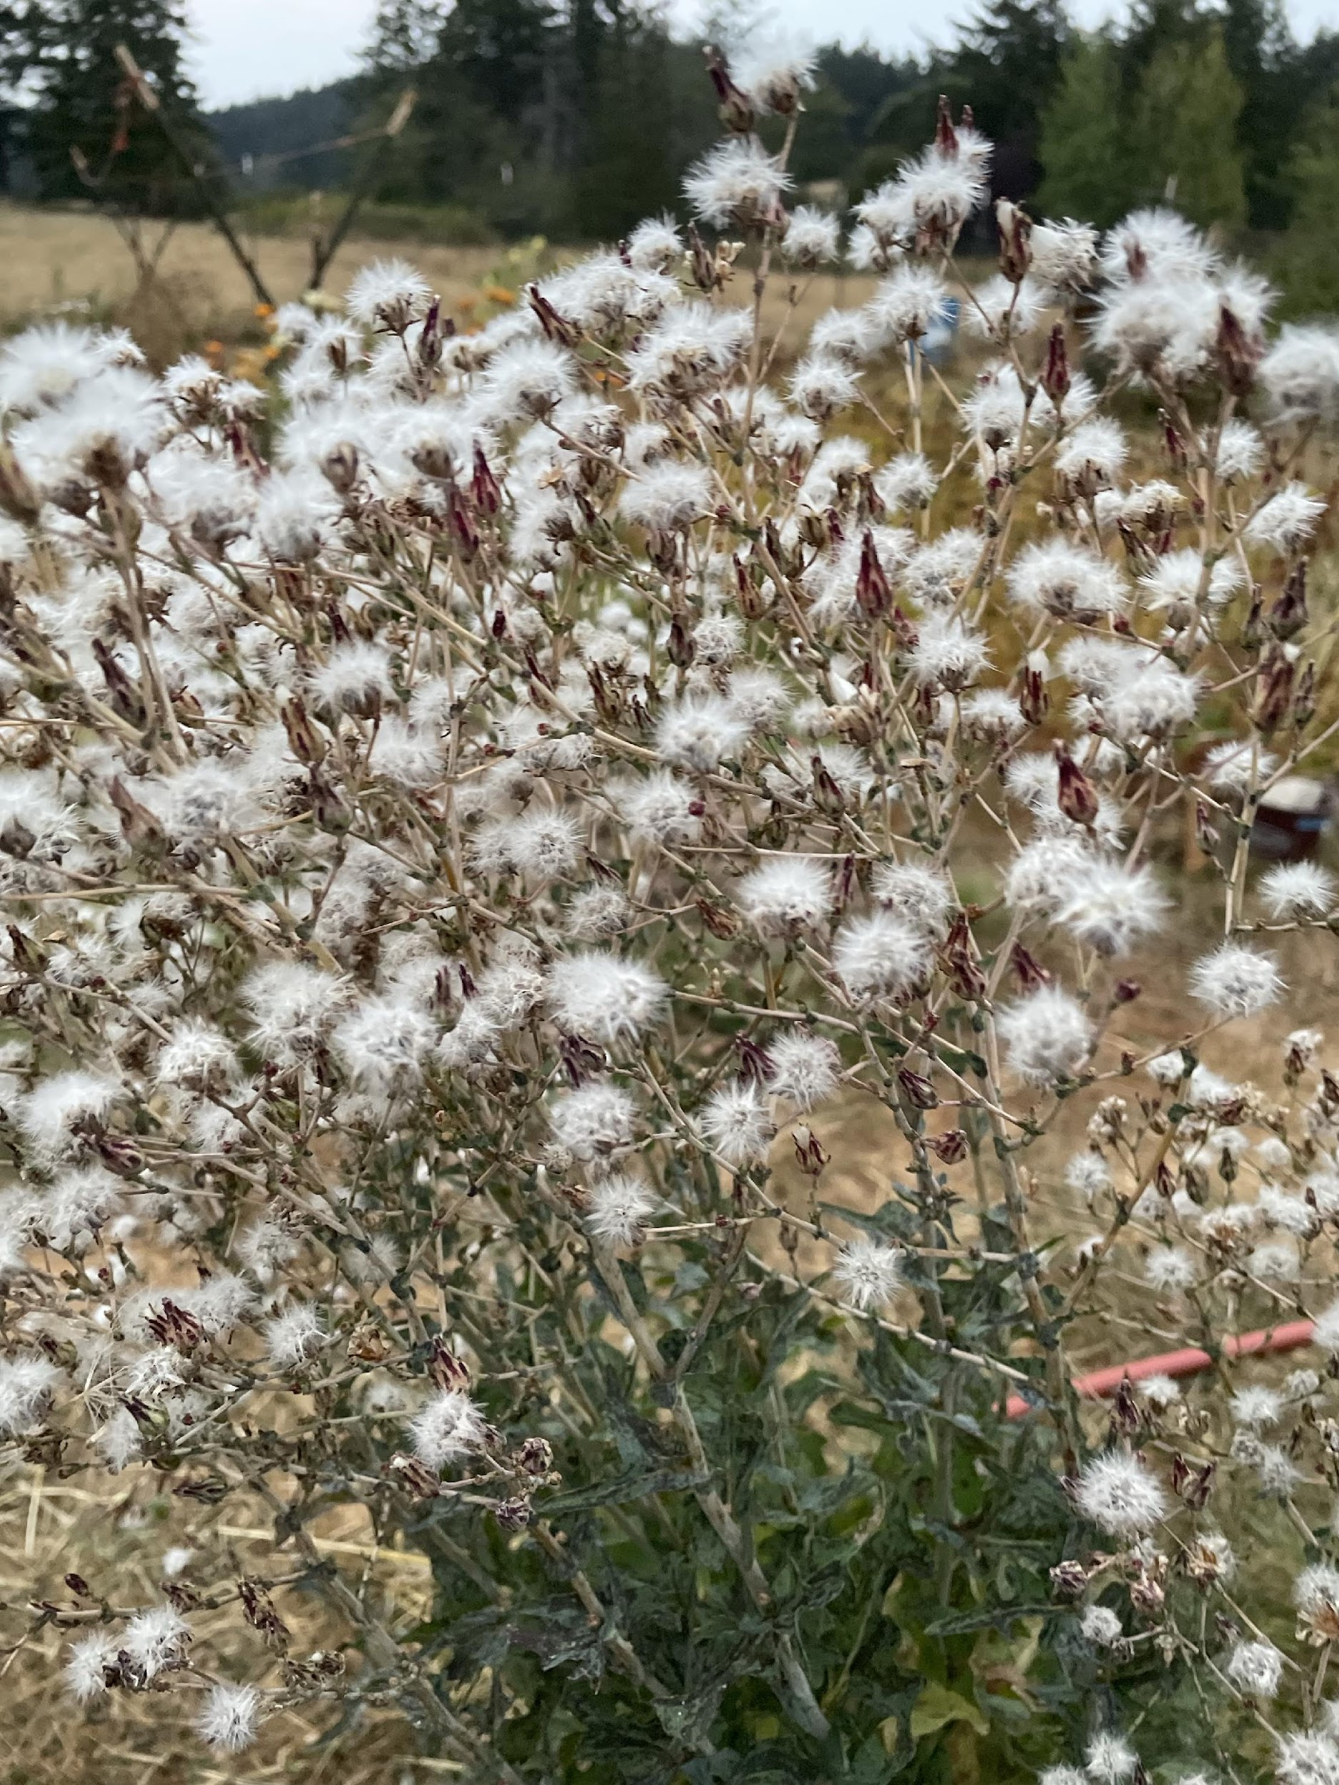
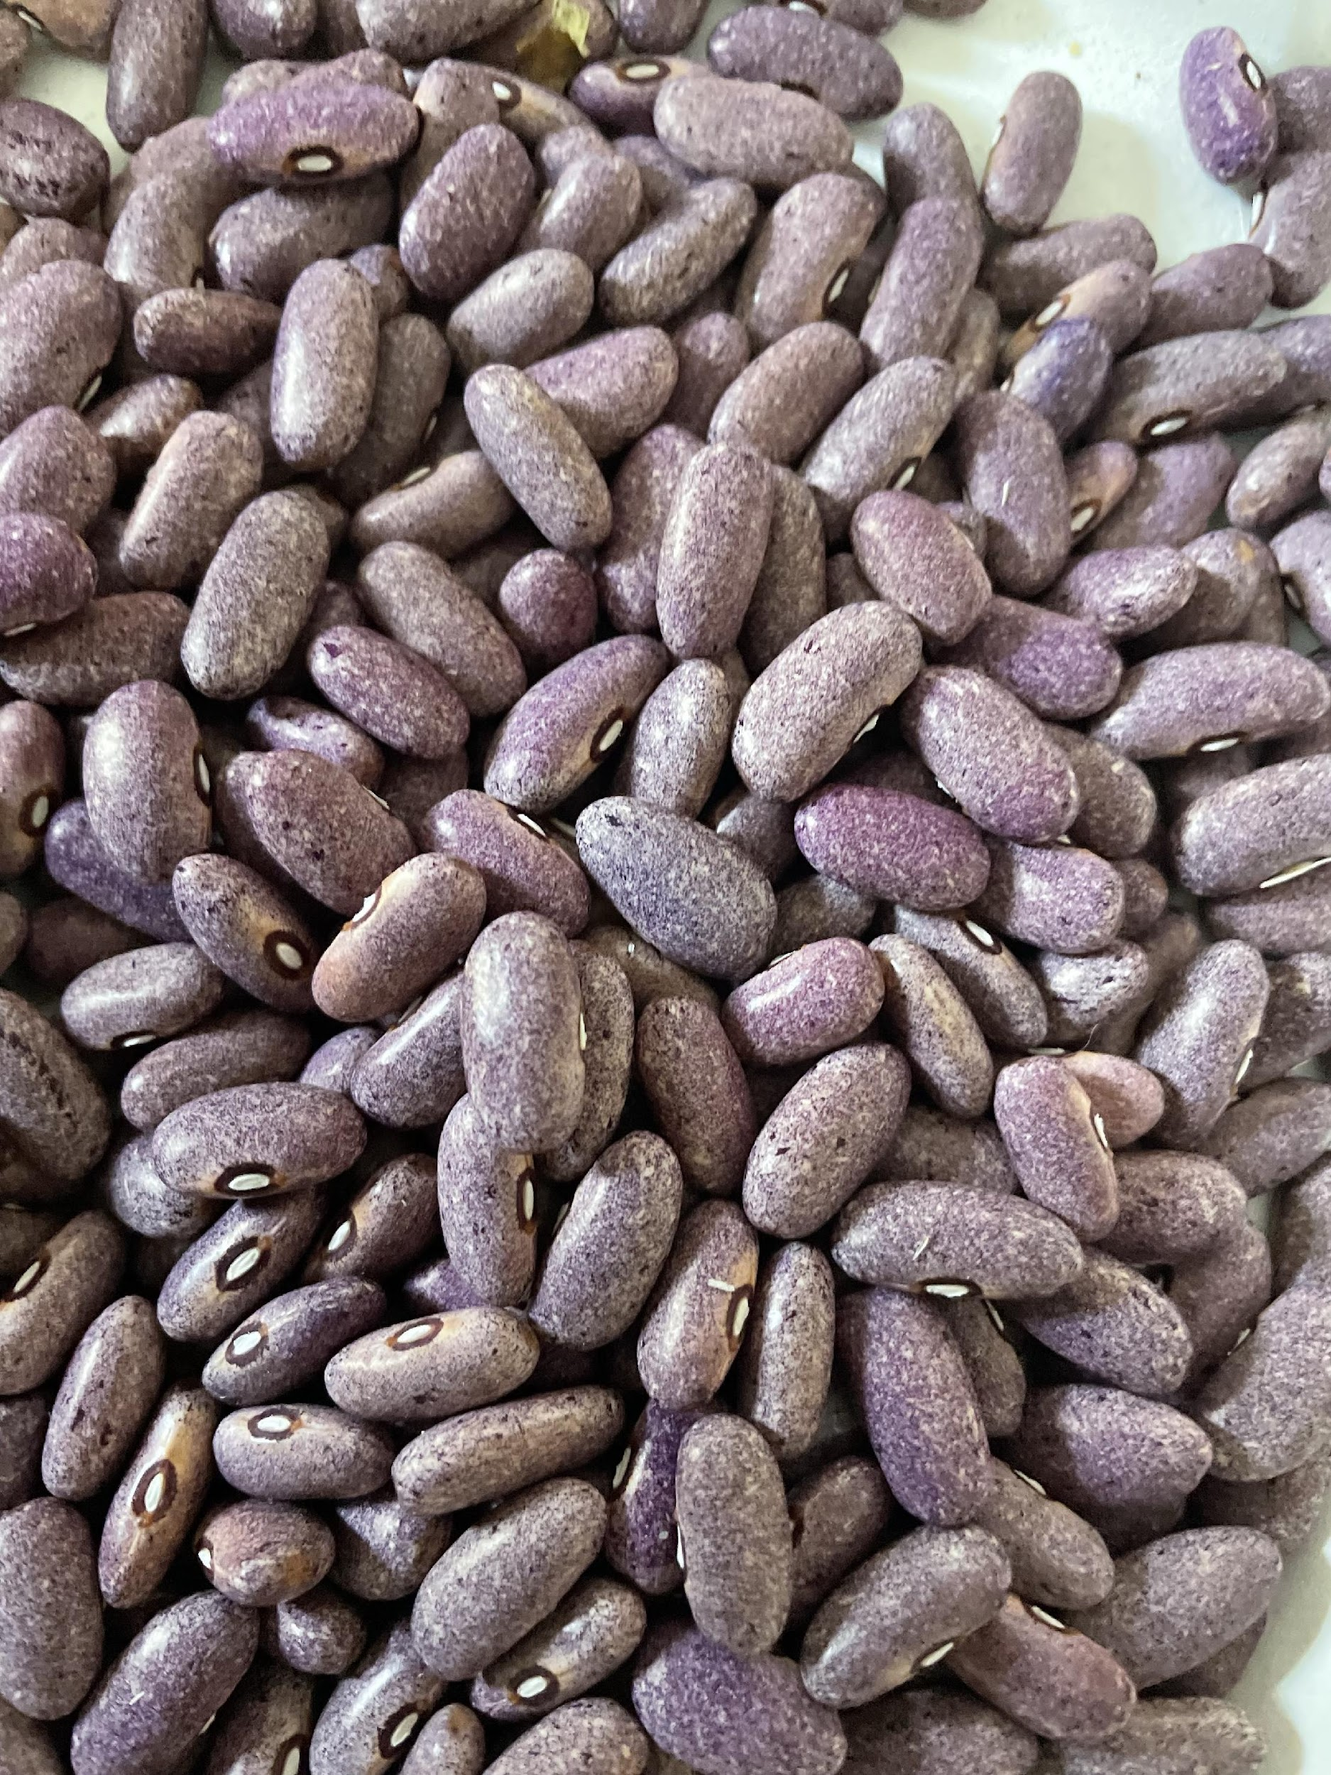
Challenges & Opportunities
Opportunities:
- Geographic isolation from GMOs and industrial agriculture
- Many local geographic barriers
- Wide variety of microclimates & soil types
- Seed saving increases resilience in a fragile economy
Challenges:
- Unpredictable climate
- Cross-pollination
- Time, space, energy (different rhythm in the garden)
- Seed life expectancy & storage
- Information gathering & sharing

Slide 13
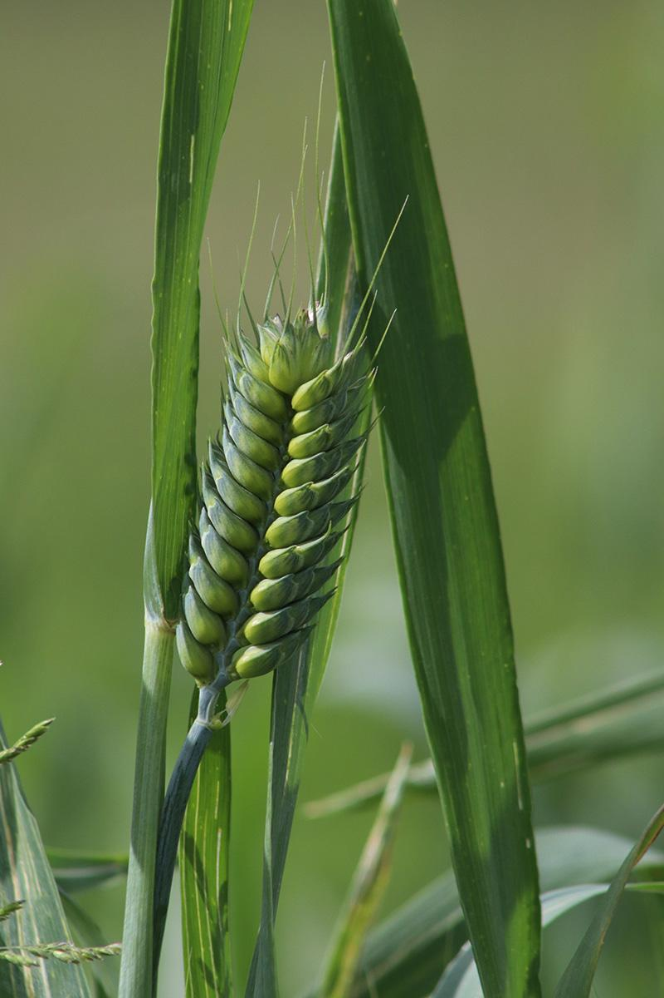
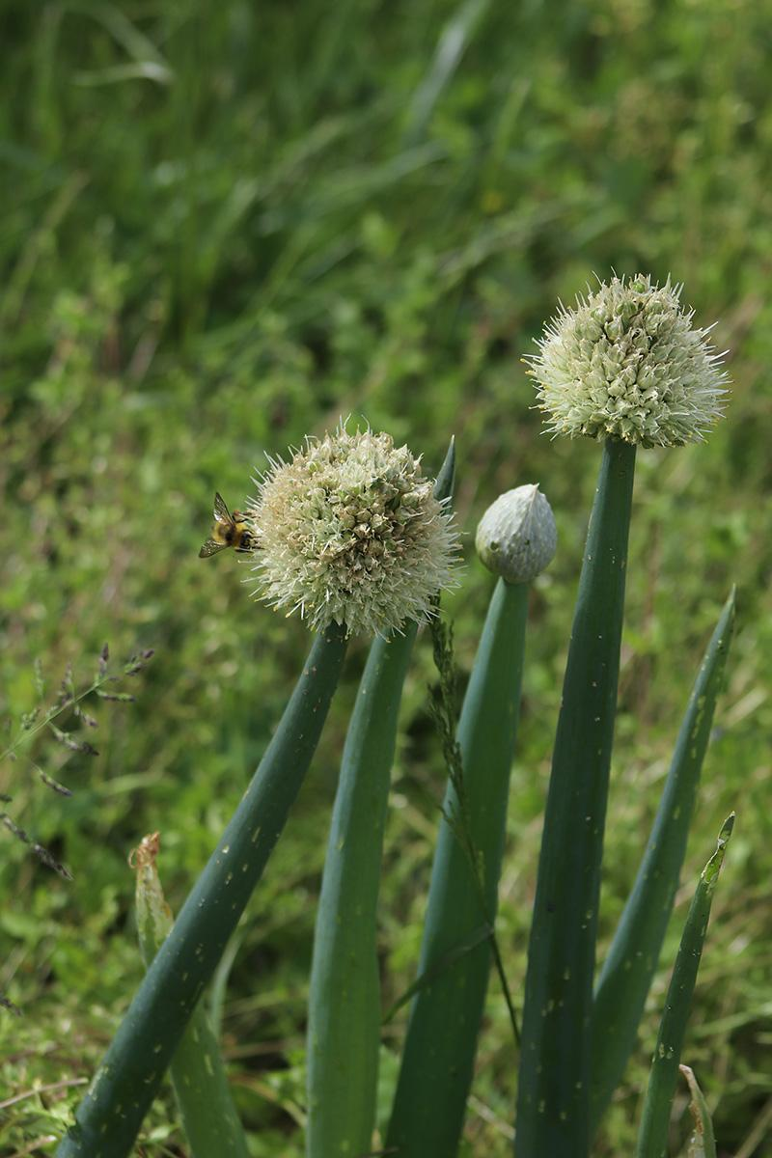
Resources, Community
Seed Saver’s Exchange:
MANY useful resources including crop-specific seed saving guides
https://www.seedsavers.org
Orcas Island Seed Bank: oiseeds.org
Salish Seed Guild:
Seed Swap Saturday Feb 18th, 2023
https://www.salishseed.org/
Community Seed Network:
https://www.communityseednetwork.org/
Seed Libraries Network:
Just had their 11th Annual conference virtually, recordings available
http://seedlibraries.weebly.com/

Slide 14
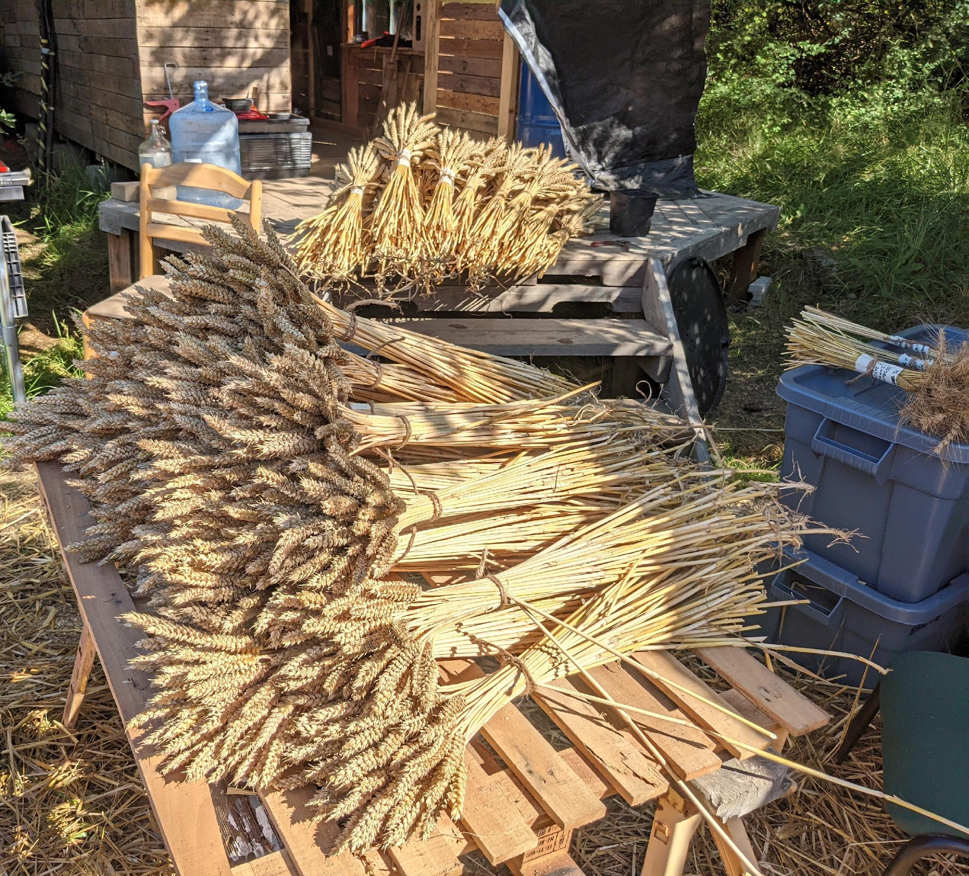
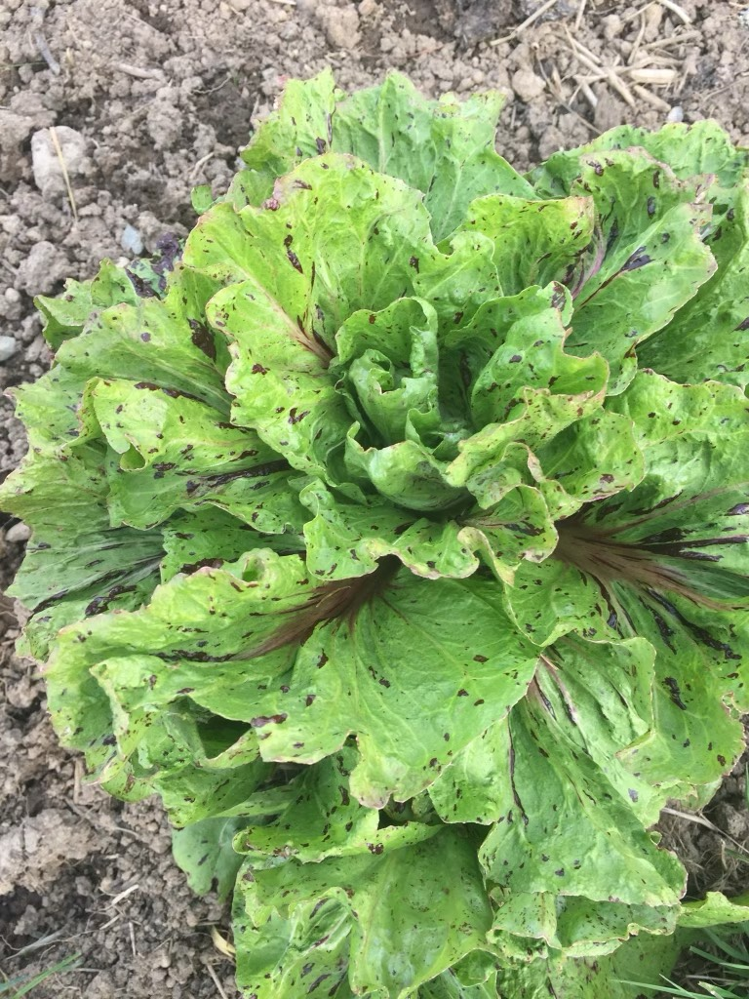
Resources, Books
Seed to Seed: Seed Saving and Growing Techniques for Vegetable Gardeners by Suzanne Ashworth & Kent Whealy (1995)
Breed Your Own Vegetable Varieties: The Gardener's and Farmer's Guide to Plant Breeding and Seed Saving by Carol Deppe (1990)
And plenty more!

