Slide 1
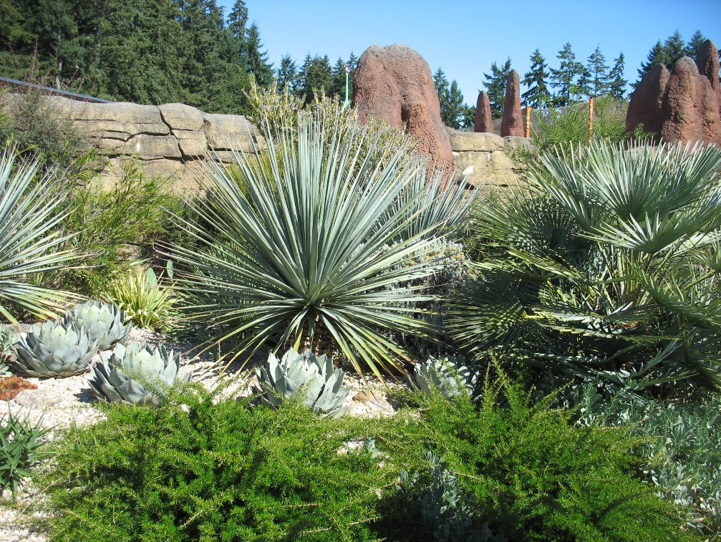
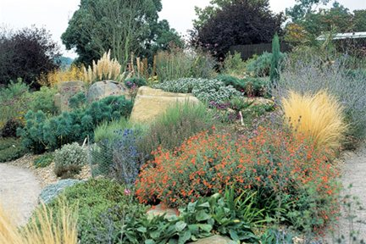
Drought-resistant Landscape
Everett Chu
Nurseryman, Azusa Garden-center Owner/Operator
Farmer, Master Gardener, Community Advocate
Landscape Designer/Builder, CPH, ecoPRO, APLD Professional Member
WSNLA ‘Member of the Year (January 2016)

Slide 2

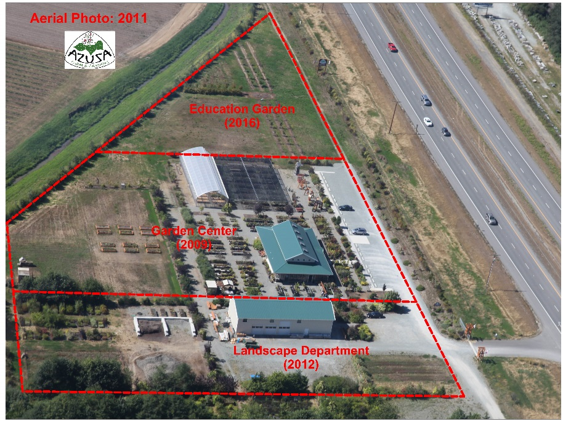
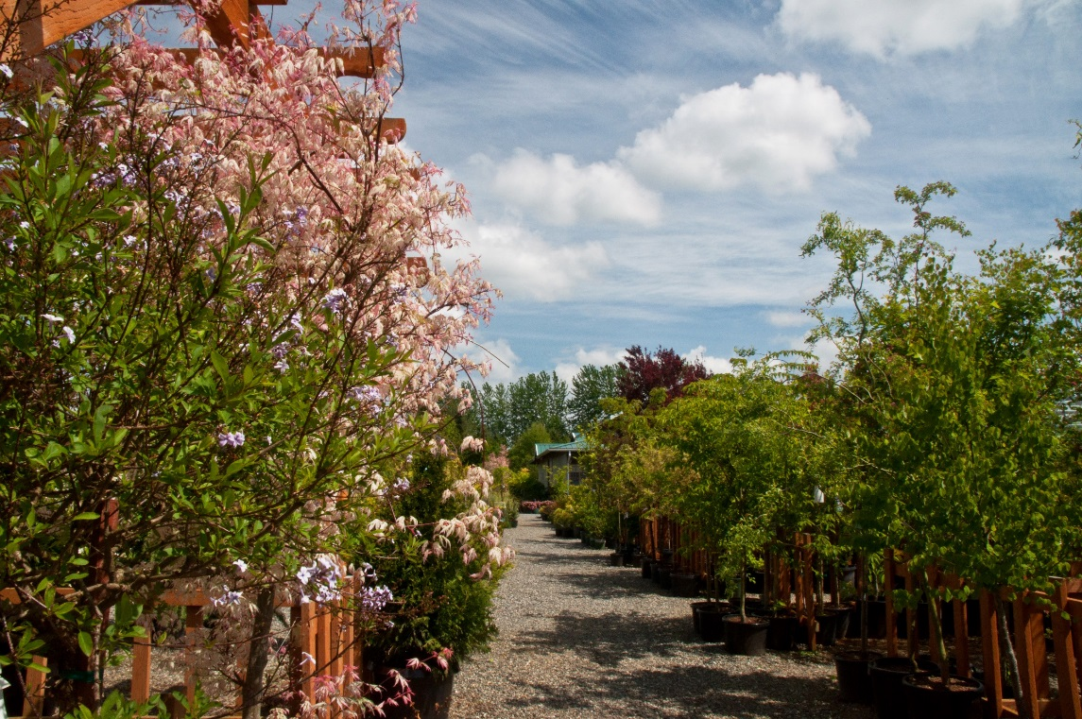
About Azusa
A garden center
A landscape designer/builder
Inspiration
Beauty
Education

Slide 3












Azusa Affiliations
Member of the year (January 2016)

Slide 4
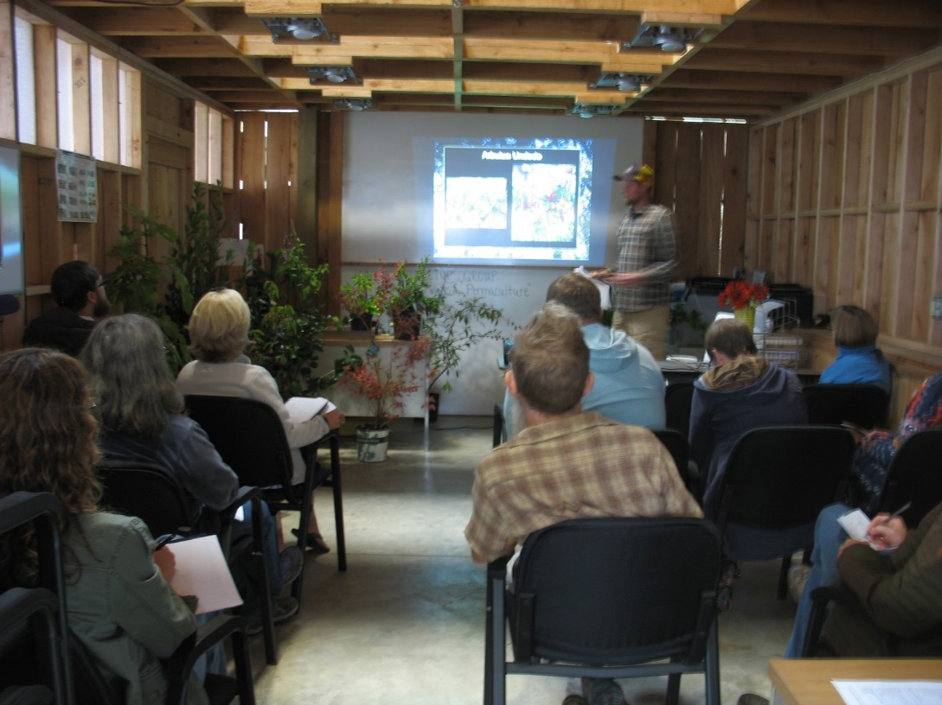
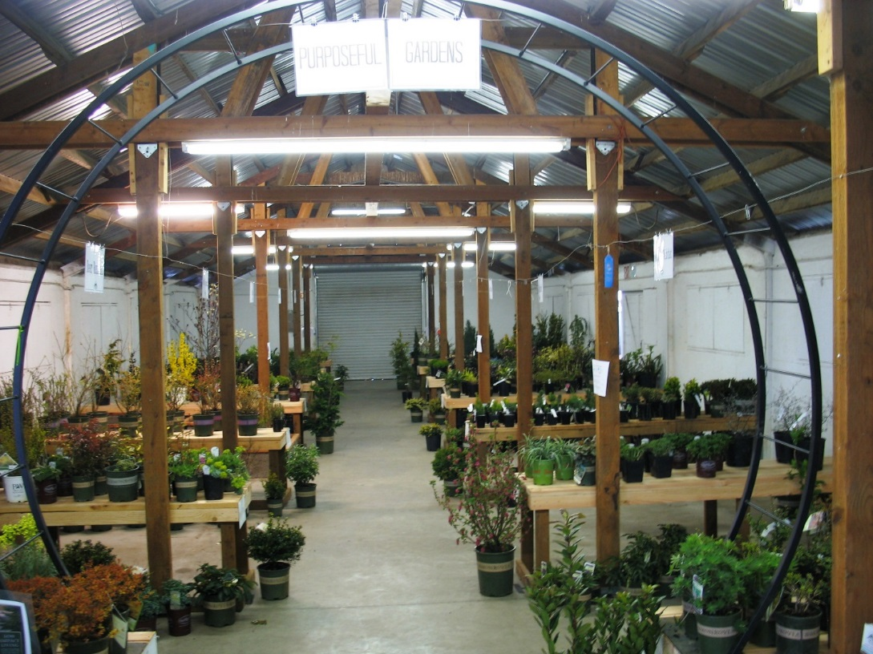
Azusa’s Classes & Workshops
Azusa class
(2017)
SICBA Home & Garden Show
(2017)

Slide 5
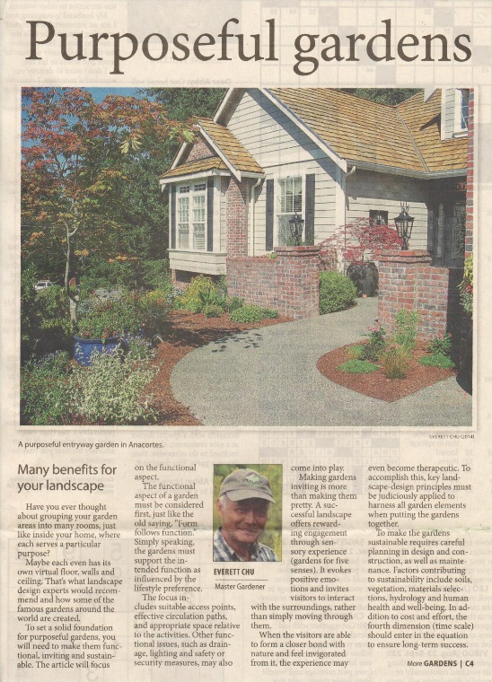
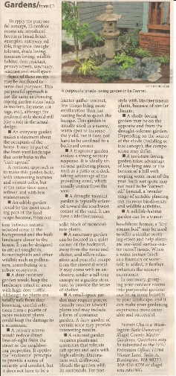
Gardens should be Purposeful
16-article Series “Ask the Master Gardener” Column

Slide 6
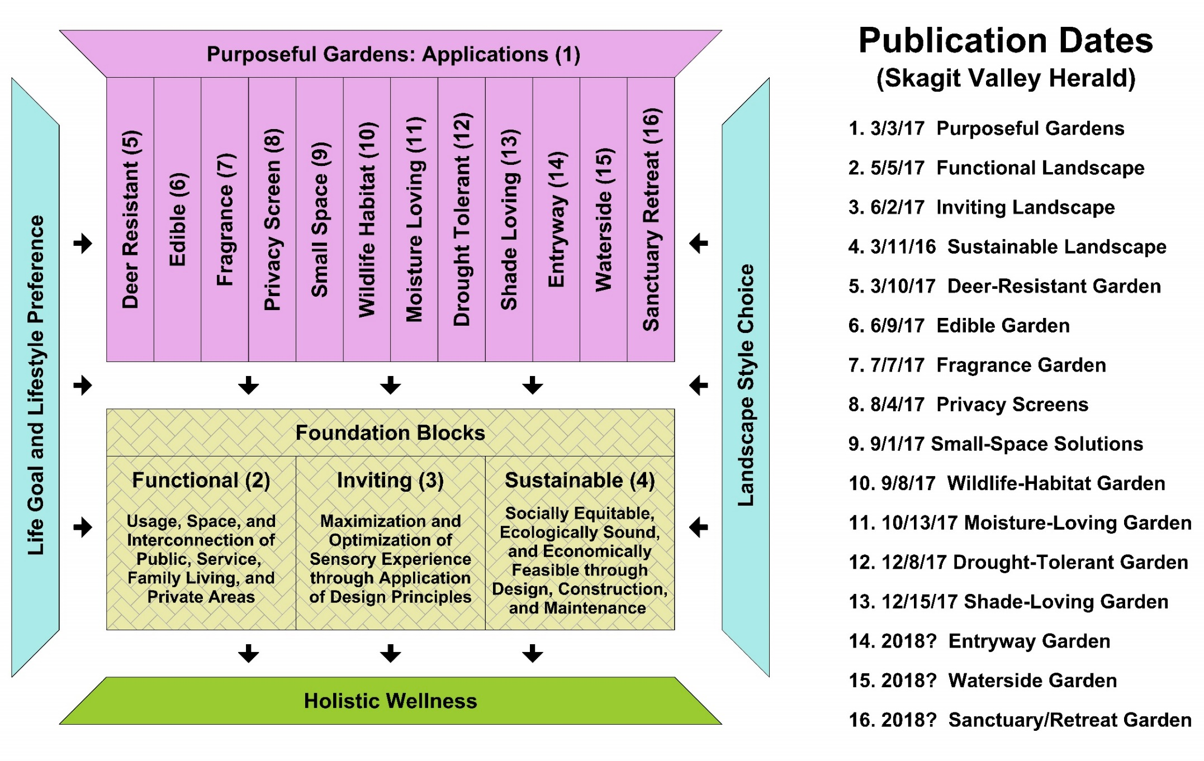
Purposeful Gardens
WSU Skagit Master Gardener: Article Archive

Slide 7
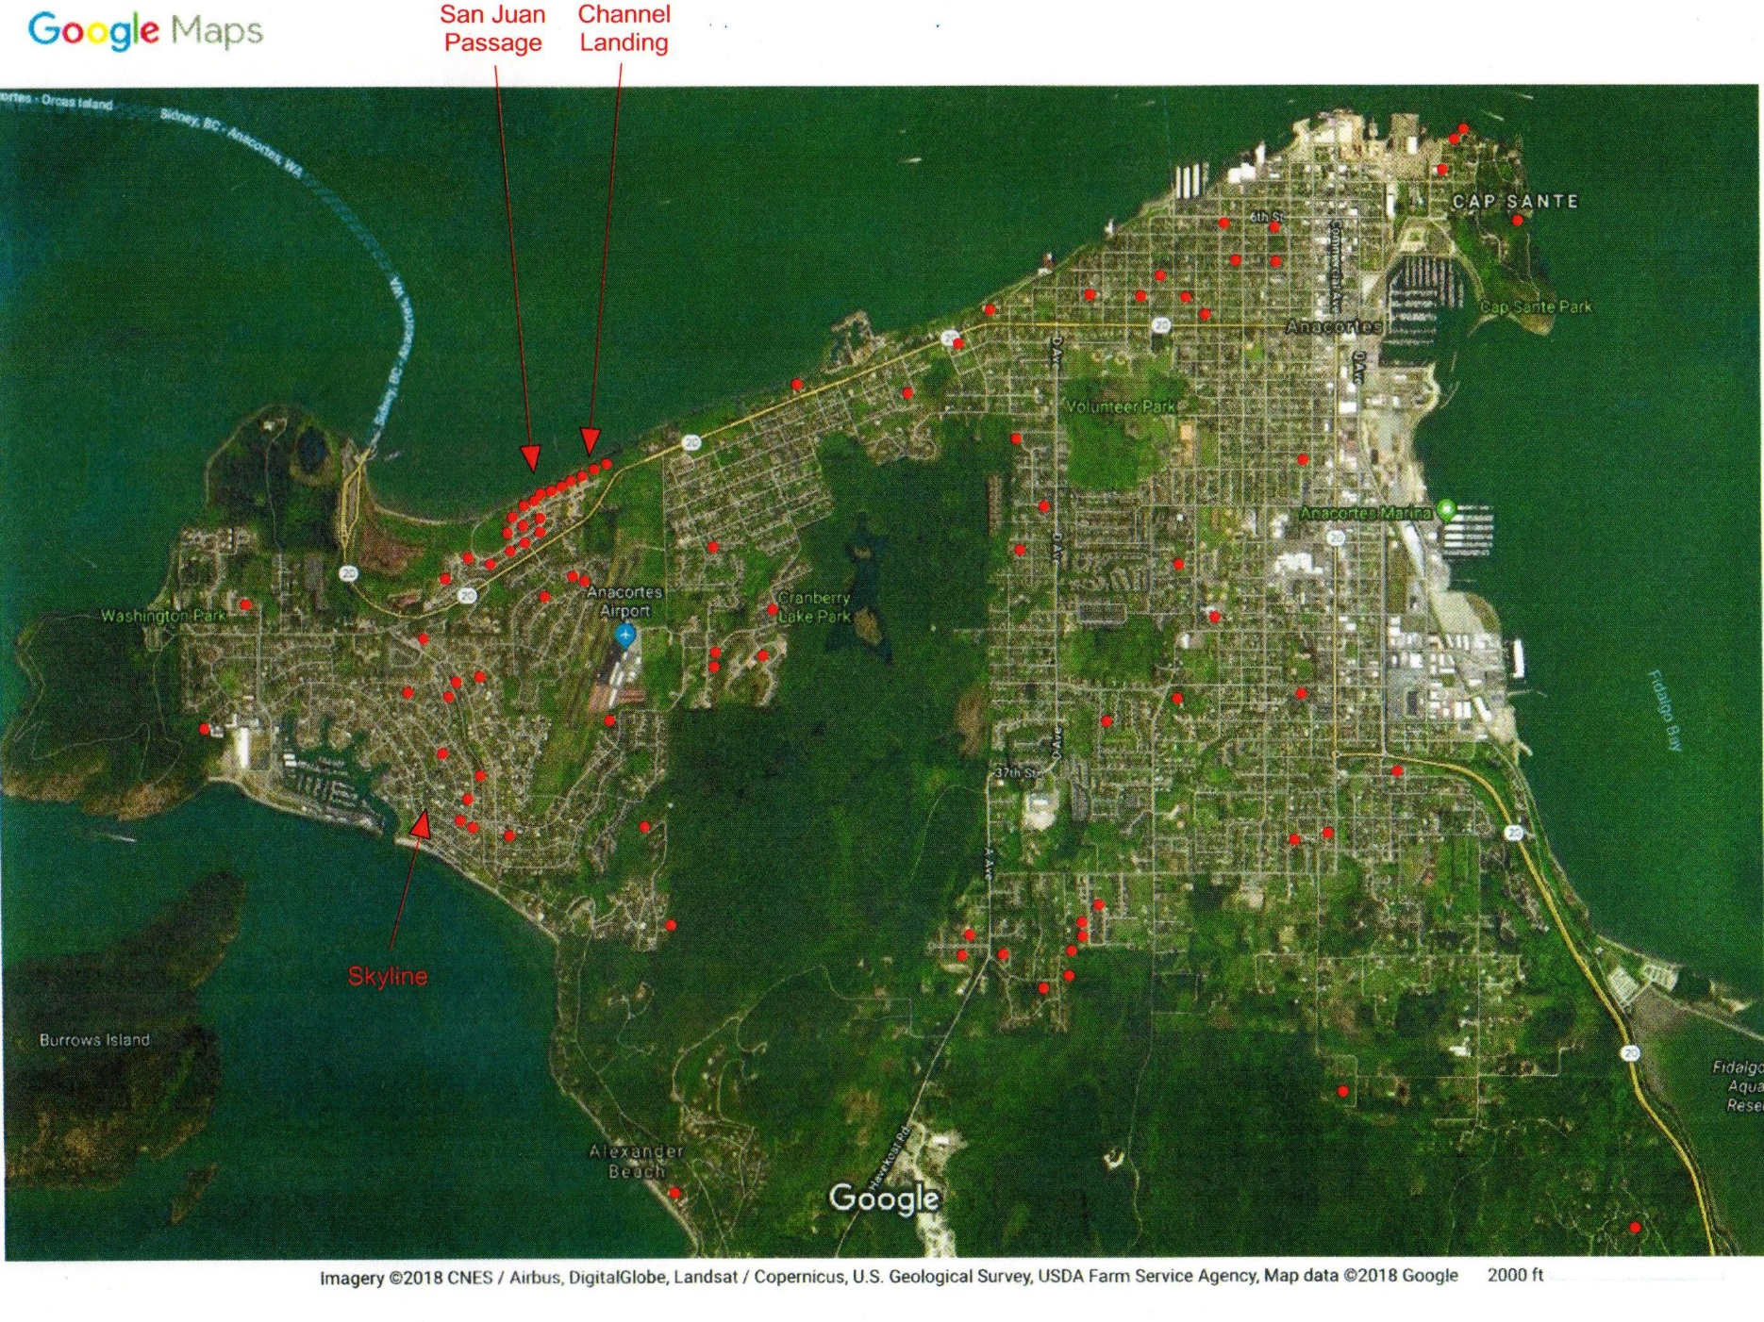
Landscape Design/Build: Anacortes
2015 - 2017

Slide 8
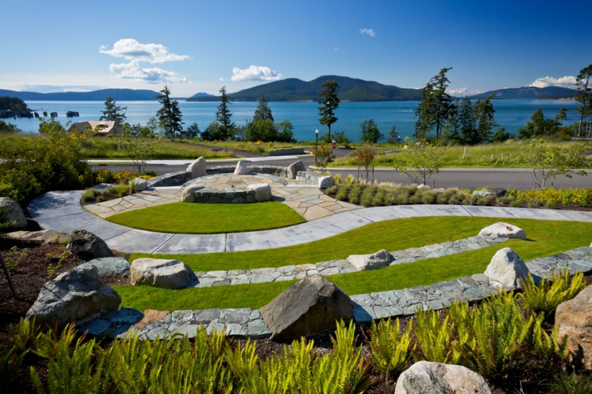
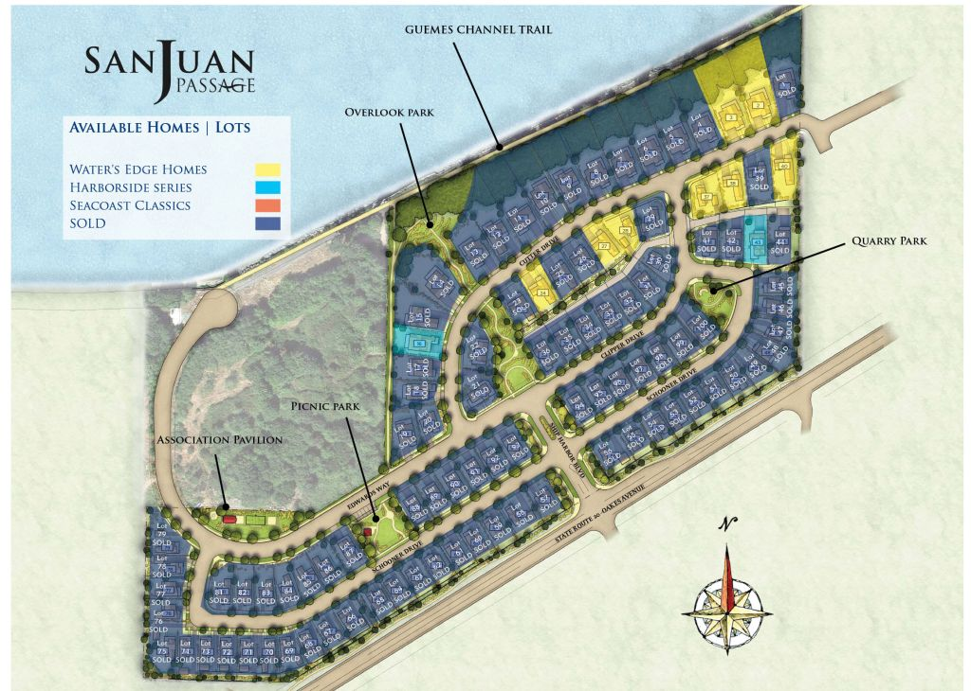
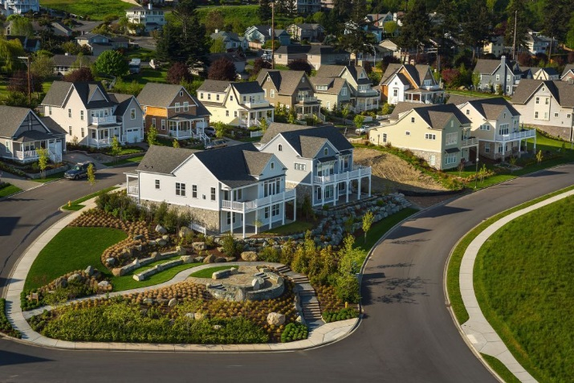
Client-Success Example
San Juan Passage: a 99-home Community
Landscape renovation for HOA’s common areas (6 parks)
Complete landscape redo for 15 homes (out of 90 existing ones)

Slide 9
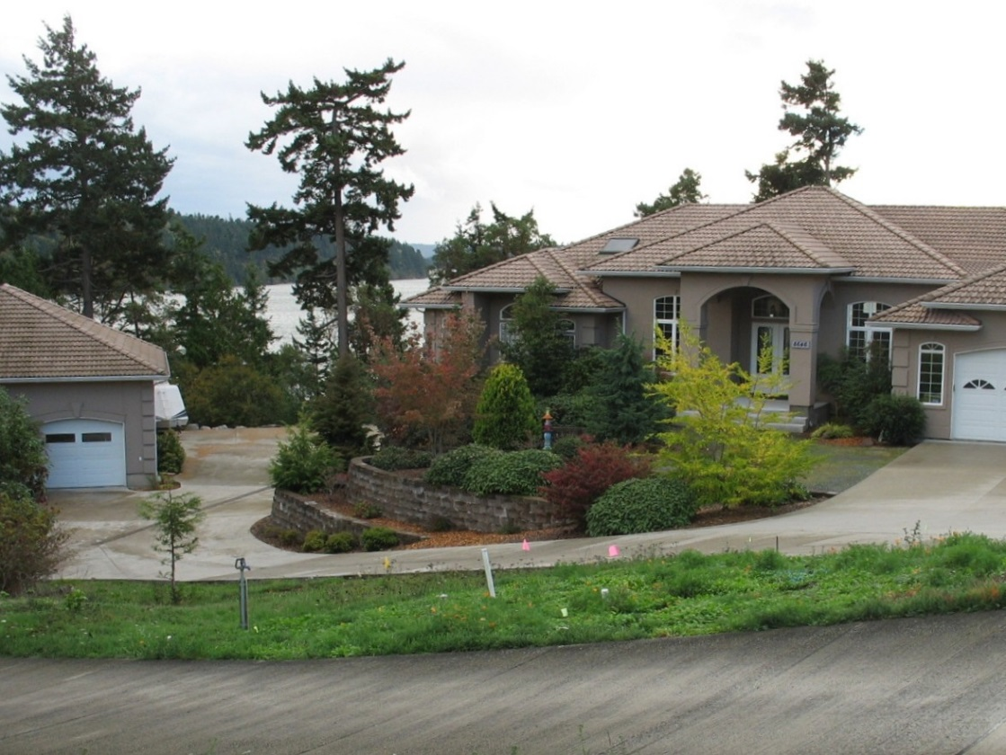
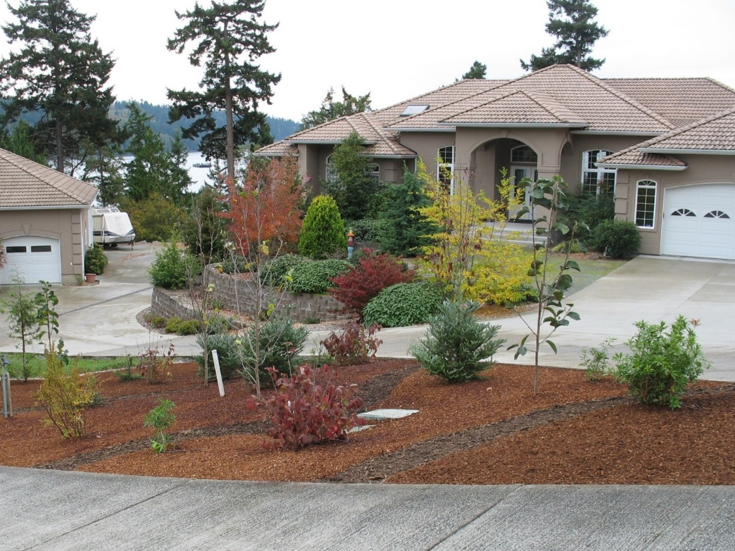
Azusa’s Nature-inspired Landscape
Before
After

Slide 10
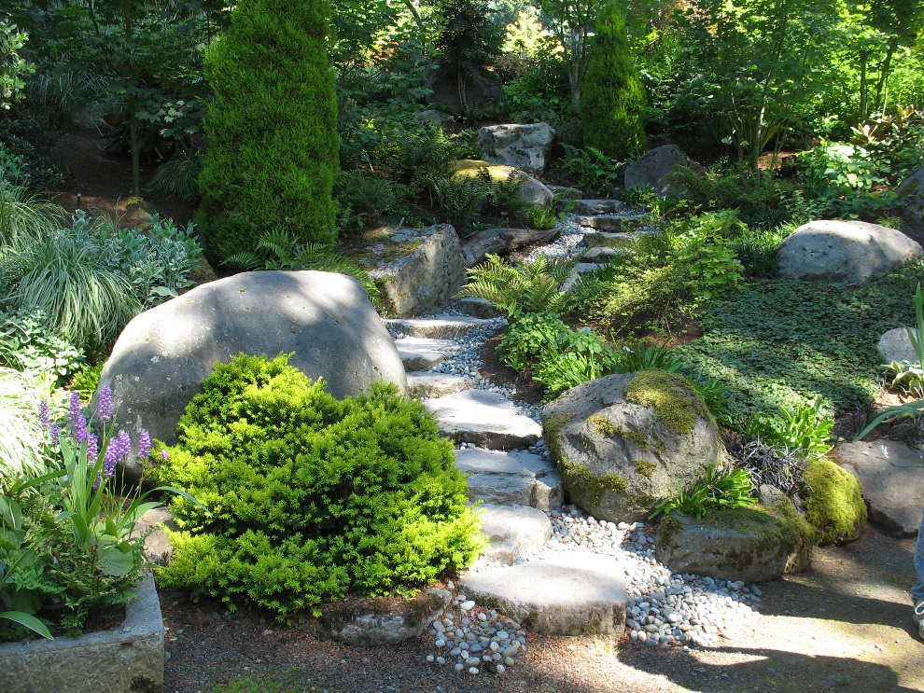
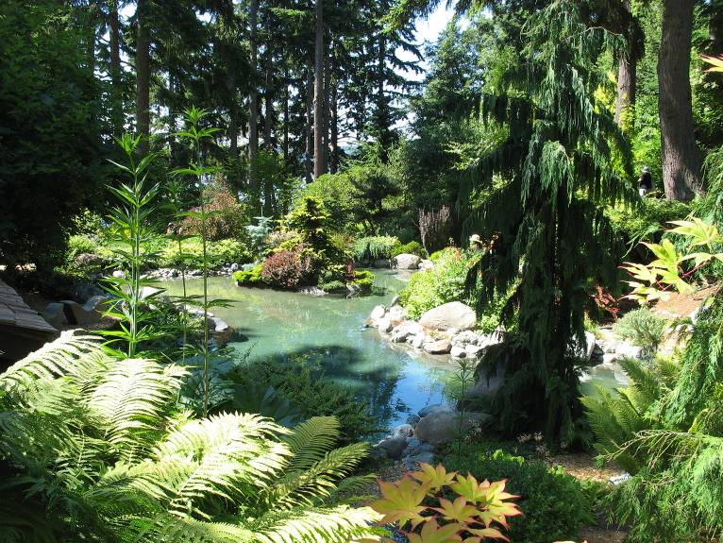
Landscape is an Ecosystem
Healthy biodiversity contributes to wellness of people and wildlife.
Mother Nature is our best teacher.

Slide 11

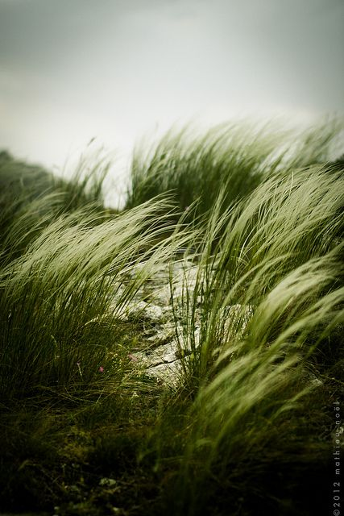
Landscape is Part of Microclimate
Interaction between prevailing weather and physical environment.
Climate components: solar (and terrestrial) radiation, wind, air temperature, humidity
Physical environment: topography, body of water, soil type and moisture, buildings and paved surfaces, trees and vegetation

Slide 12
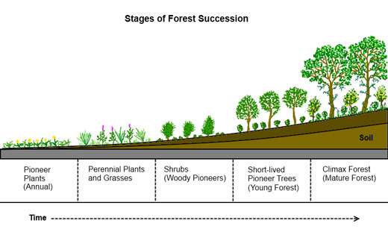
Landscaping is Reforestation
Source: deepgreenpermaculture.com

Slide 13
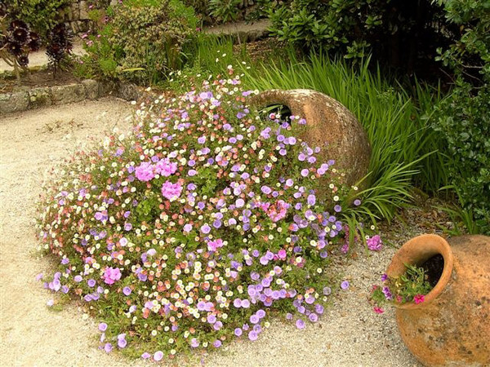
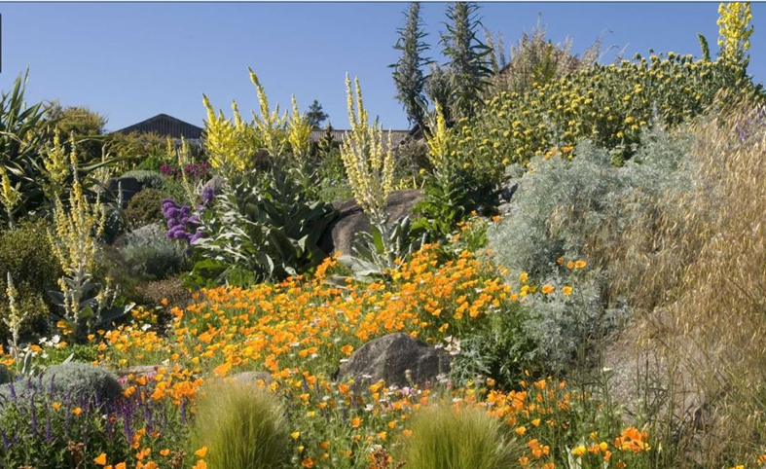
Drought-resistant Approach
No (or reduced) lawn
Create protective shade (e.g., tree canopy)
Irrigate according to hydro-zones
Invest in soil and mulch
Use drought-tolerant plants

Slide 14
How to Plant and Care
14
Well-draining soils are a must. Most drought-resistant plants easily die in wet feet.
Soil should not be high in nutrients.
Plant according to preferences for sun or shade as you do for all plants.
Provide extra irrigation for the first two seasons, then none or limited.
Use mulch to retain moisture in the summer and keep down weeds.
Use gravel for succulents and to help plants whose crowns may rot; wood chips also work.
Notes:
14

Slide 15
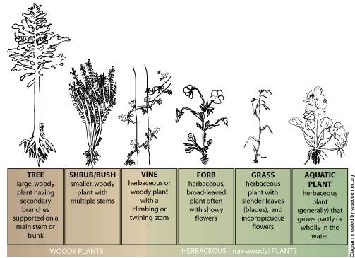
Plant Groups: Woody, Non-woody
A) Trees and Shrubs, B) Forbs, C) Grass and Grass-like
Source: UC-Davis

Slide 16
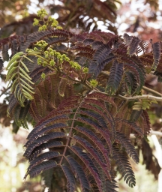
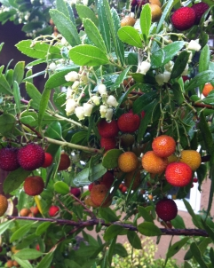
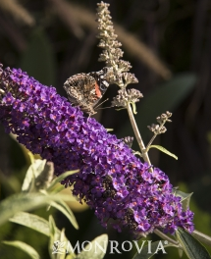
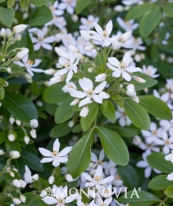
Trees and Shrubs, 1 of 7 for Drought-resistant Gardens
Albizia julibrissin 'Summer Chocolate' (Purple-leaf Mimosa Tree), #4
Arbutus unedo ‘Compacta’ (Dwarf Strawberry Tree), #12
Buddleia davidii 'Black Knight‘ (Butterfly Bush), #26
Choisya ternata (Mexican Orange Blossom)
#1
#12
#26
# omitted
Source: Monrovia

Slide 17
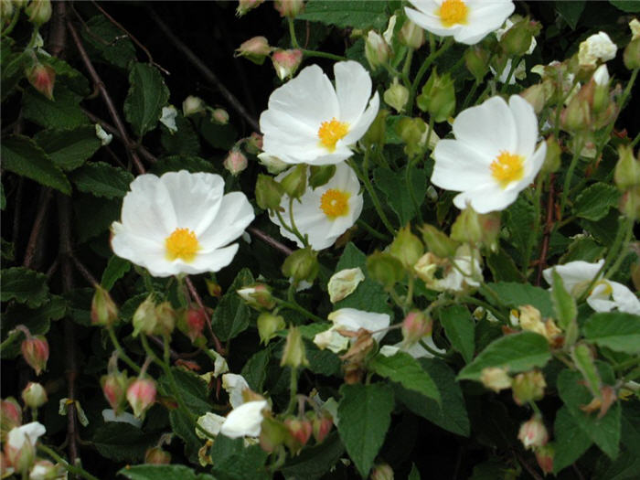
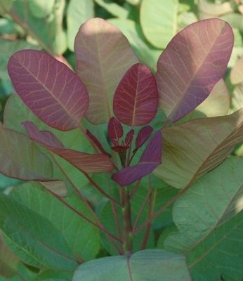
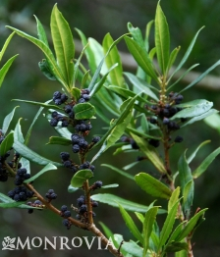
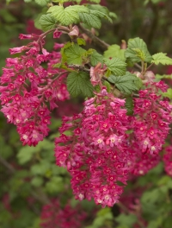
Trees and Shrubs, 2 of 7 for Drought-resistant Gardens
Cistus x corbariensis/hybridus (White Rock Rose), #39
Cotinus ‘Old Fashioned’ (Dwarf Smokebush), #45
Myrica californica (Pacific Wax Myrtle), #89
Ribes sanguineum 'King Edward VII' (Flowering Currant), #108
#39
#45
#89
#108
Source: Monrovia

Slide 18
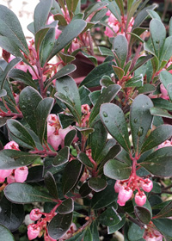
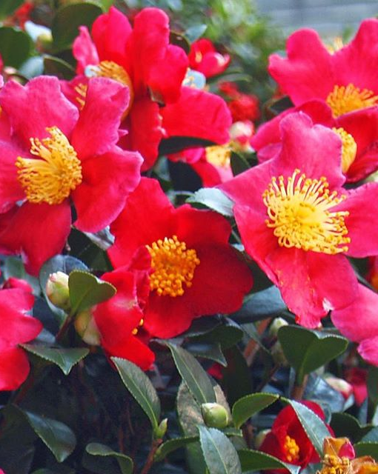
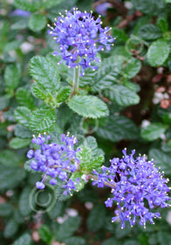
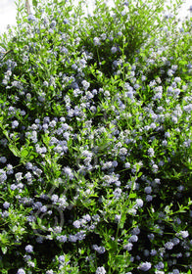
Trees and Shrubs, 3 of 7 for Drought-resistant Gardens
Arctostaphylos uva-ursi Vancouver Jade (Kinnikinnick), #13
Camellia sasanqua 'Yuletide' (Camellia, red single- flowered), #31
Ceanothus impressus 'Vandenberg' (California Lilac), #35
Ceanothus thyrsiflorus 'Victoria‘ (California Lilac), #36
#13
#31
#35
#36
Source: Blooming Nursery

Slide 19
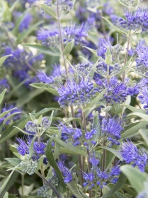
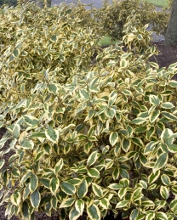
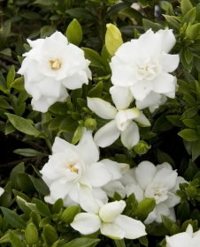
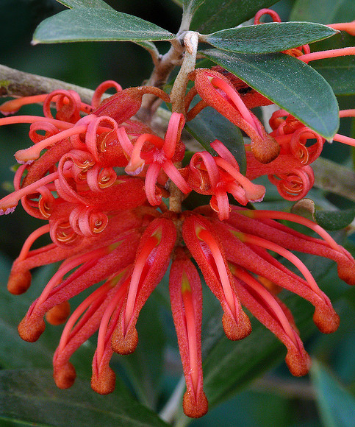
Trees and Shrubs, 4 of 7 for Drought-resistant Gardens
Caryopteris x clandonensis 'Dark Knight' (Bluebeard), #34
Elaeagnus x ebbingei 'Gilt Edge' (Golden Variegated Silverberry), #54
Gardenia jasminoides 'Summer Snow' (Gardenia), #64
Grevillea victoriae 'Marshall Olbrich' (Royal Grevillea), #68
#34
#54
#64
#68
Source: Monrovia

Slide 20
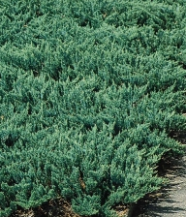
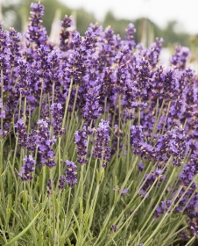
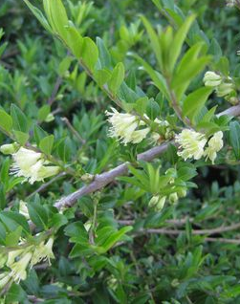
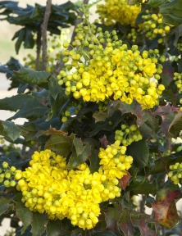
Trees and Shrubs, 5 of 7 for Drought-resistant Gardens
Juniperus horizontalis 'Blue Chip' (Blue Chip Juniper), #76
Lavandula angustifolia 'Hidcote' (English Lavender), #78
Lonicera pileata (Privet Honeysuckle), #84
Mahonia aquifolium (Oregon Grape), #86
#76
#78
#84
#86
Source: Monrovia

Slide 21
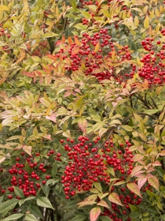
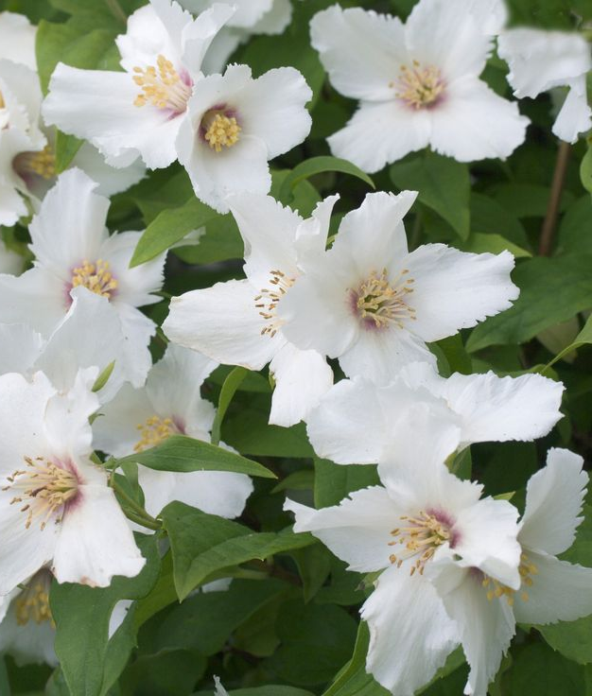
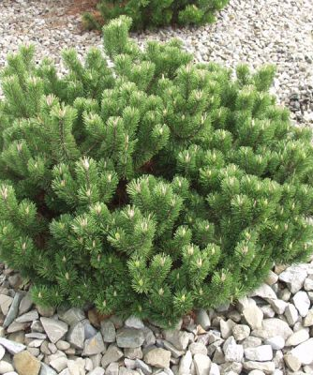
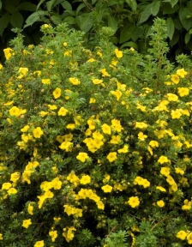
Trees and Shrubs, 6 of 7 for Drought-resistant Gardens
Nandina domestica (Heavenly Bamboo), #90
Philadelphus microphyllus (Little Leaf Mock Orange), #99
Pinus mugo 'Slowmound' (Dwarf Mugo Pine), #104
Potentilla fruticosa 'Goldfinger' (Goldfinger Potentilla), #106
#90
#99
#104
#106
Source: Monrovia

Slide 22
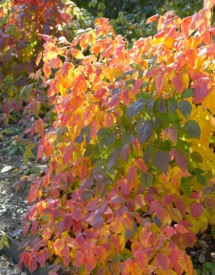
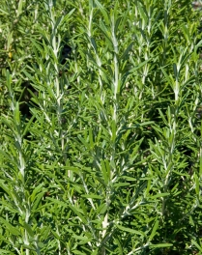
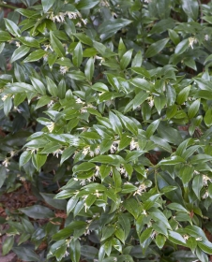
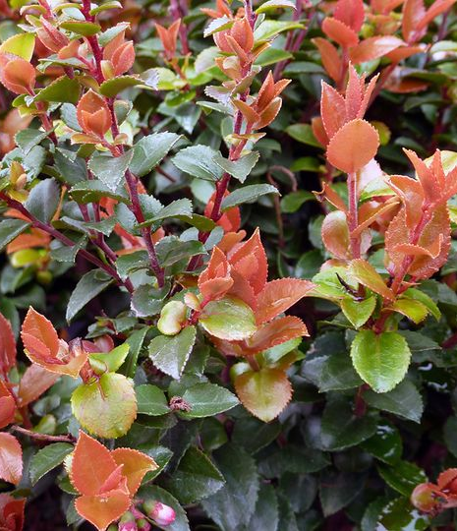
Trees and Shrubs, 7 of 7 for Drought-resistant Gardens
Rhus aromatica 'Gro-Low' (Gro-Low Fragrant Sumac), #107
Rosmarinus officinalis 'Barbecuie' (Rosemary), #110
Sarcococca ruscifolia (Sweet Box), #118
Vaccinium ovatum 'Scarlet Ovation' (Evergreen Huckleberry), #137
#107
#110
#118
#137
Source: Monrovia

Slide 23




Forbs, 1 of 8 for Drought-resistant Gardens
Achillea millefolium 'Red Velvet' (Red Velvet Yarrow), #1
Agastache 'Blue Boa' (Hummingbird Mint), #3
Alyssum/Aurinia saxatile 'Gold Ball' (Basket of Gold), #7
Anacyclus depressus 'Silver Kisses' (Mt. Atlas Daisy), #8
#1
#3
#7
#8
Source: Monrovia

Slide 24




Forbs, 2 of 8 for Drought-resistant Gardens
Arabis blepharophylla 'Spring Charm' (Purple Rock Cress), #11
Armeria maritima (Sea Thrift), #15
Cerastium tomentosum (Snow-in-Summer), #38
Coreopsis x 'Red Elf' (Lil' Bang Red Elf Tickseed), #43
#11
#15
#38
#43
Source: Blooming Nursery

Slide 25




Forbs, 3 of 8 for Drought-resistant Gardens
Delosperma cooperi (Cooper's Ice Plant), #51
Dianthus deltoides 'Flashing Lights' (Garden Pinks), #52
Erigeron glaucus 'Sea Breeze' (Seaside Daisy, Fleabane), #56
Erysimum 'Apricot Twist (Shrubby Wallflowers), #58
#51
#52
#56
#58
Source: Monrovia

Slide 26




Forbs, 4 of 8 for Drought-resistant Gardens
Euphorbia x martini 'Ascot Rainbow' (Spurge), #60
Gaura lindheimeri 'Rosy Jane' (Wand Flower), #65
Helianthemum 'Ben Fhada' (Yellow Sun Rose), #70
Iberis sempervirens 'Snowflake' (Candytuft), #74
#60
#65
#70
#74
Source: Monrovia

Slide 27




Forbs, 5 of 8 for Drought-resistant Gardens
Kniphofia 'Fire Dance' (Red-hot Poker), #77
Leucanthemum 'Snowcap' (Dwarf Shasta Daisy), #80
Penstemon strictus 'Rocky Mountain' (Beard Tongue), #97
Perovskia atriplicifolia 'Little Spire' (Russian Sage), #98
#77
#80
#97
#98
Source: Monrovia

Slide 28




Forbs, 6 of 8 for Drought-resistant Gardens
Salvia nemorosa 'Caradonna' (Meadow Sage), #114
Santolina chamaecyparissus (Lavender Cotton), #115
Santolina 'Lemon Fizz (Gold-leaf Santolina), #116
Stokesia laevis 'Color Wheel' (Stoke's Aster), #130
#114
#115
#116
#130
Source: Monrovia

Slide 29




Forbs, 7 of 8 for Drought-resistant Gardens
Sedum divergens (Yellow-flower Mounding Stonecrop), #119
Sedum spathulifolium 'Cape Blanco' (Silver Creeping Stonecrop), #121
Sedum spectabile 'Autumn Joy' (Upright Stonecrop), #122
Sempervivum arach. tomentosum (Hens & Chicks), #123
#119
#121
#122
#123
Source: Monrovia

Slide 30




Forbs, 8 of 8 for Drought-resistant Gardens
Teucrium chamaedrys 'Nanum' (Germander), #133
Thymus vulgaris 'Silver Posie' (Upright Thyme), #134
Thymus x citriodorus 'Archer's Gold' (Yellow Creeping Thyme), #135
Waldsteinia ternata (Siberian Barren Strawberry), #139
#133
#134
#135
#139
Source: Blooming Nursery

Slide 31




Grass and Grass-like for Drought-resistant Gardens
Carex testacea (Orange Sedge), #33
Cytisus x praecox 'Allgold' (Allgold Broom), #50
Nassella/Stipa tenuissima (Mexican Feather Grass), #91
Pennisetum alopecuroides 'Hameln' (Fountain Grass), #96
#33
#50
#91
#96
Source: Monrovia

Slide 32


Design Principles for Inviting Landscape
Maximize and optimize sensory experience
through the applications of design principles:
Line, shape, form, space, enclosure
Texture, color, variety, contrast/similarity
Focal, emphasis, dominance, layering, sequencing
Order, scale/proportion, balance, unity/harmony

Slide 33



Line, Shape and Form
When lines converge and enclose, they form 2-D shapes.
Form is the 3-D mass of the shape that encloses a space. Most design themes are strongly related to two fundamental forms: circles and square.
Notes:
33

Slide 34


Texture and Color
Texture refers to how fine, coarse, bold, or rough a surface is. It adds interest and variety.
Coarse texture dominates and attracts the eye. Fine texture unifies and exaggerates distance.
Notes:
34

Slide 35



Focal, Emphasis, and Dominance
Use a focal element to contrast with adjacent elements. It draws attention and helps move the eye around the space.
Allow a prominent element in a composition to establish a sense of unity in that all other, smaller elements appear secondary to it, hence unified by common subordination.
Notes:
35

Slide 36


Layering
Make planting design more effective by doing it in layers, both horizontally and vertically, imitating the stories in natural settings. When some plants are obscured by others, it creates depth.
Also important to establish
dominance and subordination
Notes:
36

Slide 37


Sequencing with Texture
Leaf size of adjacent plants should vary by at least 50% or 200%.
In plant grouping, use proportionally more fine-textured plants than coarse-textured ones. Place the coarse ones more toward the back (farther away).
Notes:
37

Slide 38



Sequencing with Colors
Treat darkest shade (most intense) as focal point, therefore fewer in number.
Use proportionally more (at least 1/3 more) in lighter shade, and place them in interlocking kidney shape.
Use 1/3:2/3 ratio (instead of 1/2:1/2) in monochrome or complementary contrasts.
Notes:
38

Slide 39


Balance by Symmetry or Asymmetry
A symmetrical design arranges elements equally around the axes. It makes various portions in equilibrium and provides a powerful design theme with a formal character.
An asymmetrical design achieves the balance by equal visual weight of the design using non-equivalent elements on either side of an axis.
Notes:
39

Slide 40


Harmony from Sameness
Compose the whole landscape with intimately similar parts or forms in their simplest shapes.
Notes:
40

Slide 41


Harmony from Simplicity
Reduce or eliminate non-essential elements.
Notes:
41

Slide 42


Movements
Create movements from lines, plant branching patterns, wind, or water flow. Straight lines cause, direct, forced, and quick movement, whereas curved lines lead the eye and create mystery.
Notes:
42

Slide 43


Unity by Repetition and Massing
Achieve unity by using similar elements (size, shape, value, or texture) through design composition.
Lack of repetition results in visual chaos due to no relationship among elements. But too much repetition can be monotonous or even boring.
Notes:
43

Slide 44







Closing Comments, Q&A
Everett Chu
Azusa Farm and Gardens, Mount Vernon
360-424-1580, everett@azusafarm.com
See our Purposeful-garden Display at SICBA Home and Garden Show
March 23-25, 2018

