Slide 1
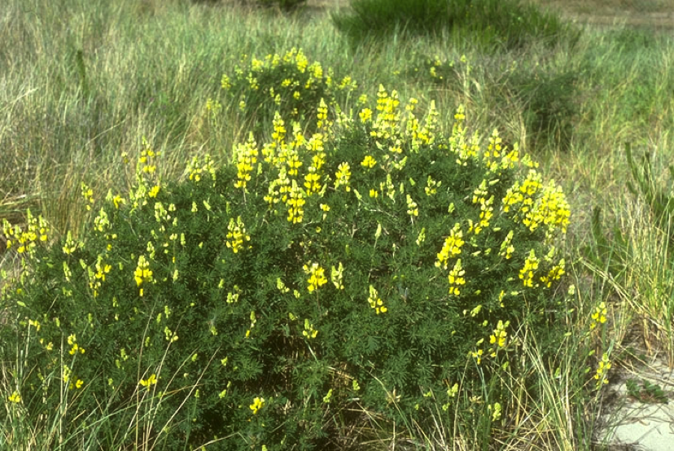
Effects of Global Change on Plant-herbivore Interactions

Slide 2
What is “global change”?
Increased atmospheric CO₂
(and methane to some extent),
due to human activities,
primarily from the burning of fossil fuels
(and cow farts)

Slide 3
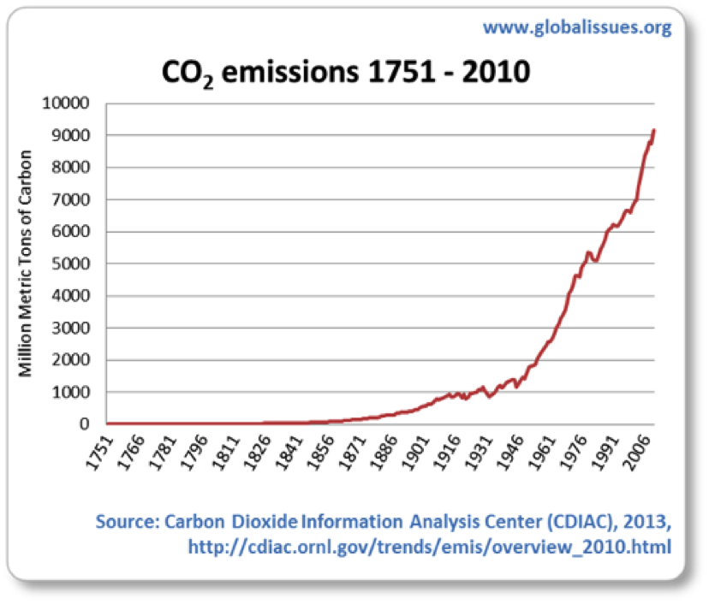
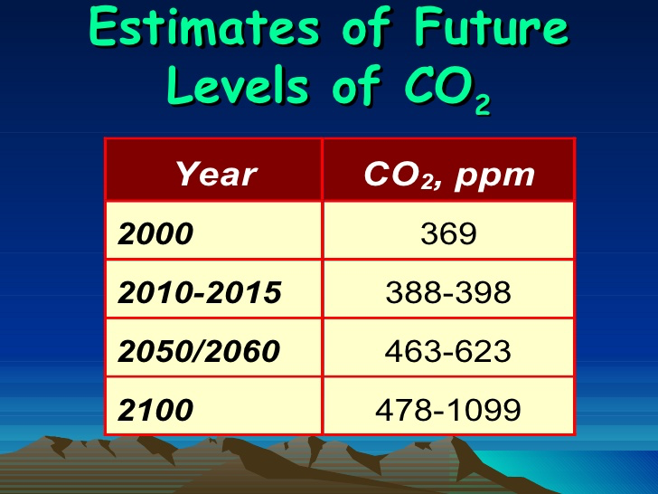
Changes in CO₂
November 16, 2018 = 409 ppm

Slide 4
Cascading effects
When we try to pick out anything by itself, we find it hitched to everything else in the Universe.
John Muir

Slide 5
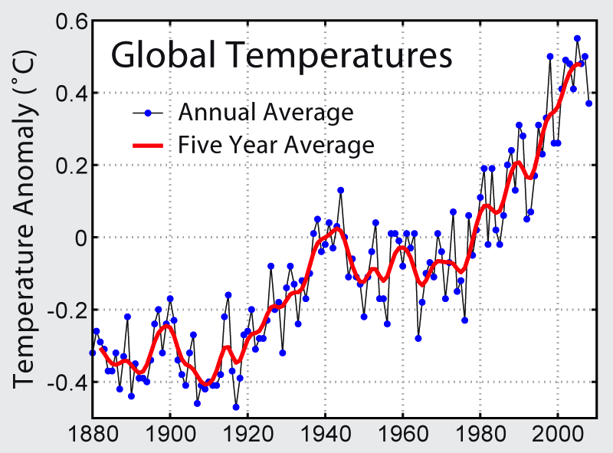
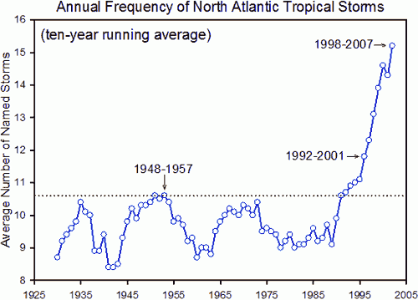
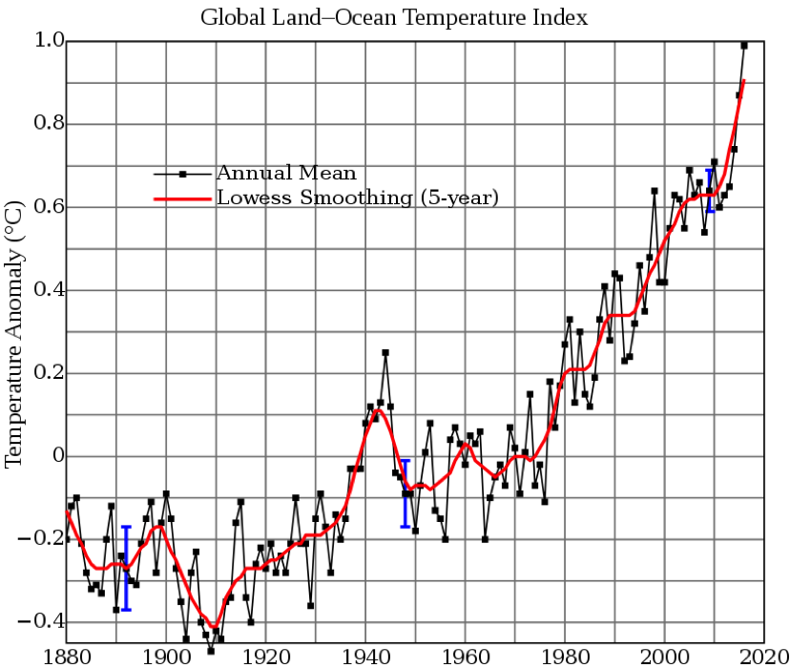
Cascading effects: Global warming
Climate changes
Surface temperatures
Storm frequency
Sea level rise

Slide 6
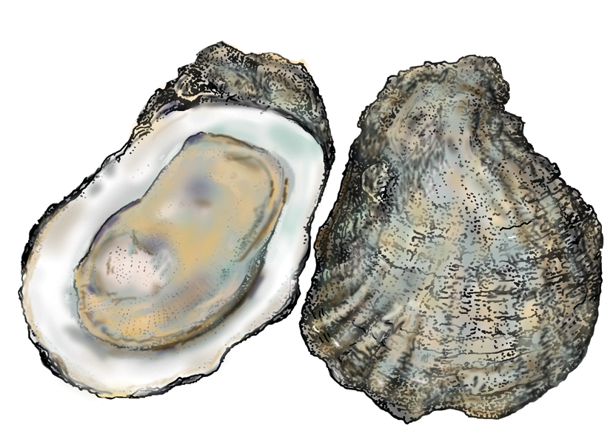
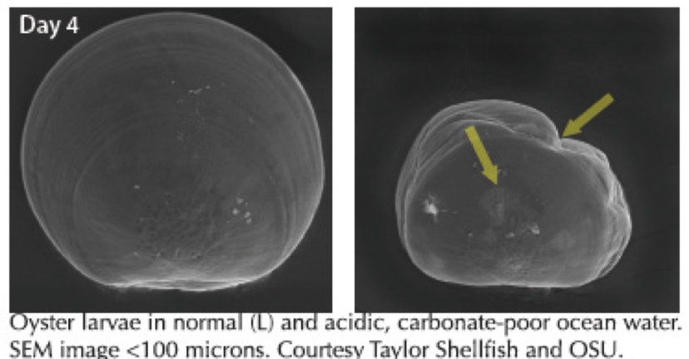
Cascading effects: Ocean acidification

Slide 7
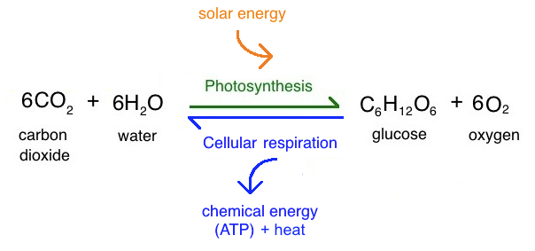
Cascading effects: Photosynthesis

Slide 8
Cascading effects: Nitrogen Fixation

Slide 9
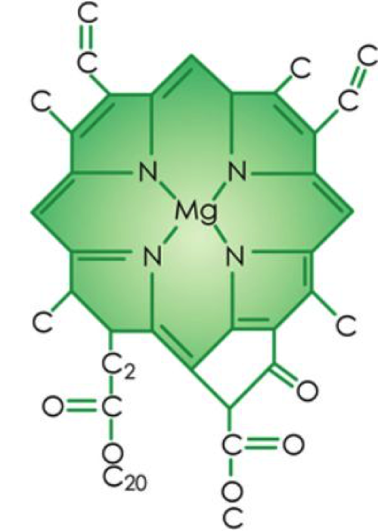
Nitrogen is important to all life
Proteins
Chlorophyll

Slide 10
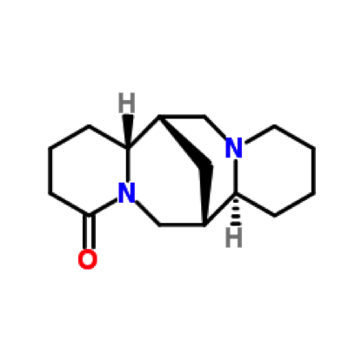
So, what about lupines?
Nitrogen fixing legume
Contain alkaloids
Bitter or poisonous to herbivores

Slide 11
Research questions
Does increased atmospheric CO₂ have any effect on nitrogen fixation?
If so, what effects does that have on the nitrogen distribution in the plant?
Changes in protein?
Changes in chlorophyll?
Changes in alkaloids?
How would these changes affect the herbivores feeding on the plant?

Slide 12
Experimental design
Grew Lupinus arboreus in the Phytotron at Duke University
Three nutrient treatments
High N
Low N
Inoculated with Bradyrhizobium
Three CO₂ concentrations
350 ppm
500 ppm
650 ppm

Slide 13
Results

Slide 14
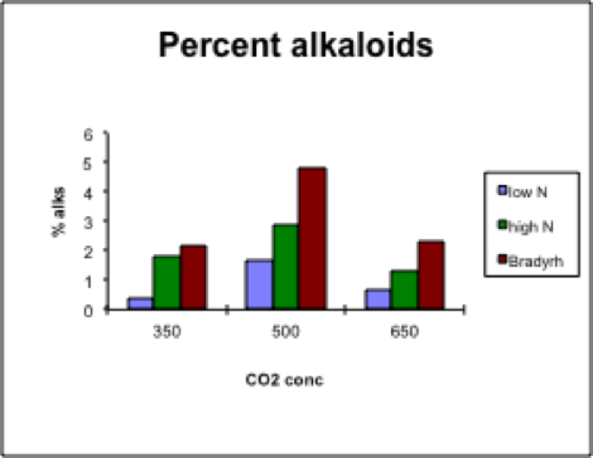
Results

Slide 15
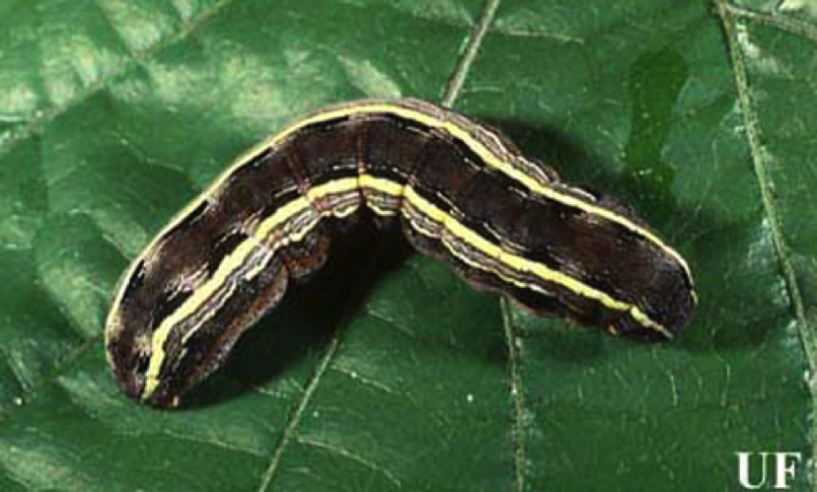
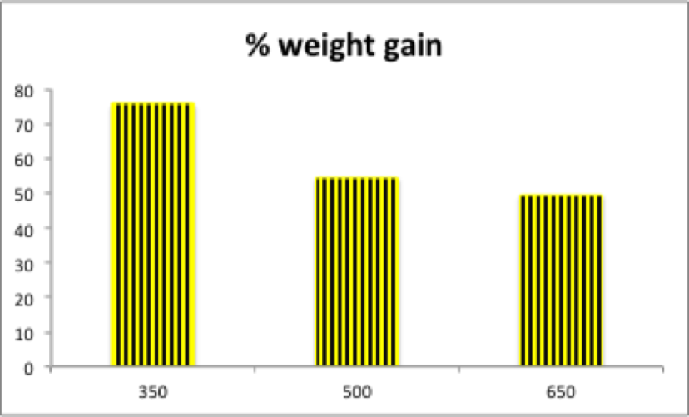
Insect experiments
Army worm larvae (Spodoptera) were fed foliage from innoculated plants grown at 350, 500, and 650 ppm CO₂

Slide 16
One more cascading effect
Pasture grasses do NOT fix nitrogen
Elevated CO₂ does result in higher photosynthesis
BUT
More C without more N
➔ lower quality forage
➔ cows must eat more to get the same amount of nitrogen
➔ lower yields for the farmer

Slide 17
Conclusions
Elevated CO₂ is like chocolate cake (for nitrogen-fixing plants)
350 ppm is good
500 is even better
But 650 is too much of a good thing
Elevated CO₂ is not so great for herbivores

Slide 18
The future = our choice and our ACTIONS…

Slide 19
Union of Concerned Scientists https://ucsusa.org
Minimize Carbon-emitting Input
Power tools
Artificial fertilizers
Don’t leave garden soil naked
Cover crops – “winter blankets”
Mulch – from cover crops or added compost
Plant trees and shrubs
Store carbon
Shade can reduce surface temperatures
Produce home-grown veggies
Reduce transportation emissions
Better quality soil
Expand recycling to the garden
Enriches soil while also storing carbon
Landfills release methane
Think long and hard about your lawn
Minimize fertilizing - leave grass clippings on the lawn
Mow high for healthy roots (more biomass, less water)

