Slide 1
Tomatoes from Seed to Harvest

Slide 2
Topics we’ll cover
Germinating Seeds
Raising Sturdy Seedlings
Transplanting Seedlings
Training Tomato Plants
Selecting Tomato Varieties
Preserving Tomatoes

Slide 3
Seed Room Exterior

Slide 4
Germinating Seeds
Goal: quick germination
To accomplish goal: soil, heat, moisture

Slide 5
Potting soil

Slide 6
Heat Box

Slide 7
Water

Slide 8
Raising Sturdy Seedlings
Goal: keep plants from becoming weak and leggy
To accomplish this goal:
Use lights, timer, fan
Move starts from 2” to 4” pots as they grow

Slide 9
Lights

Slide 10
Timer

Slide 11
Oscillating Fan

Slide 12
5-7 days: two leaves

Slide 13
2 weeks: four leaves

Slide 14
2-3 weeks: move to 4-inch pots

Slide 15
5-6 weeks: harden off and transplant

Slide 16
Transplanting Seedlings
Goals: avoid transplant shock; develop good root structure
To accomplish this goal:
harden off where they’ll be planted
plant deeply
space 16-24 inches

Slide 17
Greenhouse exterior

Slide 18
Greenhouse Interior

Slide 19
Plant half way up the stem

Slide 20
Training Indeterminate Tomato Plants
Goals: take advantage of their growth habit and encourage productive, manageable growth
To accomplish this goal: about a month after transplanting, provide support, select leaders, prune
See my blog on Training Tomatoes

Slide 21
Setting up training twine

Slide 22
Tomato Training Wall

Slide 23
Tomato leaders

Slide 24
Tomato sucker

Slide 25
Removed tomato sucker

Slide 26
Trained Tomatoes

Slide 27
Wall of Tomatoes

Slide 28
Basket of Tomatoes

Slide 29
2019 Sample Tomato Timeline
Planted seeds: February 17
Seeds germinating: February 21-24
Seedlings to 4” pots: March 2
Plants to greenhouse to harden off: March 21
Planted in greenhouse: March 27
Started training tomato plants: April 27
Harvested first tomato, a sweet million cherry: July 4th

Slide 30
2020 Sample Tomato Timeline
Planted seeds: March 1
Seeds germinating: March 7
Seedlings to 4” pots: March 21
Plants to greenhouse to harden off: April 3
Planted in greenhouse: April 10
Started training tomato plants: May 10
Harvest ?

Slide 31
Seed Catalogs

Slide 32
Catalogs and Local knowledge for information and advice
Days to maturity
Determinate vs. indeterminate
Heirloom or hybrid
Type, size, color
Friends
Tomato Tastings

Slide 33
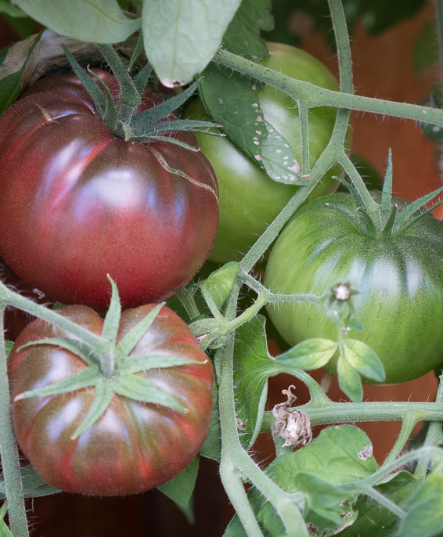
Cherokee Purple
85 days
Indeterminate
Heirloom
Purple/red
Shoulders stay green
Rich flavor, favorite of many tomato lovers
Territorial, Fedco

Slide 34
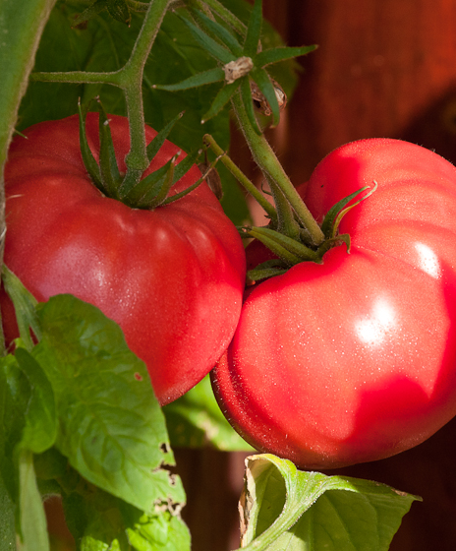
Brandywine
85 days
Indeterminate
Heirloom
Dark pink/red
Winner of many taste tests
Sweet, rich flavor
Territorial, Fedco

Slide 35
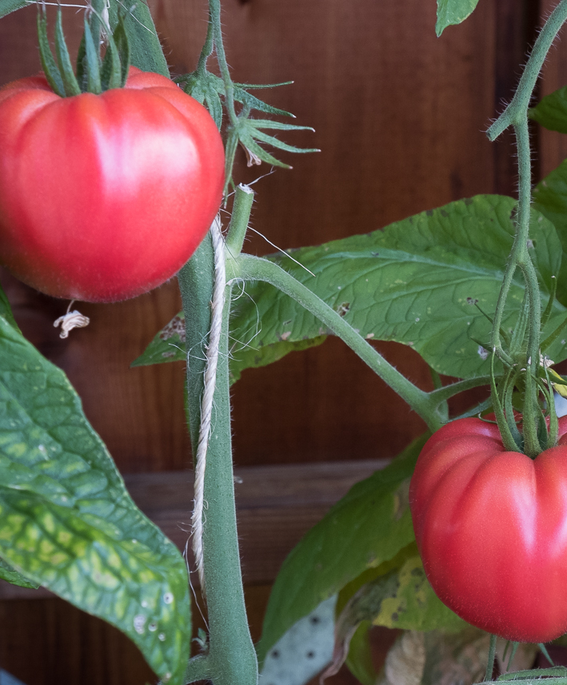
Pruden’s Purple
Indeterminate
72 days
Dark pink
1 pound
Silky texture
Sweet/tart flavor balance
Competes with Brandywine in taste tests
Fedco

Slide 36
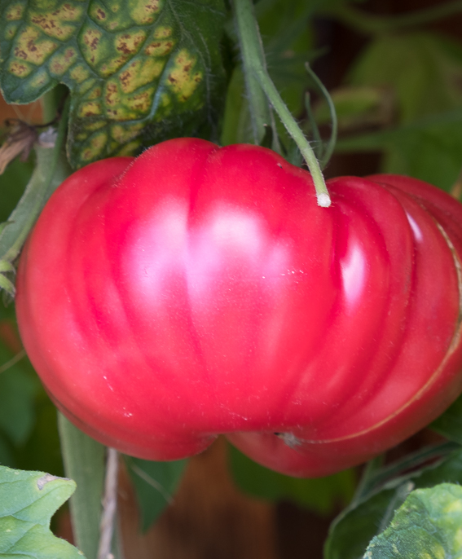
Dester
Indeterminate
Heirloom
80 days
Pink/red
Beefsteak, up to 1 pound
Winner of SSE’s 2011 Tomato Tasting
Classic sweet/acid balance
Seed Savers Exchange

Slide 37
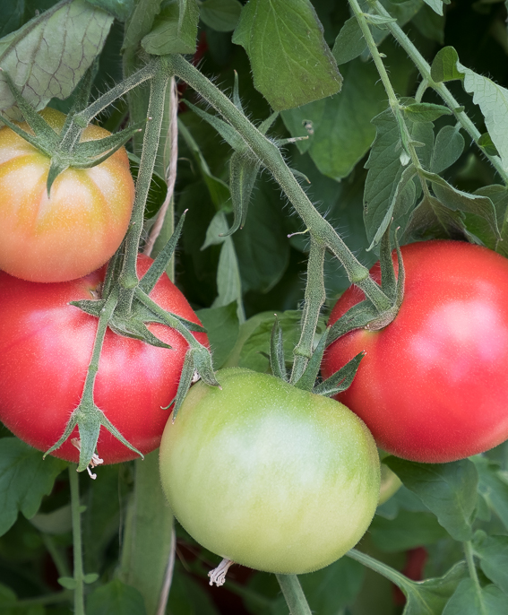
Momotaro
Indeterminate
Hybrid F1
AKA Tough Boy
70 days
Japanese
Red/pink
6-8 ounces
Rich, sweet, slightly acidic
“tastes as good as any heirloom”
Fedco, Territorial

Slide 38
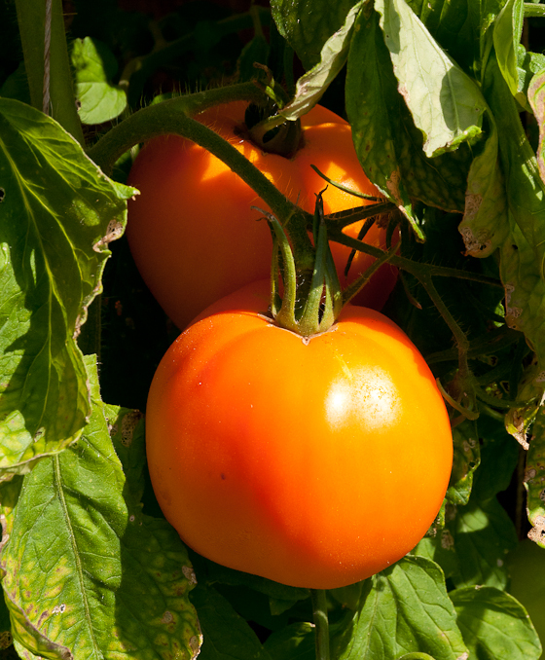
Golden Sunray
Indeterminate
AKA Golden Jubilee
80 days
Orange
8 ounce
Creamy texture
Sweet, mild, delicious
Ripens indoors at the end of the season and keeps flavor better than any tomato I know
Fedco

Slide 39
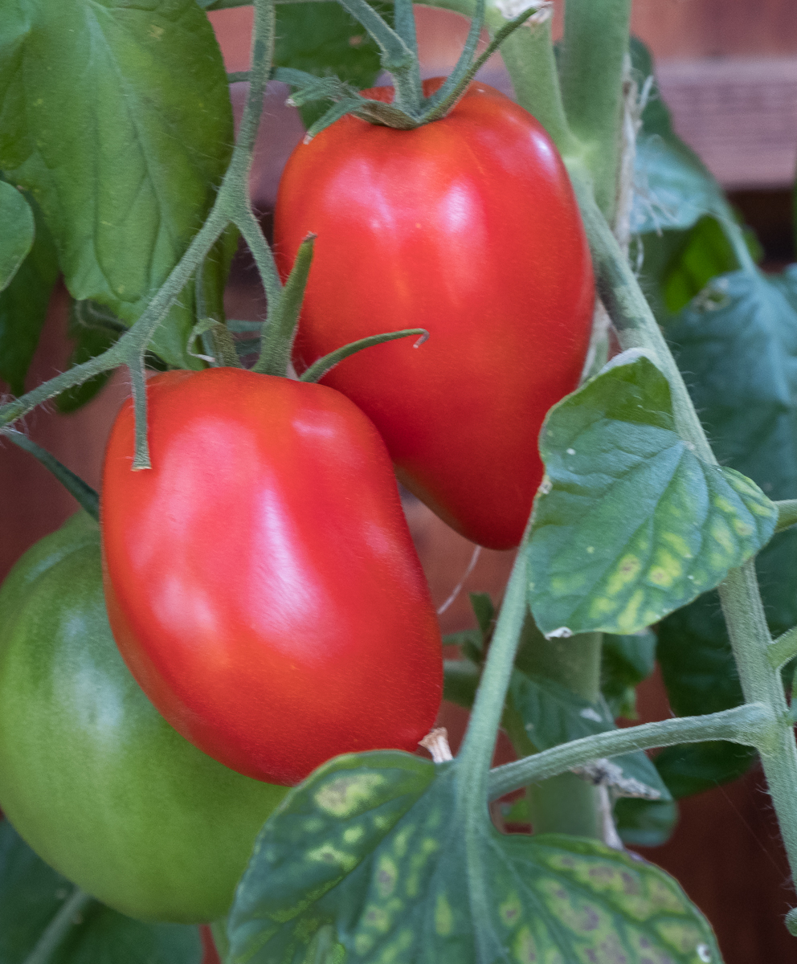
Amish Paste
Indeterminate
85 days
Heirloom
Classic tomato red
Vary in size up to 8 oz
Dense texture
Deep sweet flavor
Good fresh, dried, roasted, canned
Slow Food Ark of Taste
Fedco

Slide 40
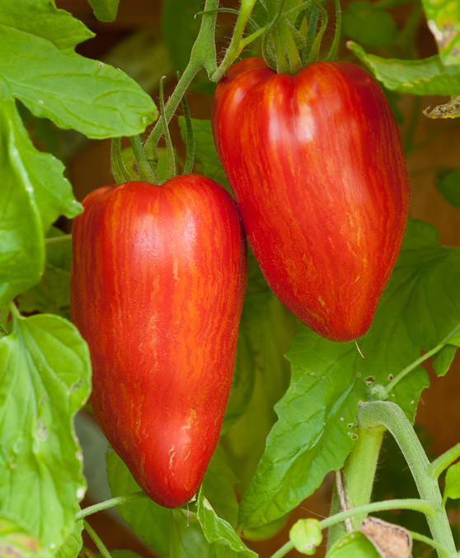
Speckled Roman
Indeterminate
AKA Striped Roman
80 days
Open pollinated
Red with yellow stripes
4-5 ounces
Dense texture
Rich, sweet tomato flavor
Good fresh, dried, roasted, sauced
Fedco, Territorial

Slide 41
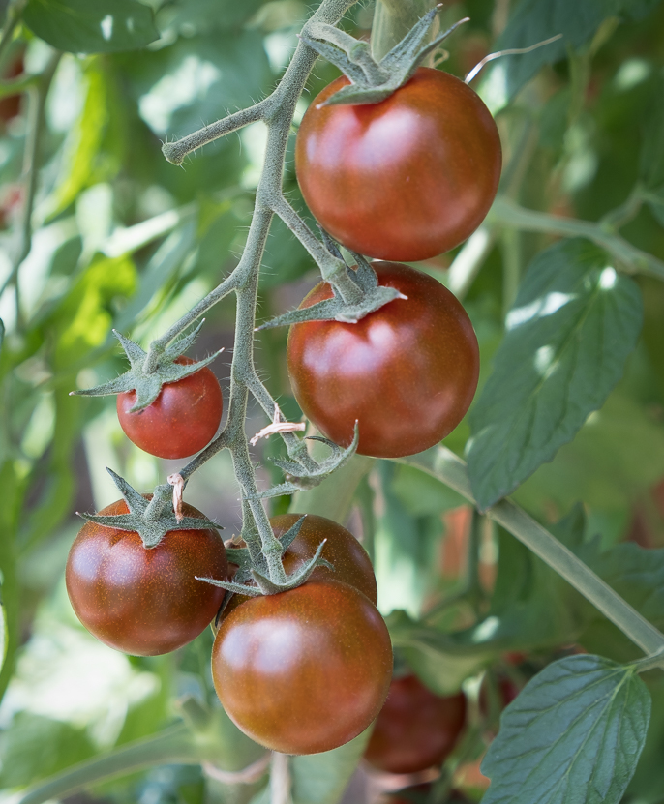
Sunchocola
Indeterminate
60 days
Hybrid F1
“Henna-colored”
1 ¼ inch
Open Trusses of fruit
Tastes like Cherokee purple
“sweet, slightly smoky, low acid”
Territorial

Slide 42
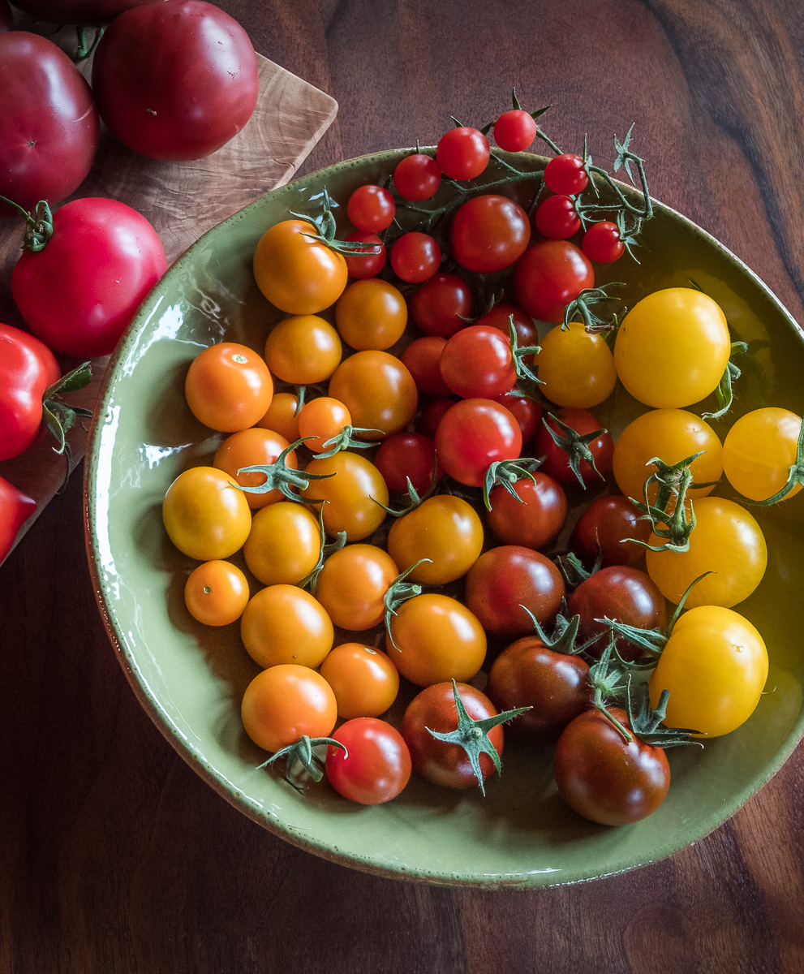
Orange Paruche
Indeterminate
67 days
Hybrid FI
Bright orange
1-inch round
Branched trusses
Taste test winner
One of my favorite cherry tomatoes for sweet flavor, color and productivity
Territorial

Slide 43
Preserving tomatoes
Roasting
Drying

Slide 44
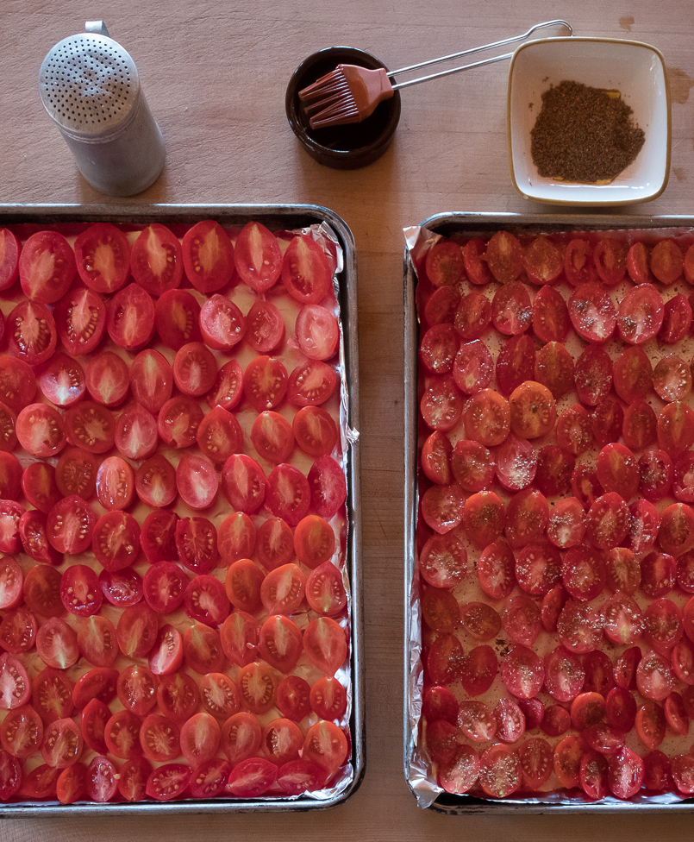
Roasting Tomatoes
Fiaschetto de Manduria
Aosta Valley
Slice in half
Place on foil-lined pans
Brush with Olive oil
Sprinkle with salt and ground coriander
Roast at 200 degrees for 4-6 hours
Pack in jars and freeze

Slide 45
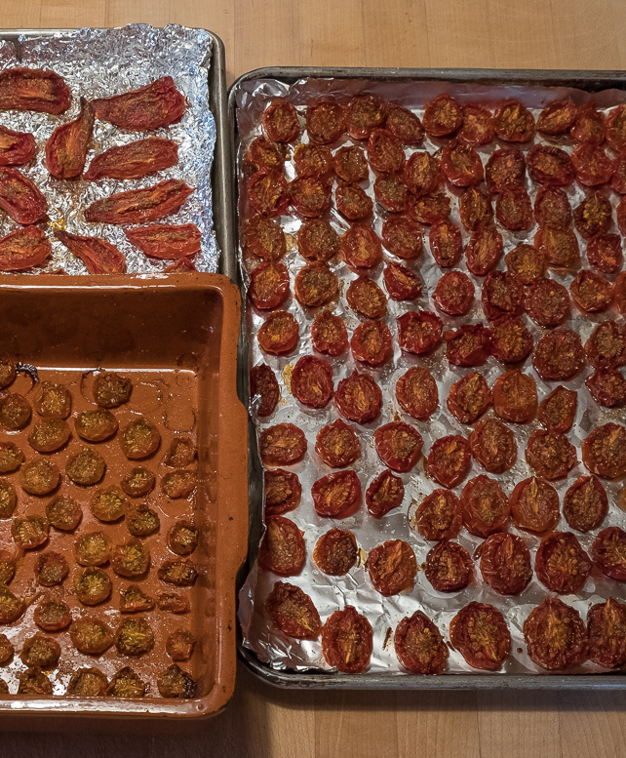
Roasted Tomatoes
They are done when they are no longer giving off juice

Slide 46
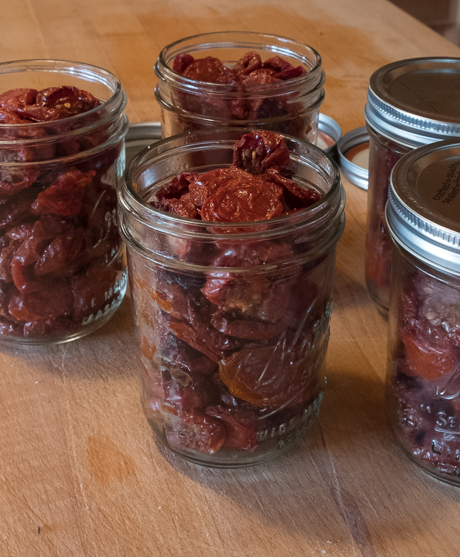
Roasted Tomatoes
They freeze beautifully
Thaw and use as is or puree in Cuisinart for tomato sauce

Slide 47
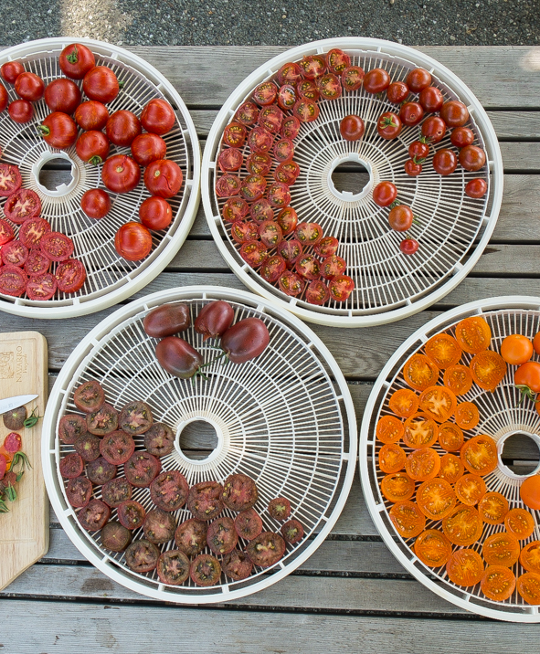
Drying Tomatoes
Cherry or plum tomatoes dry beautifully
Dehydrator to about 130 degrees
NESCO Gardenmaster food dehydrator model FD 1010
Start checking for dryness after 6 hours

Slide 48
Dried Tomatoes
They are ready when they are dry to the touch
Eat as is or rehydrate and puree for tomato sauce

Slide 49
Dried Tomatoes in Jars

