Slide 1
Growing Vegetable Crops for Seed
Carol Miles, Department of Horticulture
http://vegetables.wsu.edu

Slide 2
Topics Discussed
Pollination considerations
General growing practices
Crops easy to save seed
Crops cautious to save seed
Seed harvest and cleaning
Seed storage

Slide 3
Pollination
Self pollinated – perfect flowers contain male and female parts, use own pollen. Easy to save seed, e.g., Fabacea
Cross pollinated – require bees, insects or wind to transmit pollen. Avoid pollen contamination, so difficult to save seed, e.g., Brassicas, Cucurbits, Lilliaceae
Open pollinated (OP) – can be either cross-pollinated or self-pollinated crops
Heirloom (H) 50+ years of cultural heritage
Hybrid (F1) cross between 2 parents, seed saved not true to type

Slide 4
Open Pollinated

Slide 5
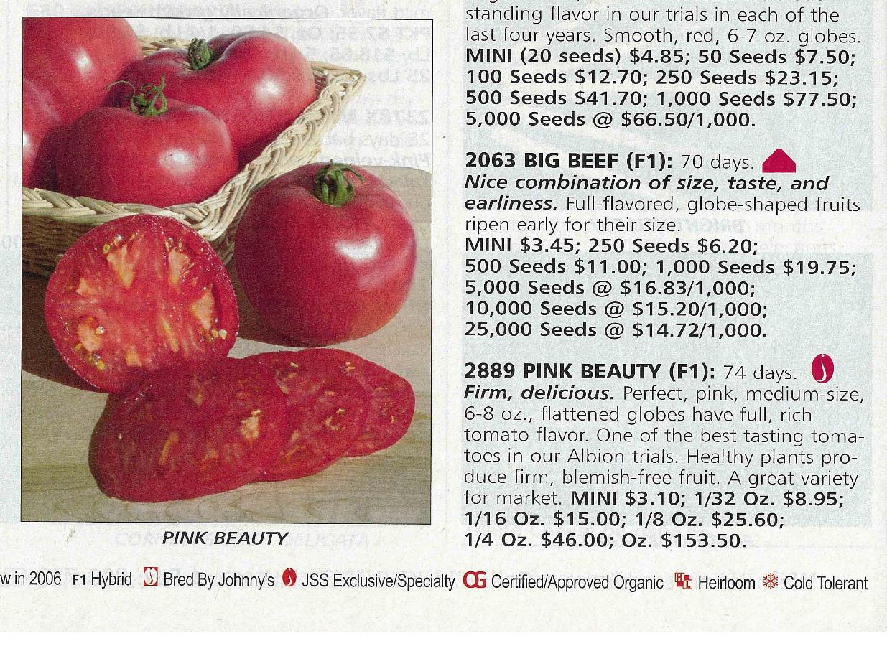
Hybrid F1

Slide 6
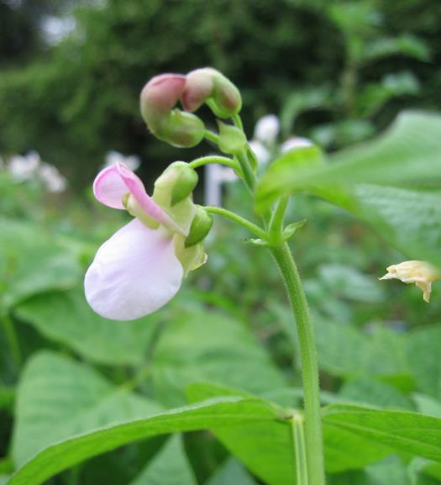
Crop Pollination
Self-pollinated crops
bean soybean / edamame
lettuce tomato
pea
Cross-pollinated crops
beet mustard
cabbage onion
carrot pepper
corn spinach
cucumber squash

Slide 7
General Growing Procedures
Transplanting – gain 3-4 weeks.
Planting schedule – just as for vegetable production.
Exception: plant biennials late summer for seed production following year.
Irrigation – regular until a few weeks prior to harvest, then stop.
Plastic mulch – warms the soil and hastens crop maturity, controls weeds, keeps large fruit clean and prevents fruit rot.

Slide 8
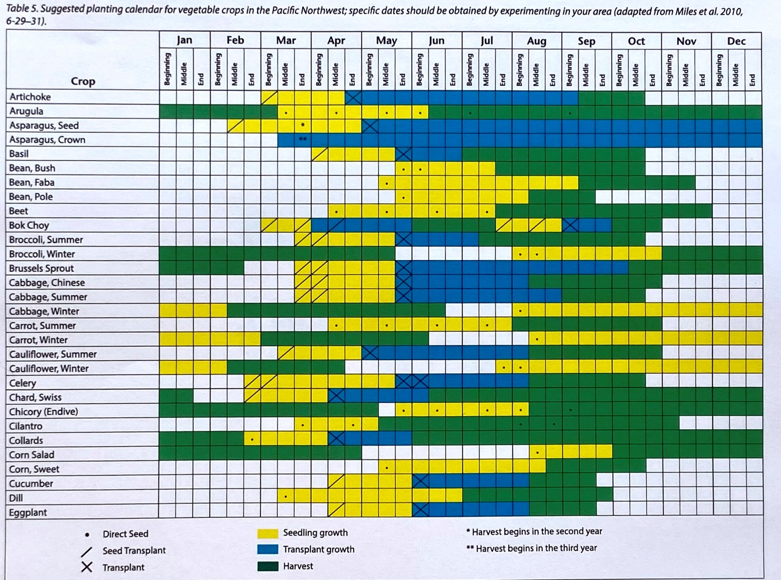
Crop Calendar
From: Home Vegetable Gardening (EM057E)
https://s3.wp.wsu.edu/uploads/sites/2709/2021/05/EM057E.pdf

Slide 9
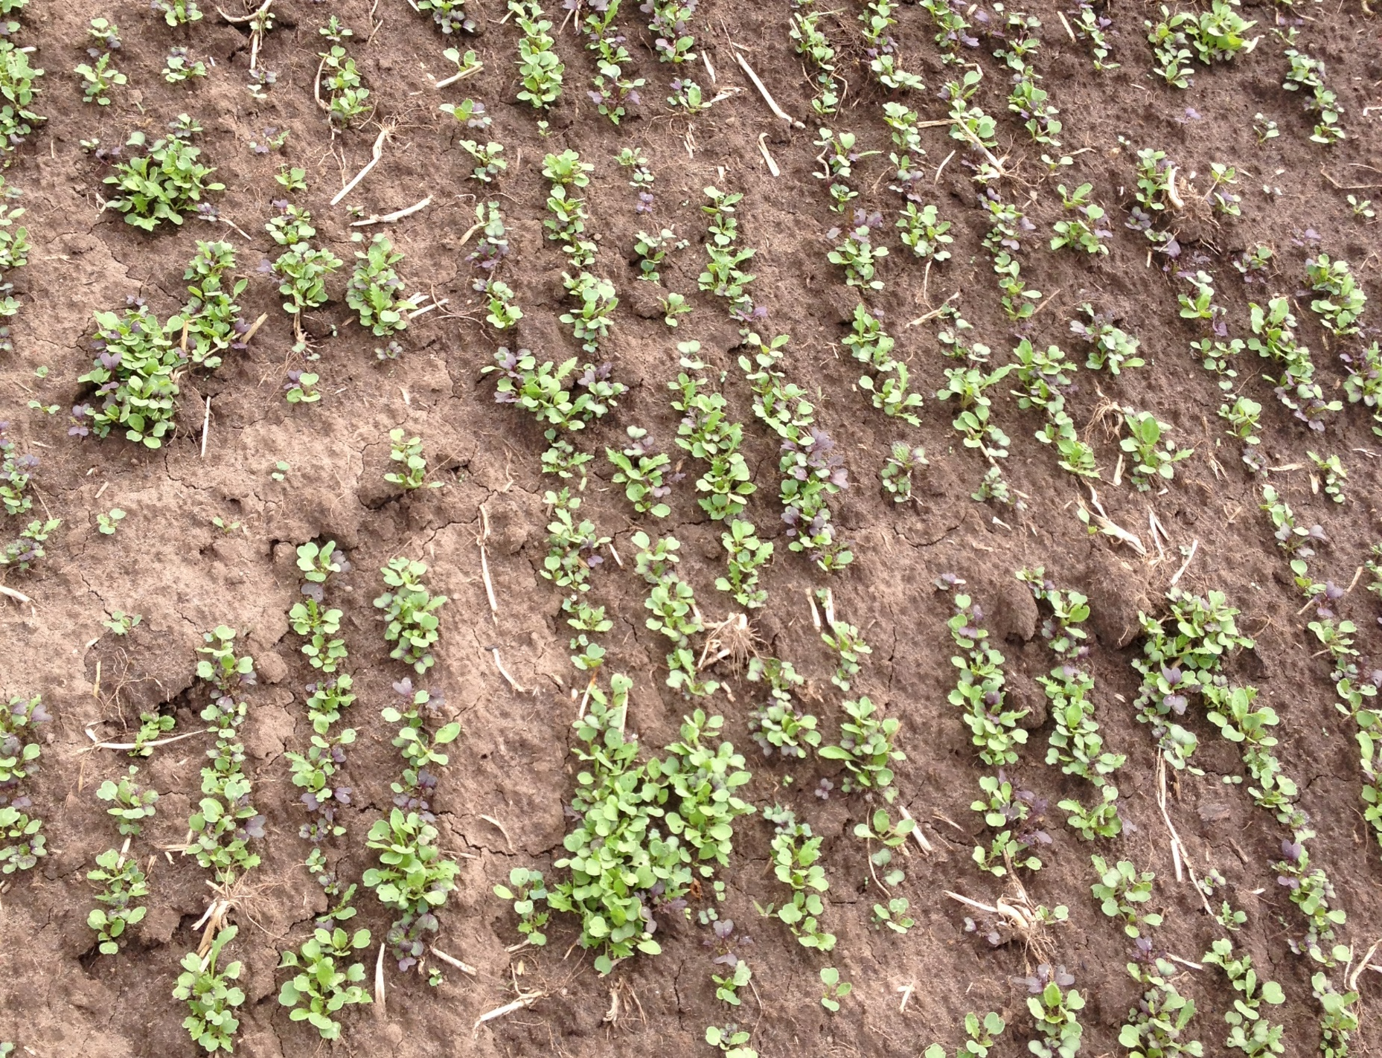
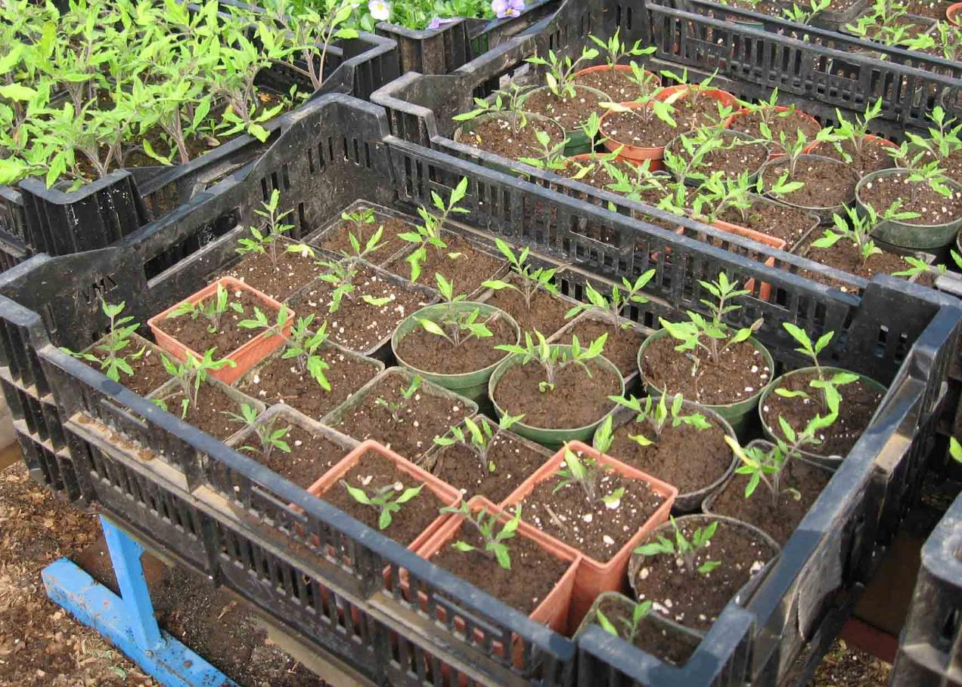
Seeding
Transplants – seed so that ready to transplant by June 1
Direct seed – root crops (radish, onion, carrot) and legumes (pea, bean)
Biennials direct seed late July: carrot, leek, onion, kale

Slide 10
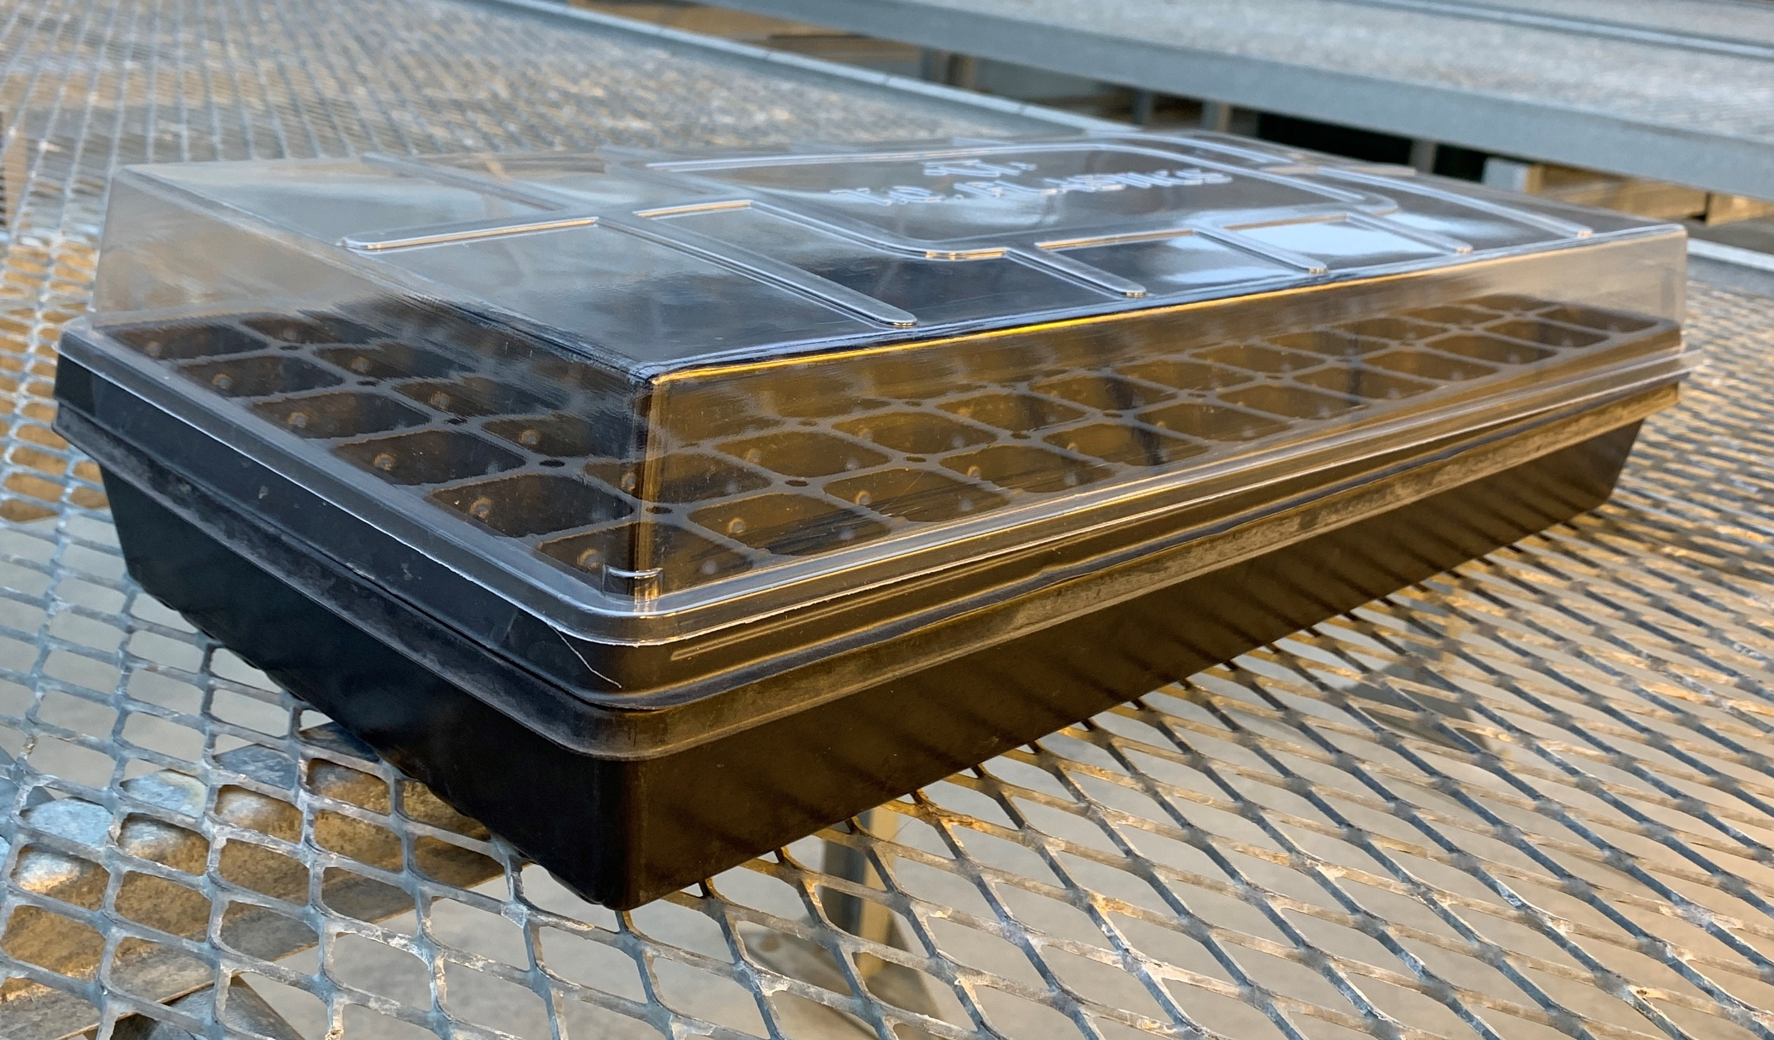
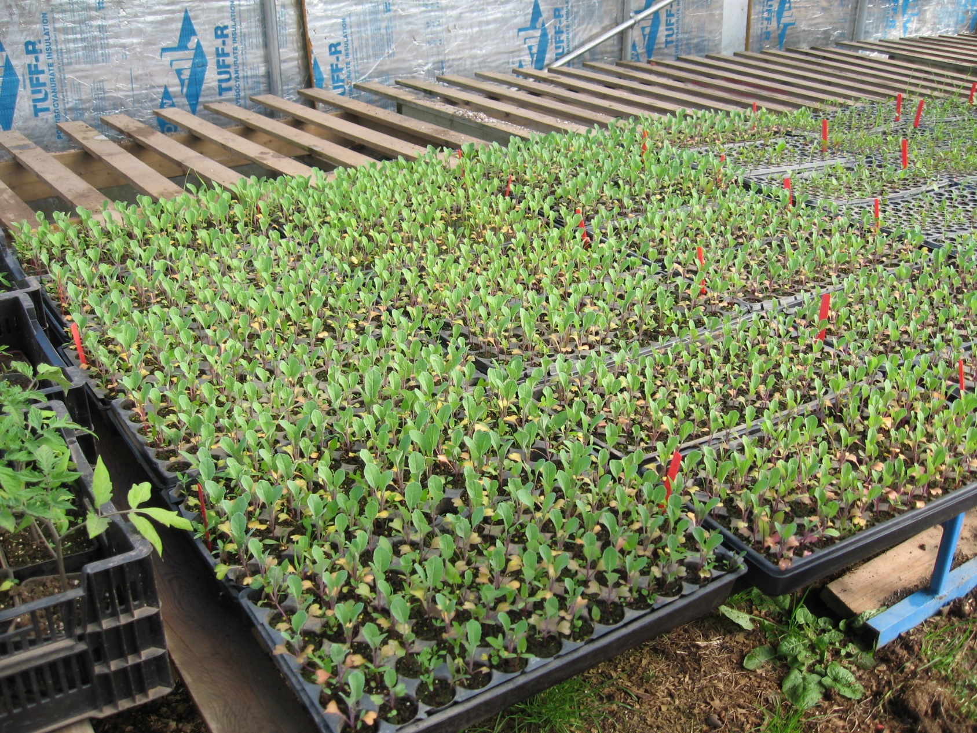
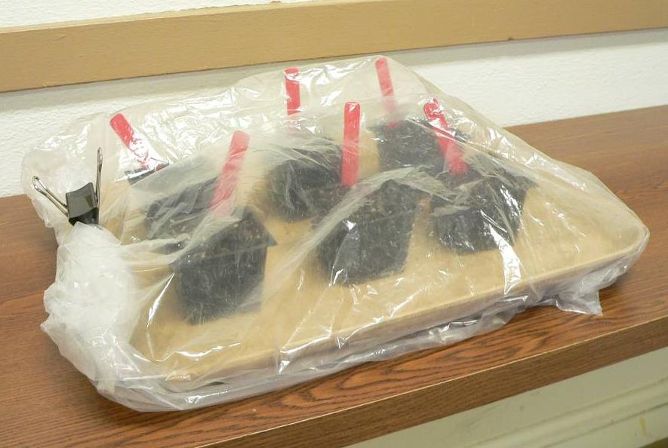
Growing Transplants

Slide 11
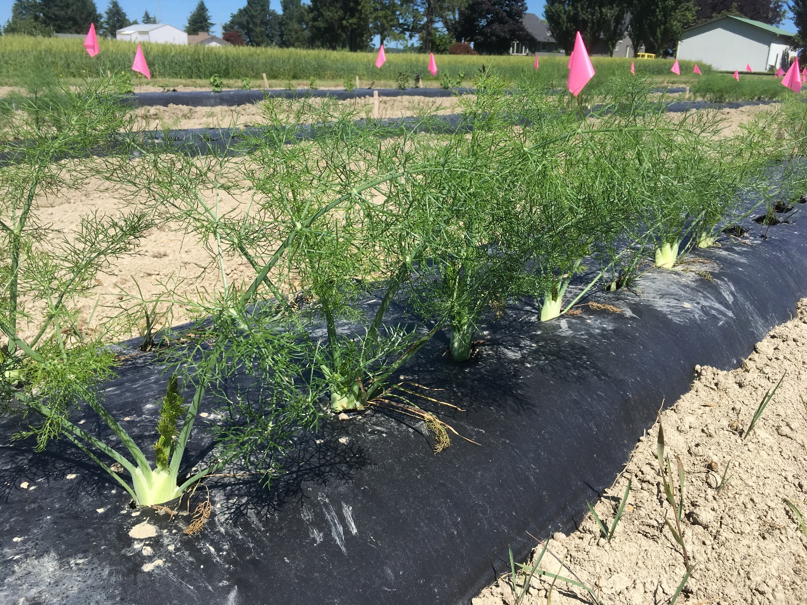
Plastic Mulch

Slide 12
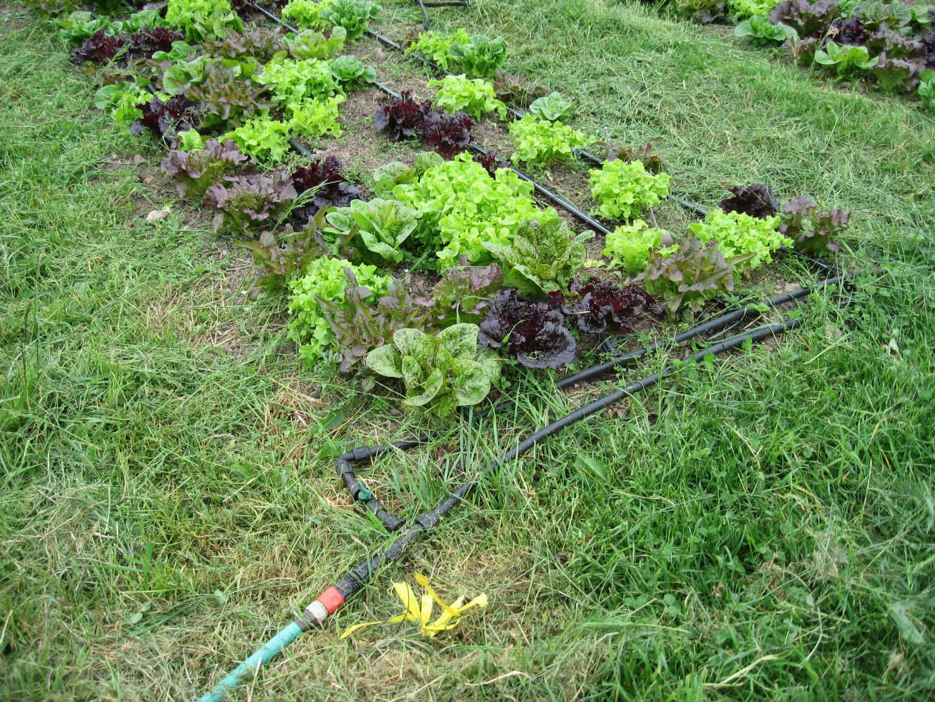
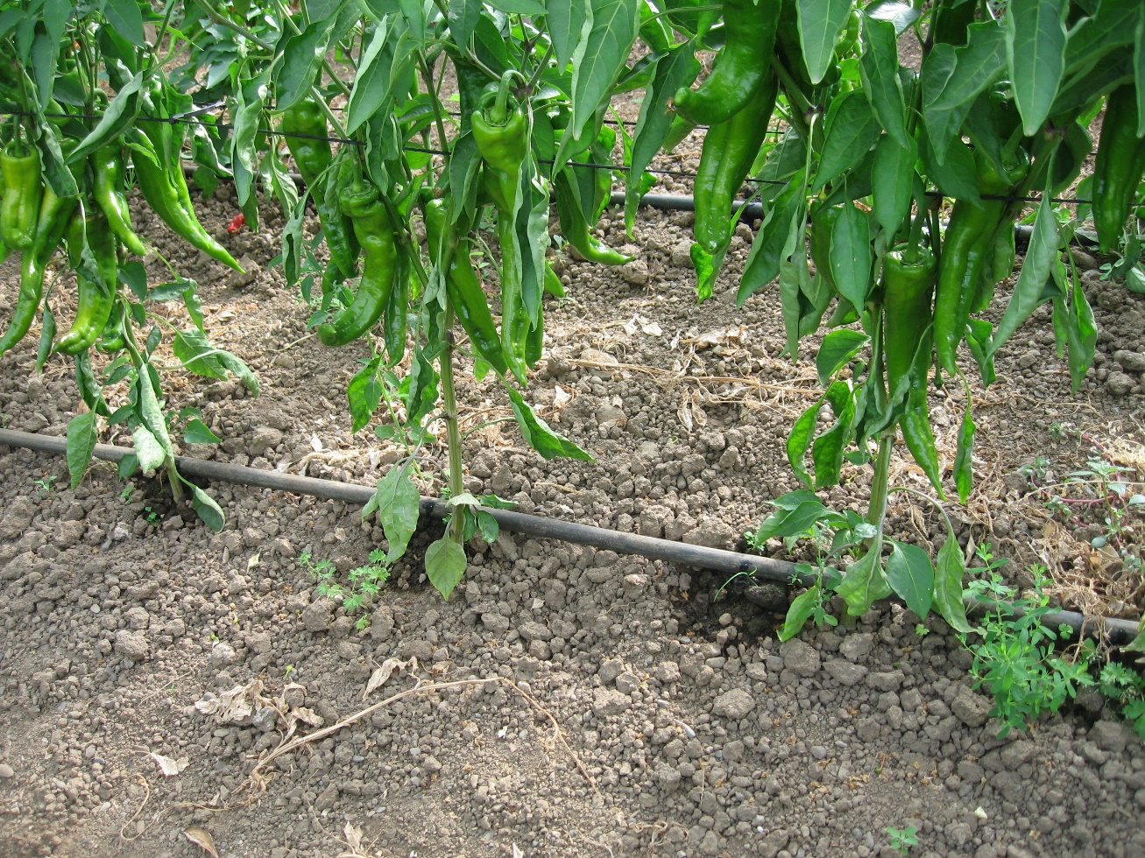
Drip Irrigation
Drip emitter lined up with plant

Slide 13
Easy Crops to Save Seed
Lettuce – flowers remain open for a few minutes.
Solanaceae Family – flowers open after pollen has been released and pollinated.
Fabaceae Family – (legumes) normally self-pollinate without bees, insects or wind.
Plant 20 feet apart to prevent cross pollination.

Slide 14
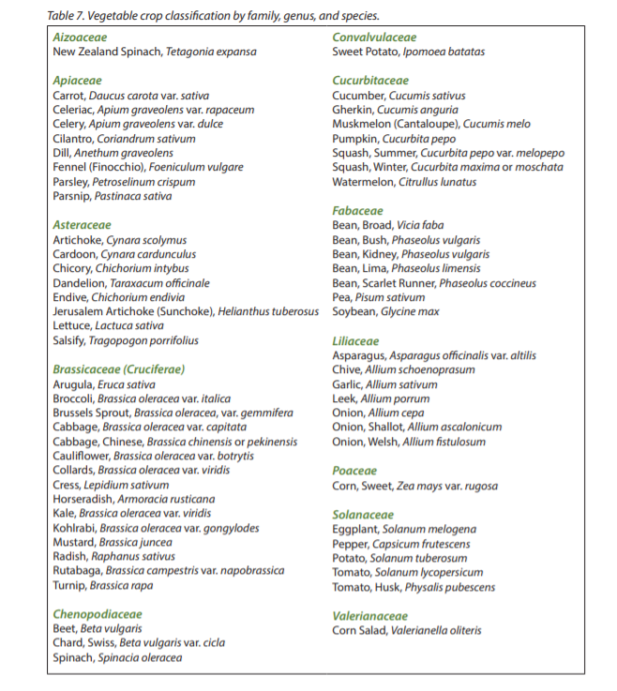
Vegetable Families
EM057E
Home Vegetable Gardening

Slide 15
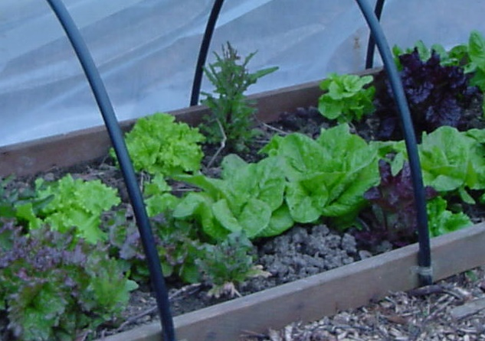
Lettuce Seed
Bolts (flower stalk emerges) under high temperature or long day
Some cultivars bolt with short day
Bolting usually occurs several weeks after peak harvest late July or early August

Slide 16
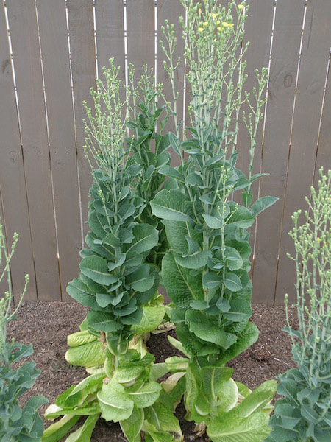
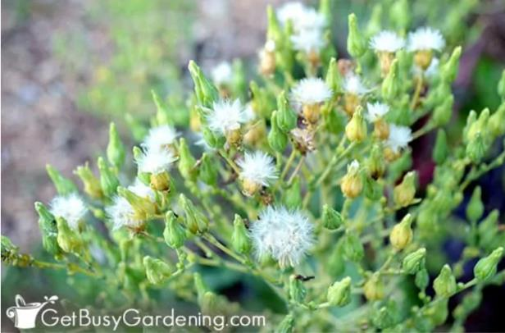
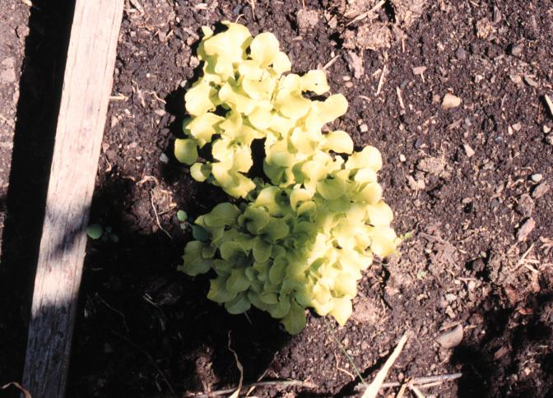
Lettuce Seed
Source: Bonnie Plants

Slide 17
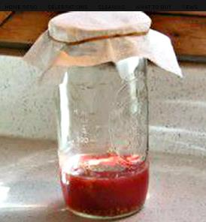
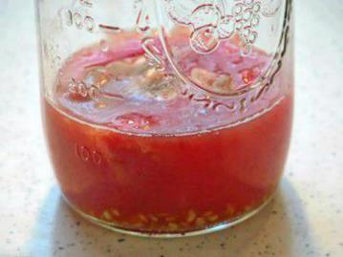
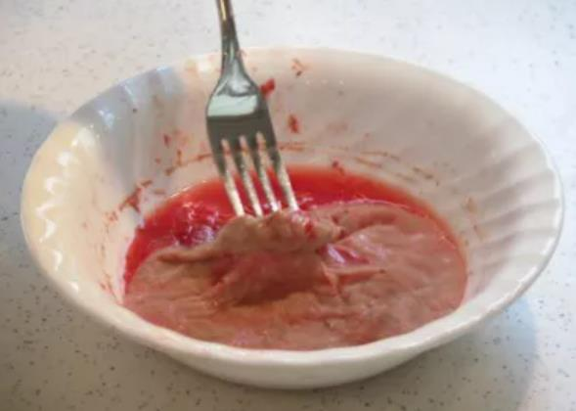
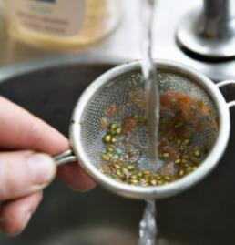
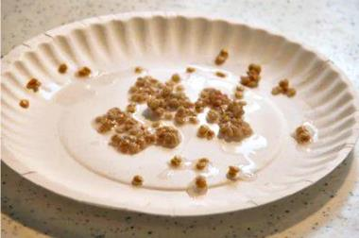
Tomato Seed
Collect fully ripe fruit, slice in half, scoop out seeds, place in clean jar, add up to 1 cup water if needed to float seed, cover top with cheesecloth or paper towel.
Place jar in warm spot to ferment to remove gel-like sack that contains growth inhibitors that prevent seeds from sprouting inside the tomato.
Fermentation in 2–4 days, layer of mold forms on top, smells bad. Done when bubbles start rising and seeds settle to bottom, do not leave longer or seeds may germinate.
Lift and remove mold layer, add water to jar and shake, pour through strainer and rinse to remove solids.
Spread seeds on paper plate to dry, will stick to paper towels or sheets. Place in warm spot, stir to prevent sticking.
Source: The Spruce

Slide 18
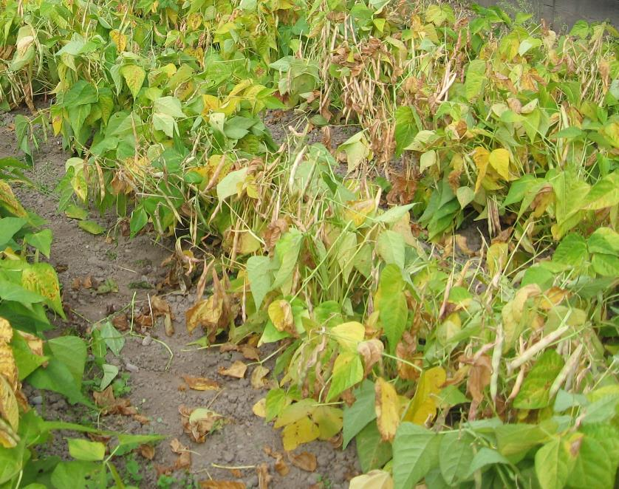
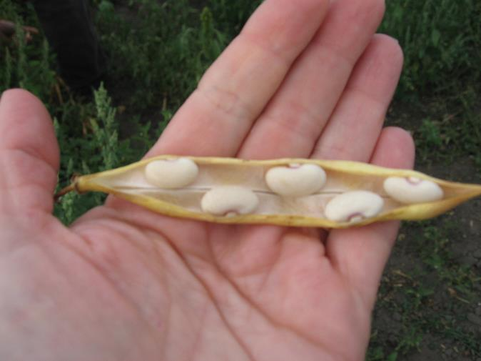
Beans

Slide 19
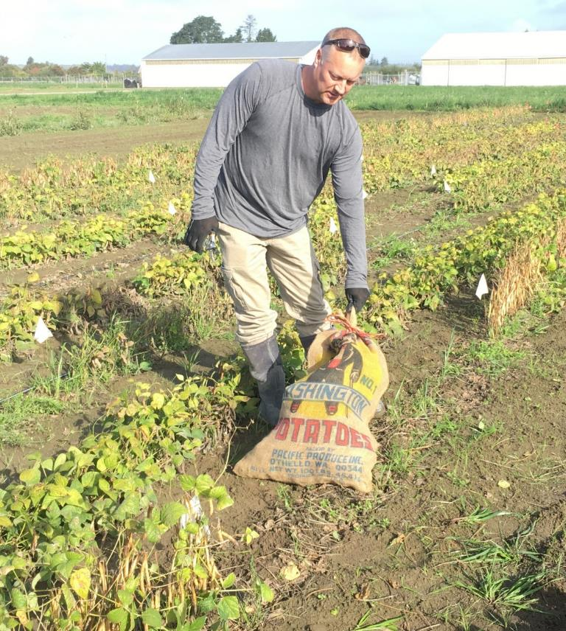
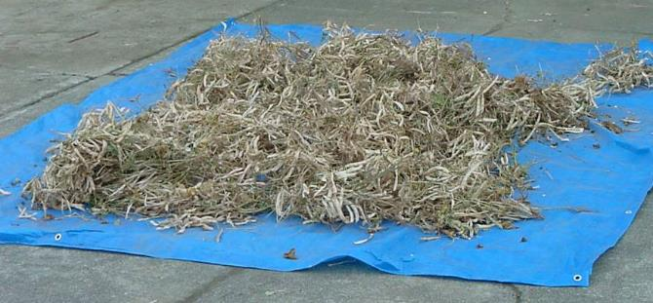
Harvesting and Drying
Dry in hot sunny place (concrete driveway)
Turn plants a few times per day to prevent mold on bottom of pile
Move inside if rain

Slide 20
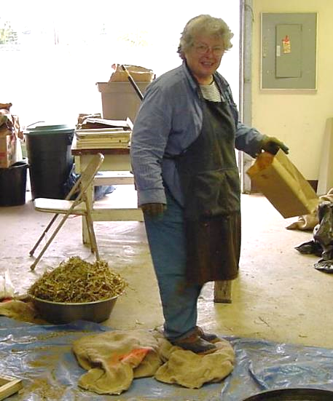
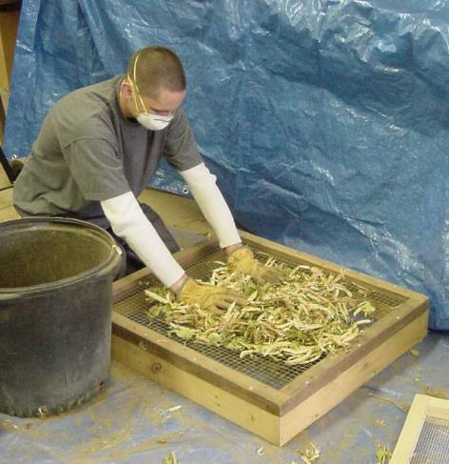
Threshing

Slide 21
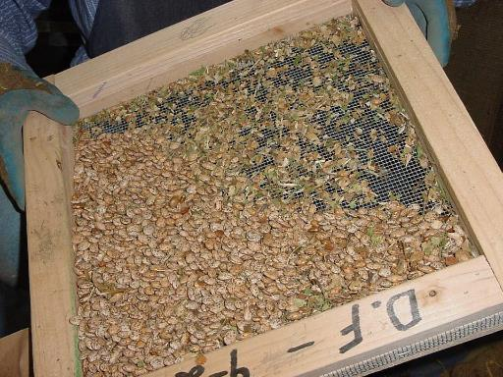
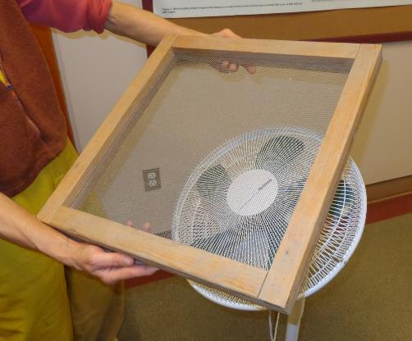
Cleaning

Slide 22
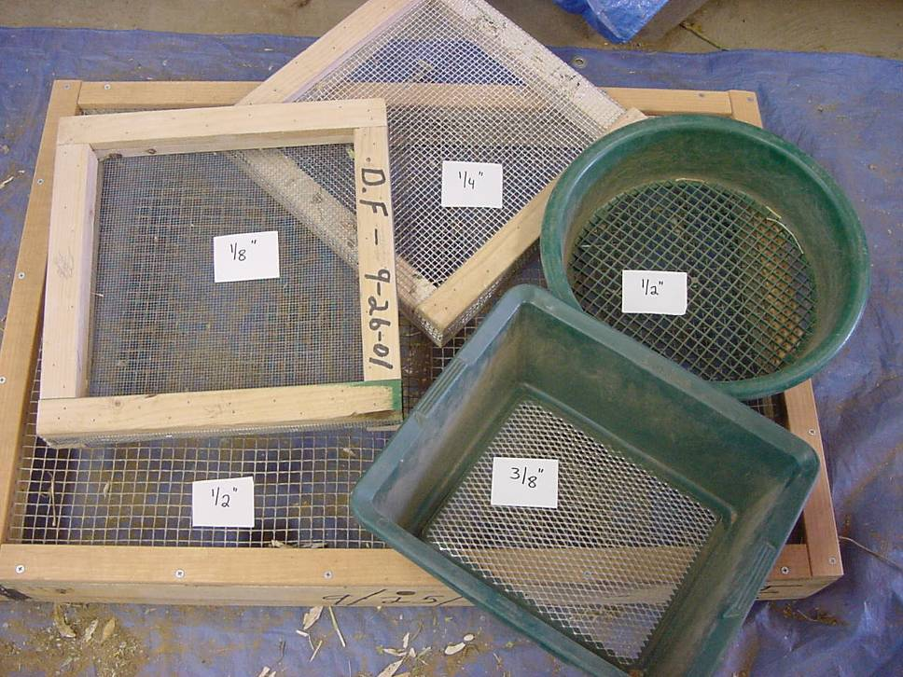
Seed Cleaning Screens

Slide 23
Crops Cautious to Save Seed
Cucurbitaceae Family – male and female flowers, pollen transferred by bees or insects.
Brassicaceae Family – flowers open and pollen transferred by wind and insects.
Liliaceae Family – biennial.
Separation of about 1 mile to prevent pollen contamination, or cage plants, or bag flowers before they open.

Slide 24
Saving Seed of Cucurbit Crops
CUCUMBERS
Leave fruit on plant for 2-3 weeks after reaches eating maturity, color changes to yellow or orange.
Scoop out seeds, place in jar, add 1 cup water, ferment 2-4 days at room temperature, stirring occasionally.
Add more water and stir, nonviable seeds and pulp will float to top, remove. Repeat if necessary to thoroughly clean seed.
Spread clean seeds on paper plates to dry, they can be snapped in half when dry.
summer SQUASH
Leave on plant until the rind hardens, process as above.
Winter SQUASH
Harvest when ready to eat, store until eating quality declines
Scoop out seed, wash by hand, dry on paper plate.
MELONS
Keep fruit on plant 1-2 weeks after maturity;
Scoop out seed, wash by hand, dry on paper plate.

Slide 25
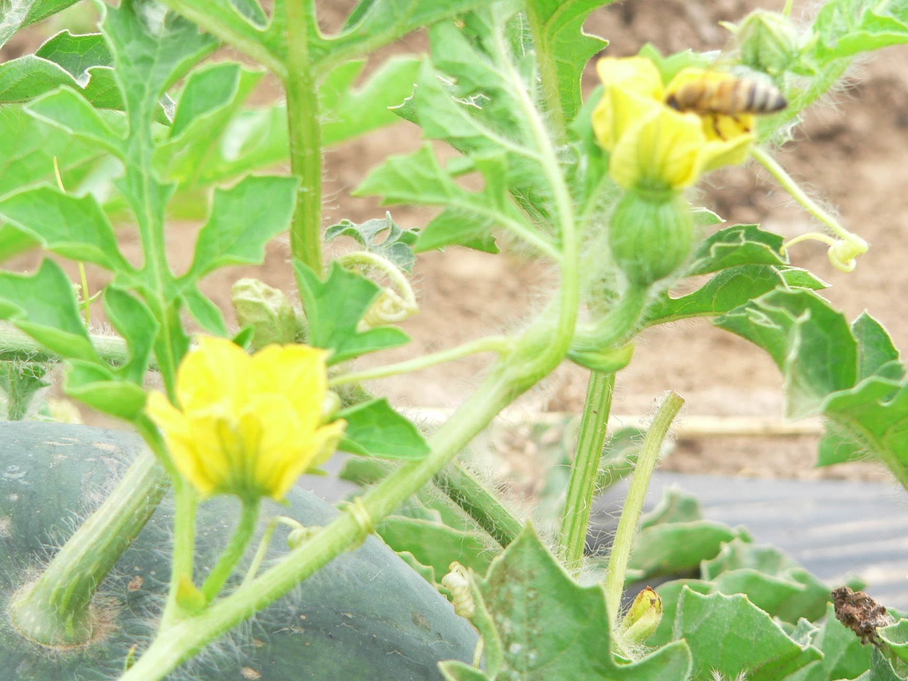
Cucurbit Flowers
Female flower
Male flower

Slide 26
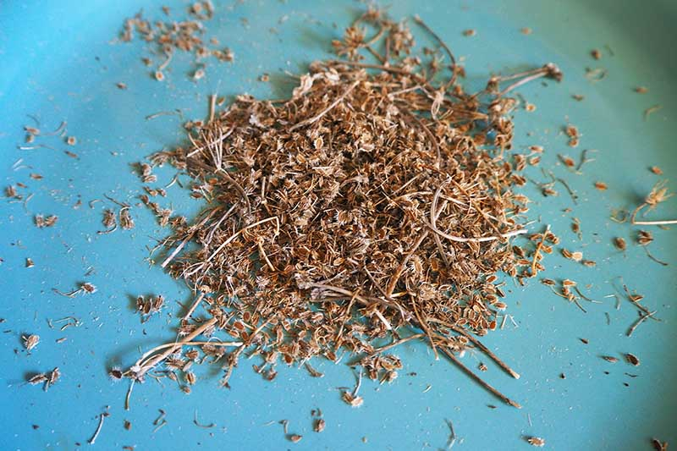
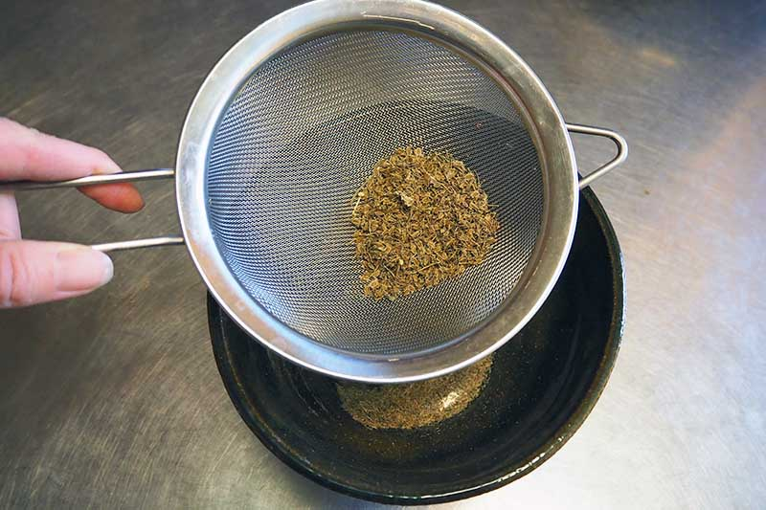
Small Dry Seed Cleaning
Cut stalks and place in paper bag.
Place bag in warm dry place for several weeks; use hands to rub seed off into the bag, wear gloves for Brassicas (sharp debris).
Pour seed through small screen to remove larger debris.
Blow gently, can use hair dryer (careful with distance) to remove small debris.
Photo source: Gardeners Path

Slide 27
Saving Seed of Kale
Biennial – overwinter young plants, flowers as day lengthens early summer
Open pollinated – no other Brassica crops flowering same time
Pods will shatter – seed is thrown to the ground, harvest before
Cut stalks – when pods almost dry, place in paper bags

Slide 28
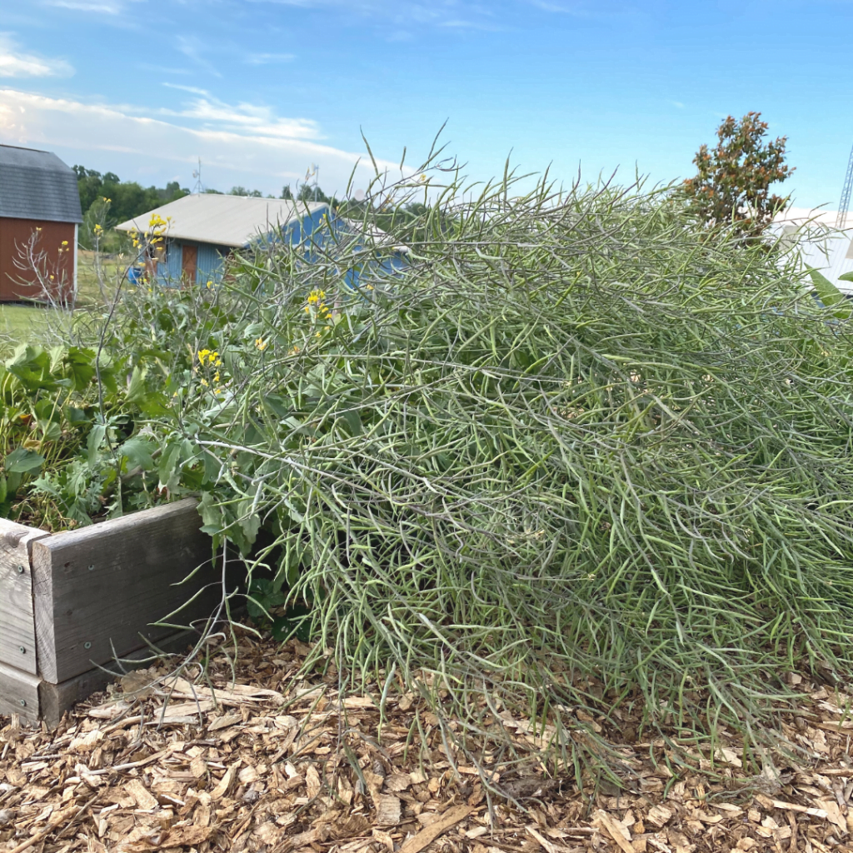
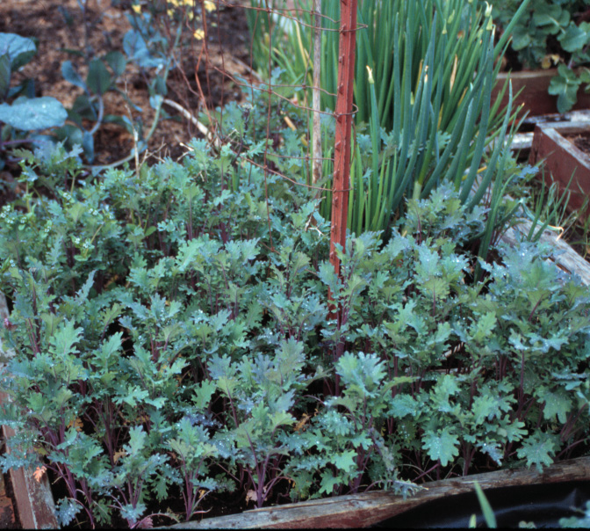
Kale Self-Seeding
Red Russian Kale

Slide 29
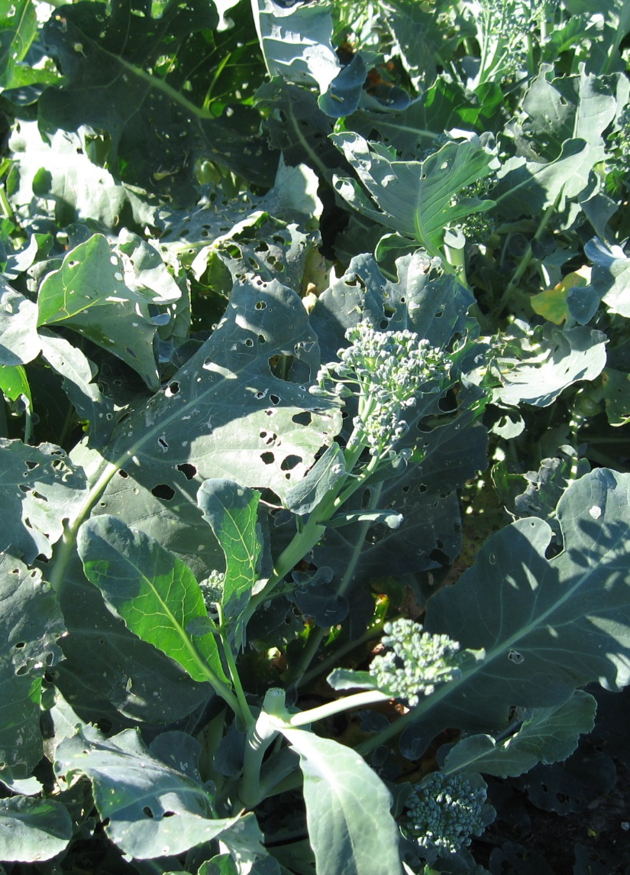
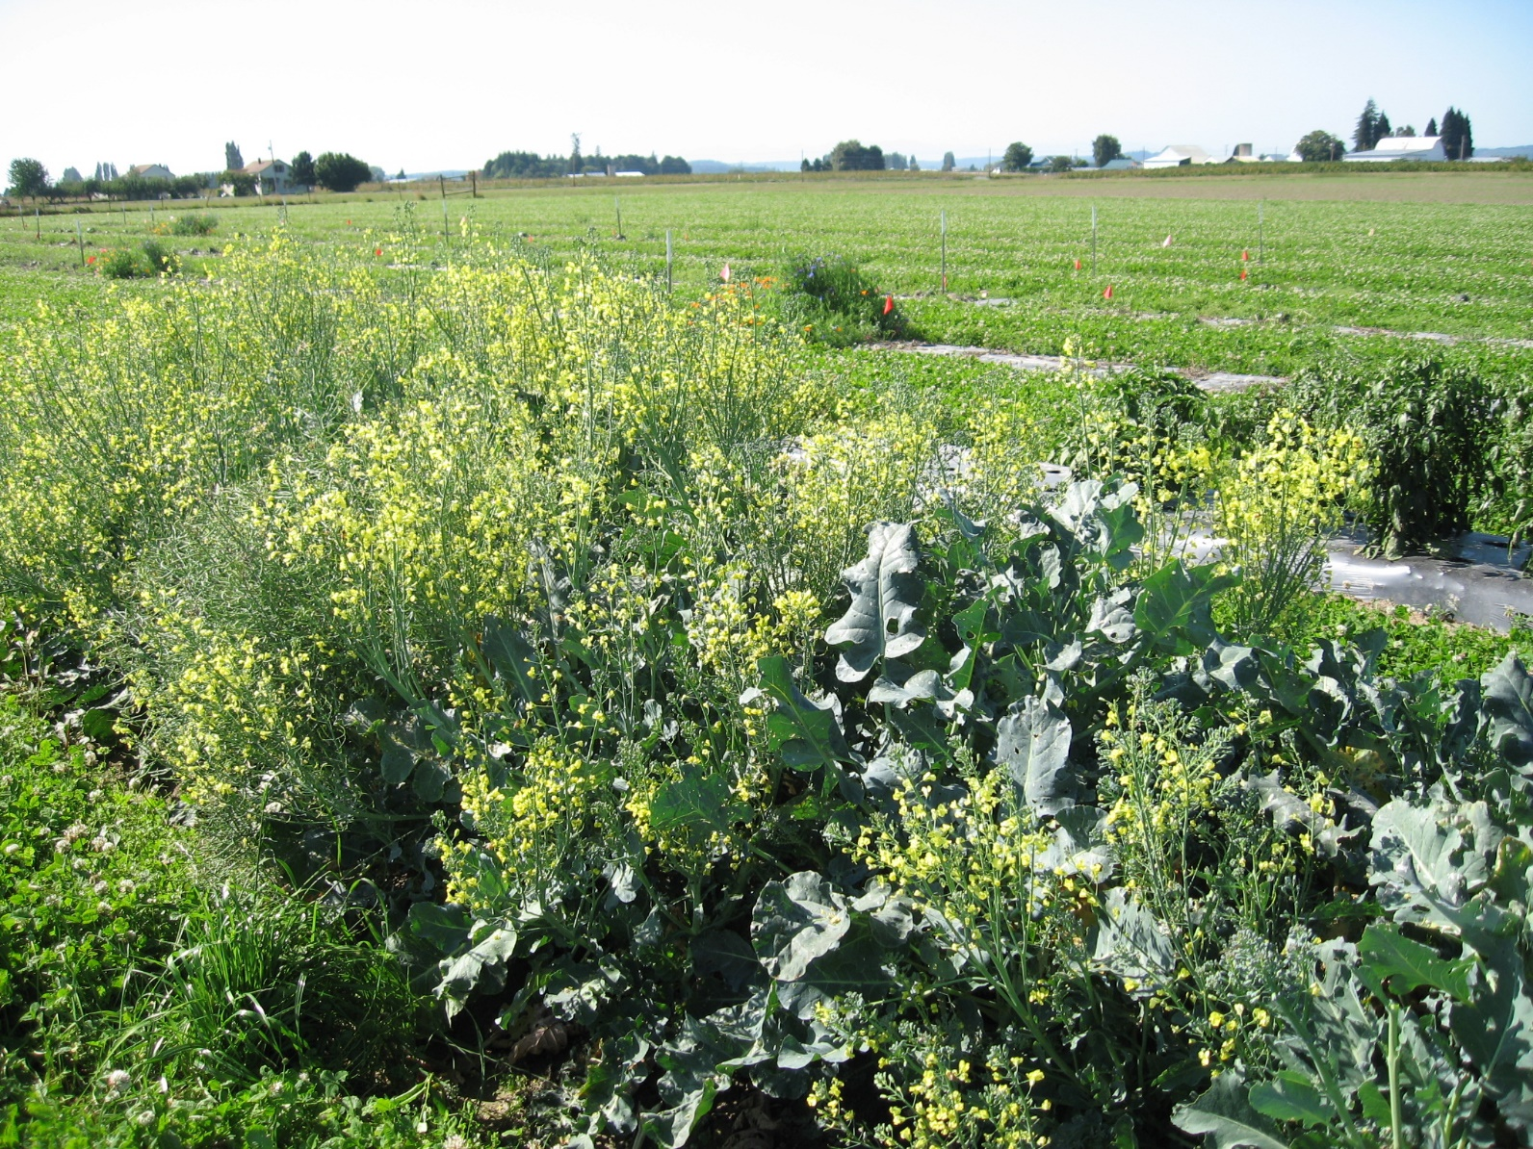
Broccoli Flowering

Slide 30
Saving Seed of Onions
Seed crop in late summer, overwinter plants that are pencil size.
Flower stalk will emerge in early summer.
Ready to harvest seed when umbrel (flowering head) turns brown.
Cut stalks few inches below the head and place in paper bag.
Process for small seeded crop.

Slide 31
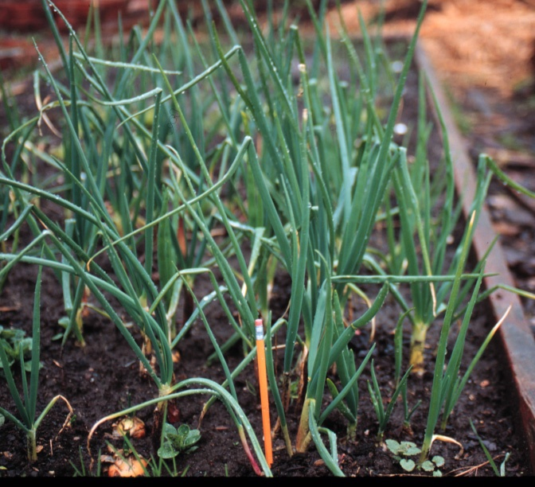
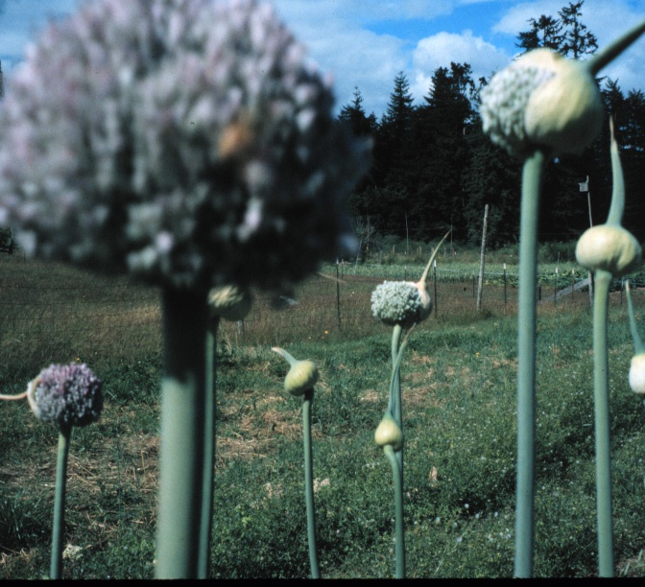
Onion Flowering

Slide 32
Saving Seed of Carrots
Biennial – overwinter plants
If freezing winter – dig in fall, store cool and dry, replant in spring
Open Pollinated – Queen Anne’s lace will cross-pollinate
Flower stalk – emerge in early summer
Ready to harvest seed – umbrel turns brown
Cut stalks – few inches below the head and place in paper bag
Process – for small seeded crop

Slide 33
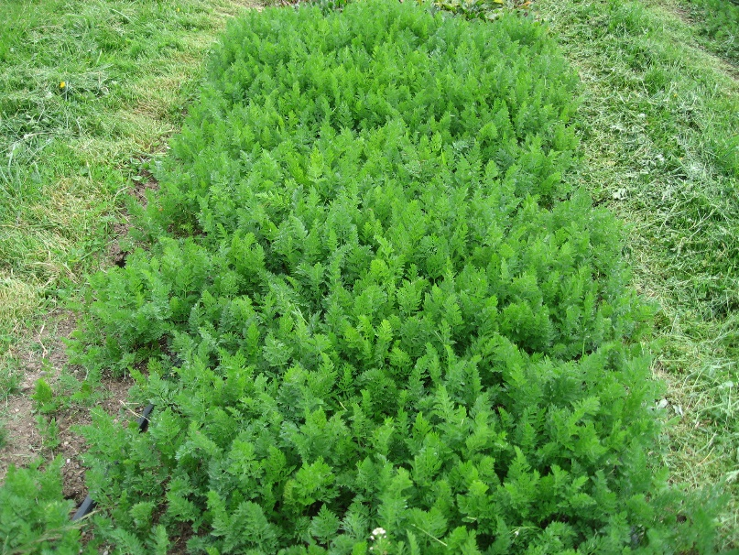
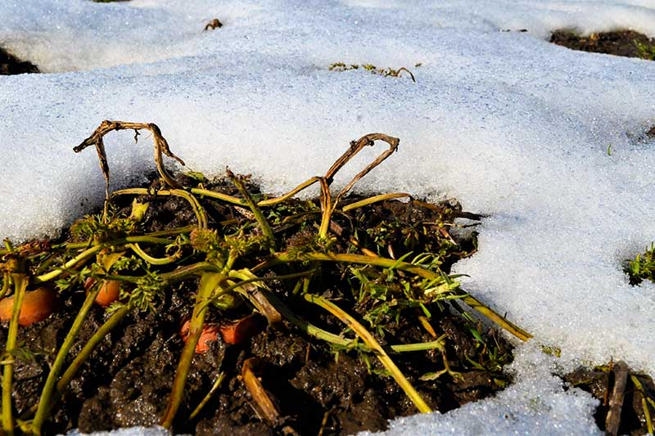
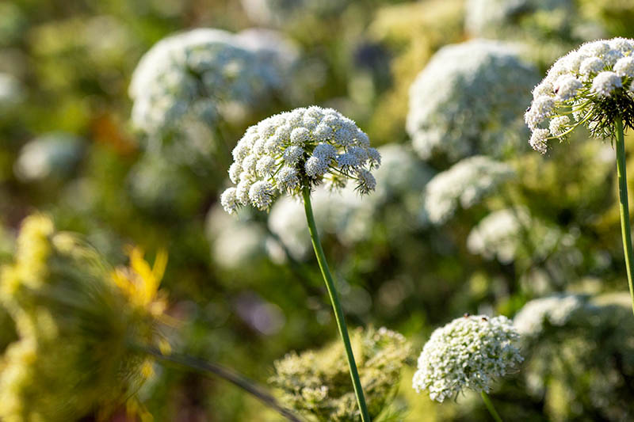
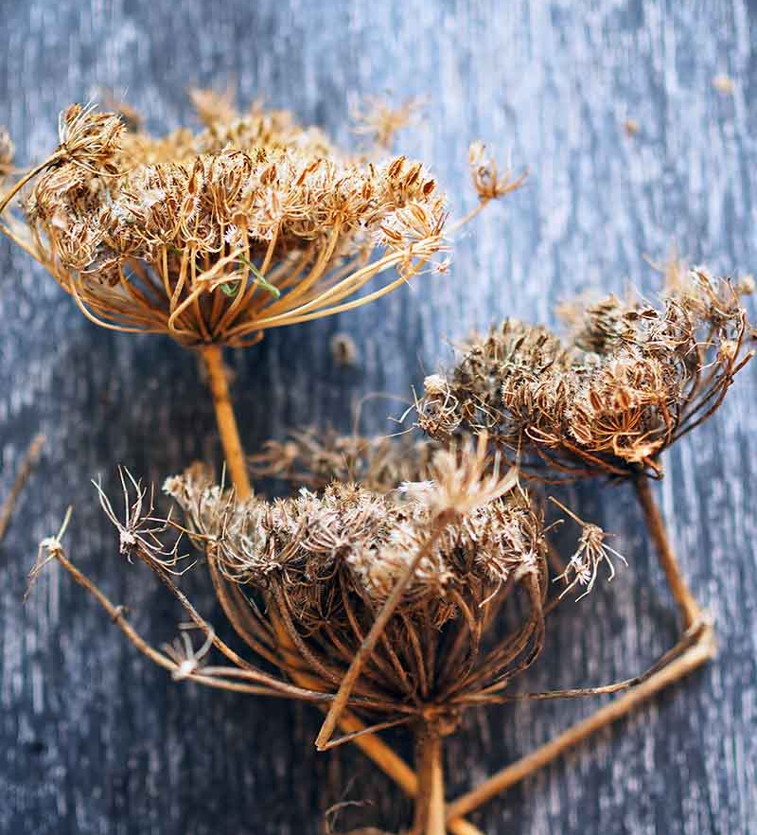
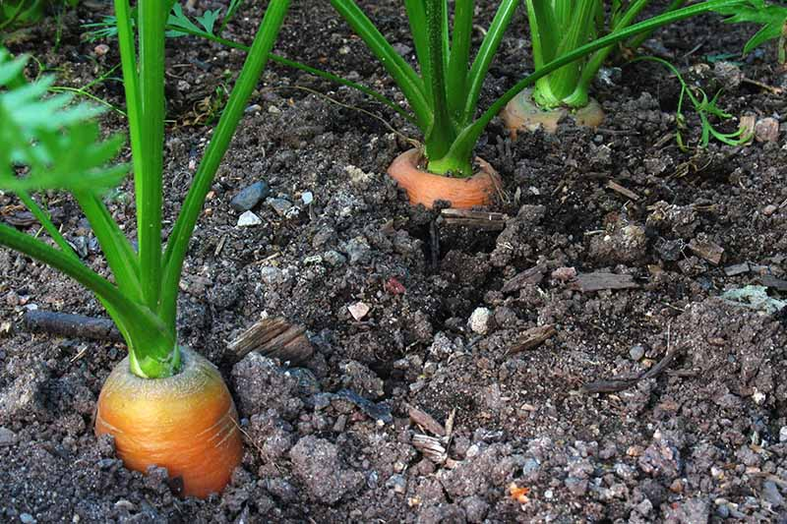
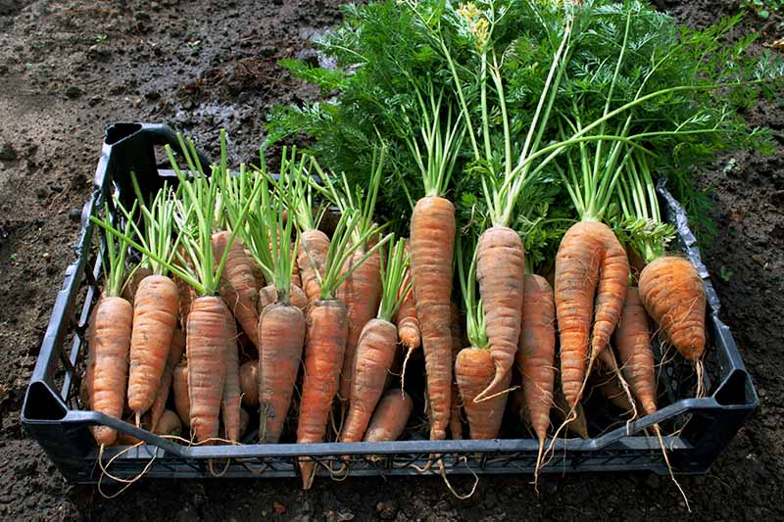
Carrot Flowering
Photo source: Gardeners Path

Slide 34
Seed Storage
Storage temperature and moisture most critical factors
Sum of temperature and humidity should not exceed 100
In our region, humidity the biggest issue
Dry seed to about 12% moisture and maintain in an airtight container
Store in dry place, without humidity
Or, store in sealed container in regrigerator

Slide 35
Storing Seed
MG Training Manual Chapter 7

Slide 36
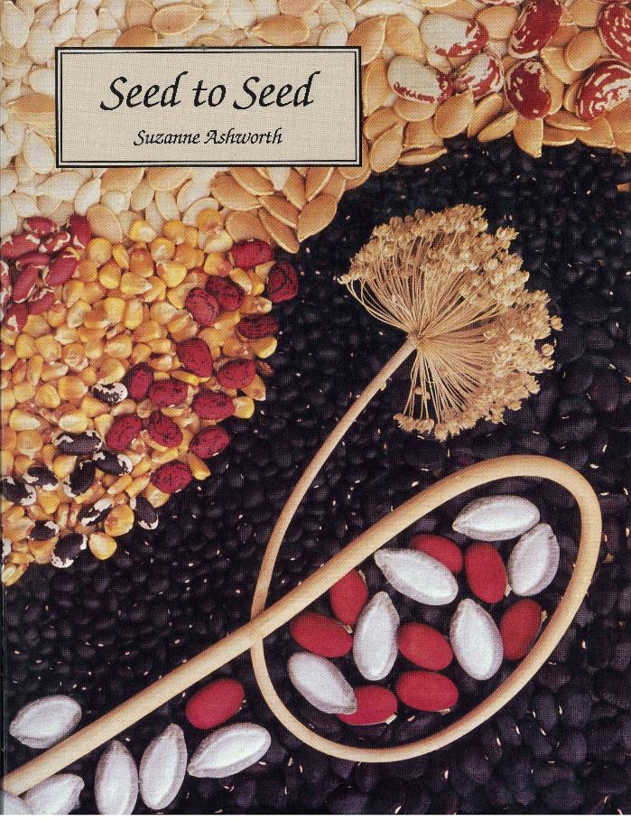
Seed Saving Book
Seed Savers Exchange

Slide 37
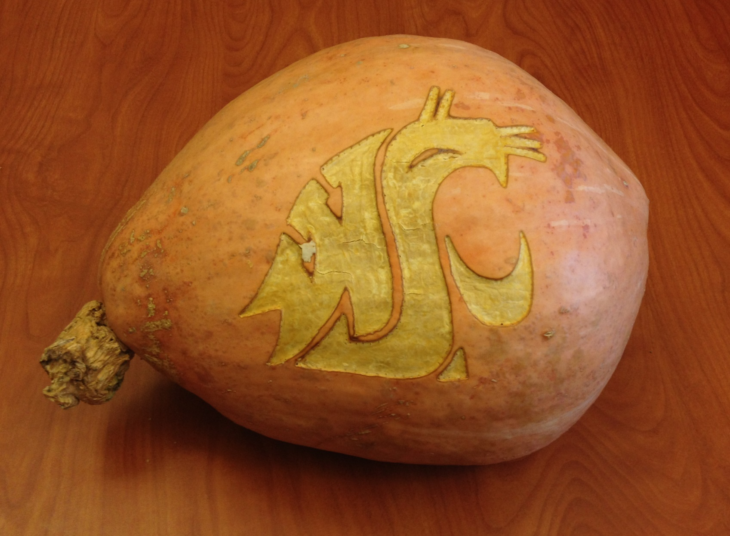
Questions?

